Slide 1
Notes:
Explanation of slide:
Logos, to show while the audience arrive.

Slide 2
MEASURING IMPACT
Impact Evaluation Methods for Policy Makers
This material constitutes supporting material for the "Impact Evaluation in Practice" book. This additional material is made freely but please acknowledge its use as follows: Gertler, P. J.; Martinez, S., Premand, P., Rawlings, L. B. and Christel M. J. Vermeersch, 2010, Impact Evaluation in Practice: Ancillary Material, The World Bank, Washington DC (www.worldbank.org/ieinpractice). The content of this presentation reflects the views of the authors and not necessarily those of the World Bank.

Slide 3
1
Counterfactuals
False Counterfactuals
Before & After (Pre & Post)
Enrolled & Not Enrolled (Apples & Oranges)
Causal Inference

Slide 4
2
Randomized Assignment
Randomized Offering/Promotion
Discontinuity Design
Difference-in-Differences
Diff-in-Diff
IE Methods Toolbox
Matching
P-Score matching

Slide 5
2
Randomized Assignment
Randomized Offering/Promotion
Discontinuity Design
Difference-in-Differences
Diff-in-Diff
IE Methods Toolbox
Matching
P-Score matching

Slide 6
Matching
Idea
For each treated unit pick up the best comparison unit (match) from another data source.
How?
Matches are selected on the basis of similarities in observed characteristics.
Issue?
If there are unobservable characteristics and those unobservables influence participation: Selection bias!

Slide 7
Propensity-Score Matching (PSM)
Comparison Group: non-participants with same observable characteristics as participants.
In practice, it is very hard.
There may be many important characteristics!
Match on the basis of the “propensity score”, Solution proposed by Rosenbaum and Rubin:
Compute everyone’s probability of participating, based on their observable characteristics.
Choose matches that have the same probability of participation as the treatments.
See appendix 2.

Slide 8
Density of propensity scores
Density
Non-Participants
Participants
Common Support
0
Propensity Score
1

Slide 9
Case 7: Progresa Matching (P-Score)
Baseline Characteristics | Estimated Coefficient Probit Regression, Prob Enrolled=1
Head’s age (years) | -0.022**
Spouse’s age (years) | -0.017**
Head’s education (years) | -0.059**
Spouse’s education (years) | -0.03**
Head is female=1 | -0.067
Indigenous=1 | 0.345**
Number of household members | 0.216**
Dirt floor=1 | 0.676**
Bathroom=1 | -0.197**
Hectares of Land | -0.042**
Distance to Hospital (km) | 0.001*
Constant | 0.664**
Note: If the effect is statistically significant at the 1% significance level, we label the estimated impact with 2 stars (**).

Slide 10
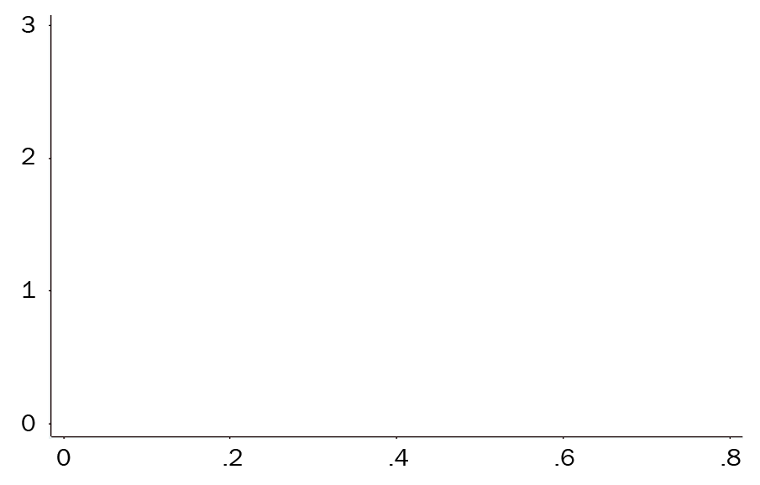
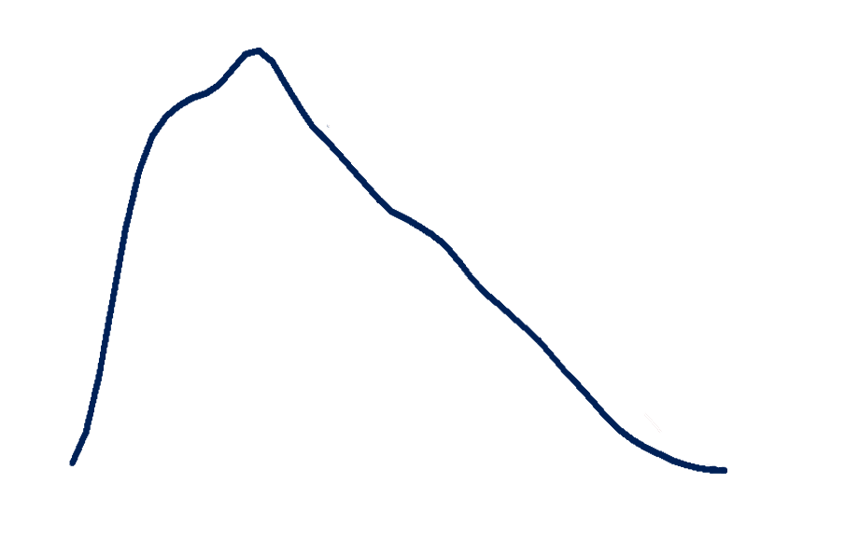
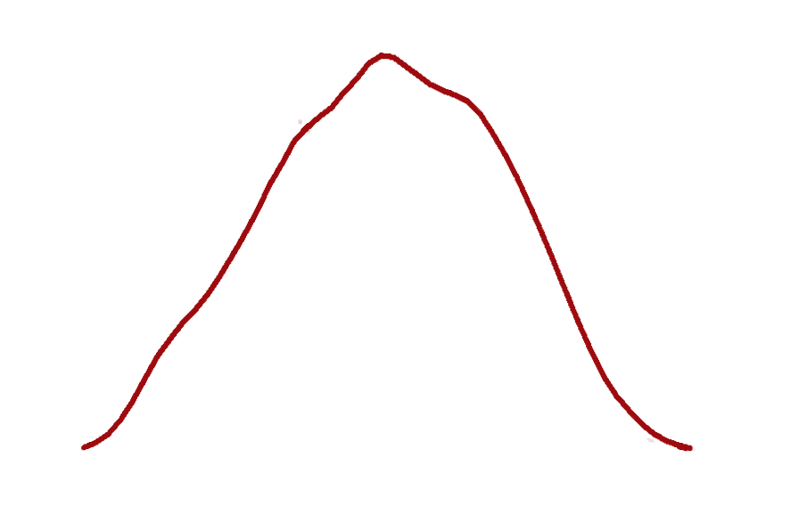
Case 7: Progresa Common Support
Density: Pr (Enrolled)
Density: Pr (Enrolled)
Density: Pr (Enrolled)
Pr (Enrolled)

Slide 11
Case 7: Progresa Matching (P-Score)
Estimated Impact on Consumption (Y)
Multivariate Linear Regression | 7.06+
Note: If the effect is statistically significant at the 1% significance level, we label the estimated impact with 2 stars (**). If significant at 10% level, we label impact with +

Slide 12
Keep in Mind
!
Matching
Matching requires large samples and good quality data.
Ex-post matching is risky:
If there is no baseline, be careful!
matching on endogenous ex-post variables gives bad results.
Matching at baseline can be very useful:
Know the assignment rule and match based on it
combine with other techniques (i.e. diff-in-diff)

Slide 13
Progresa Policy Recommendation?
Impact of Progresa on Consumption (Y)
Case 1: Before & After | 34.28**
Case 2: Enrolled & Not Enrolled | -4.15
Case 3: Randomized Assignment | 29.75**
Case 4: Randomized Offering | 30.4**
Case 5: Discontinuity Design | 30.58**
Case 6: Difference-in-Differences | 25.53**
Case 7: Matching | 7.06+
Note: If the effect is statistically significant at the 1% significance level, we label the estimated impact with 2 stars (**). If significant at 10% level, we label impact with +

Slide 14
Appendix 2 Steps in Propensity Score Matching
Representative & highly comparables survey of non-participants and participants.
Pool the two samples and estimated a logit (or probit) model of program participation.
Restrict samples to assure common support (important source of bias in observational studies)
For each participant find a sample of non-participants that have similar propensity scores
Compare the outcome indicators. The difference is the estimate of the gain due to the program for that observation.
Calculate the mean of these individual gains to obtain the average overall gain.

