Slide 1
Randomized Evaluation Start-to-finish
Nava Ashraf
Abdul Latif Jameel Poverty Action Lab
povertyactionlab.org

Slide 2
Course Overview
Why evaluate? What is evaluation?
Outcomes, indicators and measuring impact
Impact evaluation – why randomize
How to randomize
Sampling and sample size
Implementing an evaluation
Analysis and inference
Randomized Evaluation: Start-to-finish

Slide 3
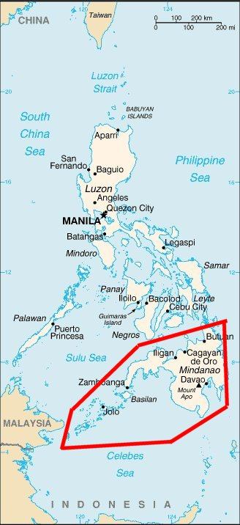
The setting: Green Bank of Caraga

Slide 4
The setting
Philippines
Green Bank
Microsavings and “MABS”
MABS Training for lenders

Slide 5
The need
Savings is low
People rely on debt
People want to save
Focus groups
The Economic Lives of the Poor (Banerjee, Duflo (2006))

Slide 6
Motivations
Theoretical Motivation:
“Standard economic man” versus “Behavioral Economics man” (Exponential discounting models versus hyperbolic/temptation models)
Policy Motivation:
Small changes & big effects: Applying lessons from psychology to economics & public policy or business practices
Hard evidence on need for specialized savings products. Access alone does not help everyone.
Microfinance research (& policy) focuses heavily on microcredit, not microsavings. Much remains to be learned about how to help poor people save more.

Slide 7
Program theory
“Time inconsistency”
Irrational behavior?
Subject to temptation?
Intra-household decision making
Commitment
Anecdotal evidence

Slide 8
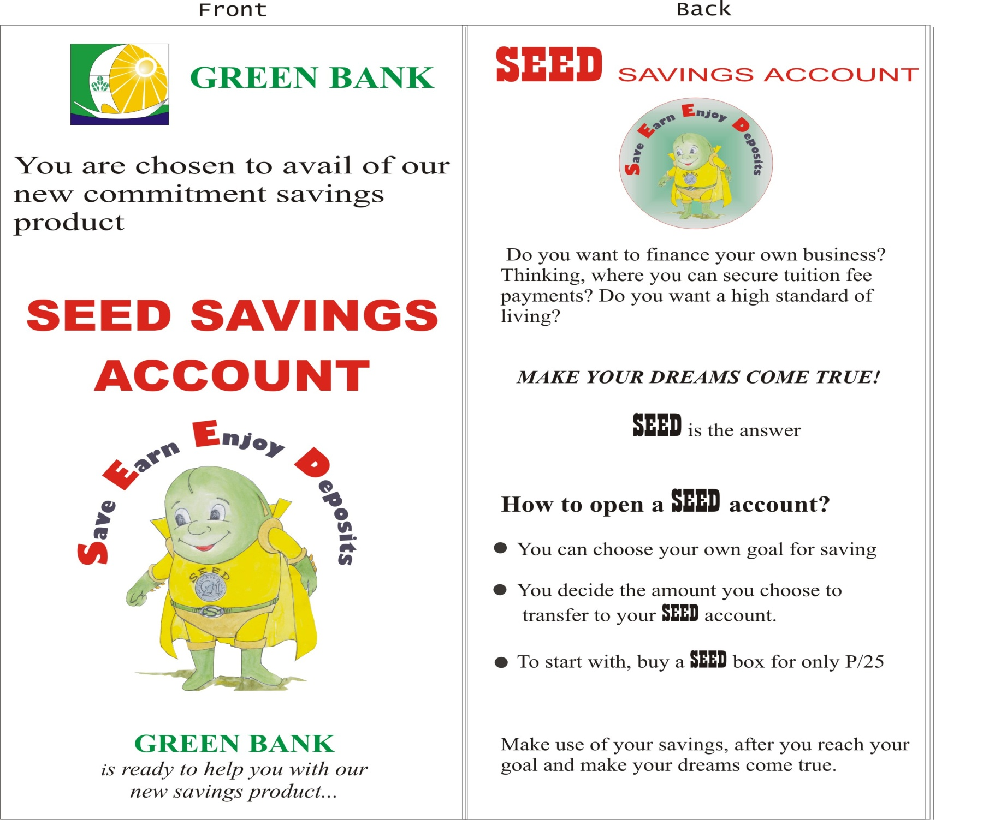
Notes:
We partnered with Green Bank of Caraga, a rural bank in Mindanao Philippines, to design and implement this product, which has the features of Choose Goal Amount/Goal Date but can’t withdraw until that date/amount has been reached (withdrawal restriction) [of 185 that opened accounts, 127 date based; 57 amount based]
Can opt for a box (deposit mobilization) [161 out of 185 chose boxes]
Same interest rate as regular savings account

Slide 9
SEED: A Commitment Savings Product
Commitment savings products create withdrawal restrictions to incentivize long-term savings
SEED is a product of the Green Bank, a rural bank in the Philippines with the following characteristics:
Withdrawal restriction
Deposit incentive
Same interest rate as regular savings account
Notes:
Withdrawal restriction is
Either time-based (140) or amount-based (62)
Decided entirely by client
Deposit incentive
Ganansiya box
Automatic transfer
Same interest rate as regular savings account
Hence, loss of liquidity is uncompensated
Note: given combination of account features, not possible establish causal link of any one feature to impact
We partnered with Green Bank of Caraga, a rural bank in Mindanao Philippines, to design and implement this product, which has the features of Out of 202 .

Slide 10
“…but you must bind me hard and fast, so that I cannot stir from the spot where you will stand me… and if I beg you to release me, you must tighten and add to my bonds.” --- The Odyssey
Notes:
quoted in Strotz 1956 paper, a classic article in the literature on time inconsistent preferences

Slide 11
Notes:
Two features—withdrawal side and deposit side. On deposit side, we offered both box and automatic transfer. 87% took box, and only 2 people took automatic transfer
Withdrawal restriction
Either time-based (140) or amount-based (62)
Decided entirely by client
Deposit incentive
Ganansiya box – 167 out of 202 tookup ☺
Automatic transfer – 2 tookup ☹
Same interest rate as regular savings account
Hence, loss of liquidity is uncompensated
Note: given combination of account features, not possible establish causal link of any one feature to impact

Slide 12
Why Evaluate?
The bank enjoyed a reputation for product innovation
“Look at our growth, it’s obvious we’re better than our competition”
“If we think this is what the market wants, then let us introduce it and find out right away”
“But this time, before we jump into the water, we need to take the temperature.”
Notes:
Managers wearying of launching product after product without knowing which ones actually benefited its customers, not to mention the bank itself

Slide 13
Goals and Measurement
Private mission
Social mission
Metrics
Institutional data
Crowd out
Product or just encouragement to save?

Slide 14
Encouragement…

Slide 15
Planning and Design
Identify problem and proposed solution
Define the problem both through qualitative work and your own academic background research
Define the intervention
Learn key “hurdles” in design of operations
Identify key players
Top management
Field staff
Donors

Slide 16
Planning and Design
Identify key operations questions to include in study
Find win-win opportunities for operations
How to best market?
How to sustain the program?
Pricing policy
Generating demand through spillovers
Types or extent of training?

Slide 17
Process
Extensive piloting

Slide 18
Pilot
Pilots vary in size & rigor
Pilots & qualitative steps are important.
Sometimes a “pilot” is the evaluation
Other times they are pilots for the evaluation

Slide 19
Why randomize
Take-up and selection bias

Slide 20
Planning and Design
Design randomization strategy
Basic strategy
Sample frame
Unit of randomization
Stratification
Define data collection plan
Notes:
Design randomization strategy
Basic strategy
Sample frame
Unit of randomization
Stratification
Define data collection plan
Key point: Baseline data is NOT necessary. It can be nice, but is not necessary.

Slide 21
Study design: basic strategy
Barangay/Village
Stratified by: Average Savings Levels & Percentage of Population with Accounts
Randomly assigned to:
Control Group
Treatment Group 1
Regular Savings Product
(Simple Encouragement to Save)
Treatment Group 2
Commitment Savings Product
Notes:
Philippines: client lists will be ordered according to barangay and clients will be randomly chosen according to the features of barangay. In Kenya, randomization will happen across villages and each treatment village will have presentations on the regular savings or commitment savings products [Dean—comments on both?]

Slide 22
Study design: randomization unit
Individual?
Barangay?
Spillovers
Green bank’s reputation
Sample size?

Slide 23
Discussion of sample size
Dean Karlan:
“Intra-cluster correlation will be small”
Nava Ashraf:
“What? No! There are lots of Barangay-specific shocks! Intra-cluster correlation will be large!”
Dean Karlan:
“There’s no way the Bank will let us randomize at the individual level!!”
Nava Ashraf:
“Let’s see!”

Slide 24
Study design: sample frame
Sample frame: 4,000 existing (or former) bank clients
3,154 individuals randomly chosen to be surveyed
1,777 surveys completed
Participants randomized individually into:
Treatment (Offered SEED), 50%
Marketing(Encouraged to Save), 25%
Control (Nothing), 25%
Marketing team from Bank visited one-on-one with T & M groups
28% of Treatment group took-up
Marketing & Control groups not allowed to take-up
Six months and then 12 months later we collected bank savings data on all 3 groups
Data from SEED account
Data from their normal savings account
Follow up Survey 2 years after
Notes:
Stratified them on: client savings balance, active account, barangay’s distance to branch, bank’s penetration to branch, variance of balances and mean balance.
Sample drawn from bank database
Low contact rate suggests sample bias whereby more “stable” people (those who move less) are in the study

Slide 25
Baseline Survey: Two Purposes
Understand take-up decision
Pre-intervention measurements in order to measure changes in savings/income and assess welfare implication from intervention
Notes:
Household finances
Fixed assets
Financial savings
Informal savings
Loans
Household income
Wage income
Enterprise income
Agricultural income
Remittances
Business & agricultural assets
Household decision-making
Savings expectations

Slide 26
Implementation
Identify “target” individuals and collect baseline data
Randomize
Real-time randomization
All-at-once randomization
Waves
Implement intervention to treatment group
Ensure internal control
Measure impact after necessary delay to allow impact to occur
Common question: “How long should we wait?”
Operational considerations must be traded off. No one-size-fits-all answer.
Want to wait long enough to make sure the impacts materialize.
Notes:
Identify “target” individuals and collect baseline data
Randomize
Real-time randomization
e.g. credit scoring
All-at-once randomization
All villages known up front
Waves
Want to learn from one wave to the next
Expansion plans not well defined throughout country. One district at a time.
Implement intervention to treatment group
Internal controls critical… nothing worse than doing all this work, but not having control on the field!
Measure impact after necessary delay to allow impact to occur
Common question: “How long should we wait?”
Operational considerations must be traded off. No one-size-fits-all answer.
Want to wait long enough to make sure the impacts materialize.

Slide 27
Dealing with fairness
Dear Valued Client Mr./Mrs._______________
We at Green Bank are committed to offering the best products we can to our clients. We are very happy that you have shown interest in our new product, SEED. However, we are still piloting the SEED savings product, and are not offering it yet to all of our clients. We are doing a slow-rollout of the SEED product, to only an initial 1000 clients for this year. During this year, we will monitor the product and its impact, and then perfect it before offering it to all of our clients.

Slide 28
Dealing with fairness
Please do not be sad that you were not chosen as part of the initial 1000 clients. These clients were chosen randomly, through a lottery/raffle draw. We put all of our valued clients’ names into a box, and then randomly selected 1000 clients to be the first to get the SEED product during the pilot phase. We did this randomly so that we could be as fair as possible to all of our clients.

Slide 29
Dealing with fairness
We at Green Bank care very much about each and every one of our clients. We also care about being fair to all clients, and about creating and perfecting the best savings services and products to help our clients improve their lives. Doing a slow-rollout of this new SEED savings product to a randomly chosen group of clients is the best way to do this. We sincerely hope you understand, and look forward to offering you the new and improved SEED in July, 2004.

Slide 30
Preview of the Warts!
Sample frame: Existing & prior clients of a bank
Hence, not an intervention on the “general” public
Perhaps not bad, because it means the impact does not come merely from expanding access
Take-up predicted by hyperbolicity only for women
Women more “sophisticated”?
Externalities to family internalized by women, not men?
No data on substitution from non-bank savings
But we do observe change in non-SEED savings at the bank
Notes:
Pro:Everyone in study had access to savings (and used it) prior to study. Allows us to focus on product design and incentives therein. In other words, any observed changes are because of the design and not the expansion of access
Con:This is not a study about how to bank the unbanked, or how to expand formal savings options to the disenfranchised.
We’re actually getting all the data in now and it doesn’t look like there’s any substitution happening

Slide 31
Measuring Impact
Intent to Treat: Compare means between groups
Treatment on the Treated: Instrumental variable approach, effectively scaling-up impact by proportion who took up
Assumption #1: Take-up correlated with instrument.
Assumption #2: “Exclusion restriction”
Notes:
#1: This is so by brute force via randomization and controls on who could take-up
#2the assignment to treatment cannot effect savings in some way OTHER than the usage of the SEED. “Marketing” group critical here to defend the exclusion restriction.

Slide 32
Preview of Good Results
Impact:
Average bank account savings increase for those assigned to treatment (ITT): after 6 months=46%; after 12 months=80% increase
Scaling up estimate by those who actually opened the account: increase in average savings (TOT): after 6 months =192%; after 12 months= 337% increase
28% of those offered the product took-up
Takeup:
Women with hyperbolic preferences are more likely to open the Commitment Savings Account (SEED) than women without hyperbolic preferences (not true for men)

Slide 33
Measuring Impact
Measuring Impact
Notes:
Distribution of changes in savings balances for the three groups (assignment)—b/c of random assignment, control group distribution provides us with a counter-factual of what the distribution would have looked like had we not offered the treatment. The treatment group distribution shows us how the distribution has shifted—clearly towards higher deciles. These are cutoff points of the deciles:
important to note that they are not means, and there’s lots of spread—in the upper decile of the treatment group, it starts at 458 but actually goes up to 49,000
For bottomT, starts at –332, goes to 1064
For bottomC, starts at –479, goes to –1628
For topC, starts at 51, goes to 19403

Slide 34
Measuring Impact
Notes:
Top decile for SEED starts at 1337 and ends at 49213 (second largest is 22 133)
Top decile for non-SEED starts at 96.44 and ends at 25000 (second largest is 15 412)

Slide 35
Magnitude in Real Dollars
Doctor’s visit: 150 pesos
Public school fees are 150 pesos/year, plus ~200 pesos/month for special projects
1 month supply of rice for a family of 5: 1000 pesos

Slide 36
Sub-group Impacts
No differential impact for:
female
college
time inconsistent
household income
Notes:
Who is this working for?

Slide 37
Conclusions
Commitment Savings Product design features correctly attracts individuals with hyperbolic preferences or who put self-control devices in place to overcome temptation problems
Impact
Treatment on the Treated: Average savings increased by over 300%
Intent to Treat: Average savings increases by 80%
~34% of SEED clients actively using the account
Puzzle remains: why does “hyperbolic” predict take-up only for women?
Notes:
Commitment Savings Product design features correctly attracts individuals with hyperbolic preferences or who put self-control devices in place to overcome temptation problems
Impact
Treatment on the Treated: Average savings increased by over 300%
Intent to Treat: Average savings increases by 80%
~34% of SEED clients actively using the account
Puzzle remains: why does “hyperbolic” predict take-up only for women?
Externality on family from time inconsistency inspires corrective action? (Ashraf, 2008 (AER),”Spousal Control and Intra-Household Decision Making: An Experimental Study in the Philippines)

Slide 38
Further Research (1)
Follow-up survey (2.5 years later) told us:
No Substitution from other non-bank savings
Welfare implications
Better able to handle shock?
Less able to handle shocks?
More likely to invest in long run items?
Fewer Coke’s, Bigger Parties?
Still implies higher average savings for the bank
Additional Impacts: Women’s Decision Making Power significantly increased (Ashraf, Karlan & Yin (2007): “Female Empowerment”)
Notes:
Requires second wave of data collection
Regardless, shift from home savings to bank savings is important.
Safer for client (safer from self, from spouse, and from theft)
Better for economy (multiplier effect)
Welfare Implications:
Long run items:
Education
Home
Fewer Cokes, bigger parties? Worst case scenario impact… but not as bad as it sounds:
Aggregate savings in economy still higher

Slide 39
Further Research (2)
Further intervention tests will tell us:
Scalable? Expanding into new branches, full marketing launch
Further product tweaks
Deposit collectors (Ashraf, Karlan and Yin (2005) Advances in Economic Analysis and Policy)
Notes:
Requires second wave of data collection
Regardless, shift from home savings to bank savings is important.
Safer for client (safer from self, from spouse, and from theft)
Better for economy (multiplier effect)
Welfare Implications:
Long run items:
Education
Home
Fewer Cokes, bigger parties? Worst case scenario impact… but not as bad as it sounds:
Aggregate savings in economy still higher
Conditions under which households make decisions are very important in determining outcomes.

