Slide 1
Data Publication: The “Last Mile” of the Research Process
Delivered by prathap kasina
Prepared by Mahvish Shaukhat
Staff Training, Chennai, September 2012

Slide 2
Scope of this 30 minute session
Will understand what “Data Publication” means.
Will look at the abysmal numbers of published data by J-PAL/IPA.
Will encourage you to think about Data Publication in your current roles. How can YOU contribute?
A bit about relevance of this topic?

Slide 3
Over to Spandana Example on IQSS Network

Slide 4
Why should we publish data?
1.) Paper published.
2.) Policy Outreach done.
3.) Many players have bought into it.
4.) Scaling up massively.
5.) Why do we need to publish the data?
Notes:
Talk about research process – you’ve published the paper, you have policy outreach, talk about scaling up……….. You’re done, right?! So why should we even bother publishing data? Who cares? Why is this important?

Slide 5
Whhhhyyyy?
Increase Transparency
Let other people play with the data. They might come up with more interesting results.
Ask the ask way round:
Why wouldn’t you want to publish data?

Slide 6
Current Statistics on Data Publication
Only 18 of 153 completed studies published datasets (12%)
18 datasets have a combined total of over 63,000 downloads
NOT ACCEPTABLE.
Marc – “Black Eye”
Notes:
Textbooks and Testscores (12616)
Measuring the Impact of Microfinance (12225)
(Does not include handful of studies on j-pal website that are not currently on IQSS - downloads from J-PAL website)

Slide 7
Why haven’t we published more data?
Cleaning and documenting data takes a lot of time:
Data needs to be clean, de-identified, and translated to English
Data needs to be documented
Low incentives to publish data (very few journals require data)
Data publication is typically low priority
Notes:
Data publication requires A LOT OF WORK but LITTLE INCENTIVE TO DO THAT WORK – PI’s focused on publishing high-impact results, most journals don’t require publication of data – if they do, they don’t require the publication of ALL AVAILABLE data
The basic point here is that usually a paper only uses a proportion of the data and they tend to only thoroughly clean that. There tends to be quite a bit of interesting data that others would like to use but which they dont thoroughly clean. They may also do ad hoc cleaning, ie do it without recording exactly what they did. When we publish we need to be able replicate how we get from raw data as entered to final published data.
Give example of IMPUTING

Slide 8
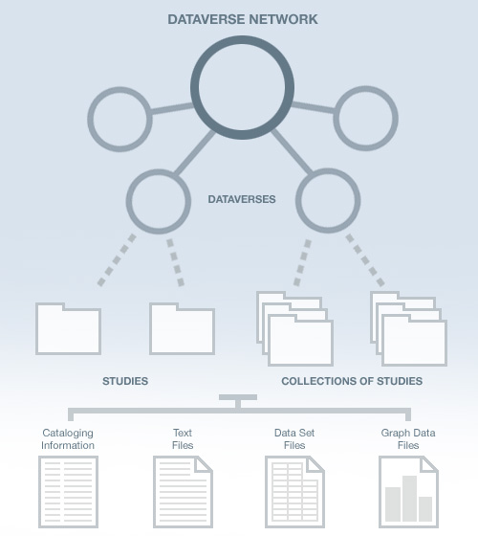
Data Publication Process
JPAL publishes its data on IQSS (Institute for Quantitative Social Sciences) dataverse network
http://dvn.iq.harvard.edu/dvn/
Google: jpal iqss
Notes:
200 dataverses;
Go through tabs on website!
Good versioning system so we can update data when needed

Slide 9
Data Publication Process
1.) Public form of data set
2.) Corresponding questionnaire or survey
3.) All other information about the data set (including citation information).
Notes:
Example of Conditional Cash Transfer Program – clean, de-identified data – but everything is in Indonesian! 210 datasets, each with 20 or so variables, and each variable and variable value has to be relabled into English.

Slide 10
Data Publication Process: The Data
Start with clean data for published papers
Remove all personally identifiable information (GPS coordinates, names, etc.)
Label variables with question text
Translate datasets to English (this is time-consuming!)
Replicate tables
Notes:
Example of Conditional Cash Transfer Program – clean, de-identified data – but everything is in Indonesian! 210 datasets, each with 20 or so variables, and each variable and variable value has to be relabled into English.

Slide 11
Data Publication Process: The Questionnaires/Surveys
May need to translate to English
But usually no additional work required!
Notes:
Example of Conditional Cash Transfer Program – clean, de-identified data – but everything is in Indonesian! 210 datasets, each with 20 or so variables, and each variable and variable value has to be relabled into English.

Slide 12
Data Publication Process: The Metadata (data about data)
IQSS uses framework set by DDI (Data Documentation Initiative) to document data
DDI is an effort to create an international standard for describing data from social sciences
Many organizations use this standard: World Bank, Bureau of Labor Statistics, ICPSR, etc.
Notes:
Metadata is data. So there is a system of storing this information.
Lots of organizations use this standard – World Bank, ICPSR at University of Michigan - makes it easier to read and understand metadata quickly

Slide 13
Data Publication Process: Metadata…
Codebooks contain descriptive statistics and variable information for each data set. Over to an example codebook.
Read-me files explaining how data was assembled, how data is organized, etc.
Do-files for assembling data and/or replicating original analysis
Notes:
Codebooks need to have question text and question IDs entered manually sometimes. Invalid values have to be manually entered.

Slide 14
Thinking about Data Publication
From start to finish, depending on how clean the datasets are, how cooperative the PIs and RAs are in getting the data and information to create the metadata, etc. it can take 30-60 person-hours of RA time to fully prepare a project for publication.
Current focus is on low-hanging fruit (data that is already clean)
Notes:
Able to get 4 datasets from November to June – 3 more datasets by end of summer

Slide 15
Thinking about Data Publication..
The problem is we start thinking about data publication at the end of the research process, when publication requires a big push
We should be thinking about data publication at the start of the research process so publication will be easier at the end
Notes:
Able to get 4 datasets from November to June – 3 more datasets by end of summer
We are trying to create a system where DDI can be integrated at the start of research project – so metadata can be created as questions are being written by investigators (World Bank has integrated this system) instead of post-hoc by a third party who is less familiar with the project

Slide 16
Thinking about Data Publication..
Some basic things you can do (or already should be doing):
Write do-files that other people can understand
Keep well-commented do-files that keep track of major changes to data and reasons for changes (i.e. were observations dropped? Were values changed or imputed? If so, why?)
Translate variable names and variable labels into English along the way – this would be helpful even if you cannot translate the entire dataset

Slide 17
Which of the following best represents how you feel about the length of this presentation?
Unbearably long
Long, but bearable
Adequate
Not quite long enough
Much more, please!

Slide 18
Which of the following best represents how you feel about the pace of this presentation?
Too fast! I couldn’t keep up.
It felt rushed.
Adequate pace.
It felt slow.
It was so slow, I fell asleep.

Slide 19
How likely are you to use the content covered in this lecture/exercise in your work?
Very unlikely
Unlikely
Uncertain
Likely
Very likely

