Slide 1
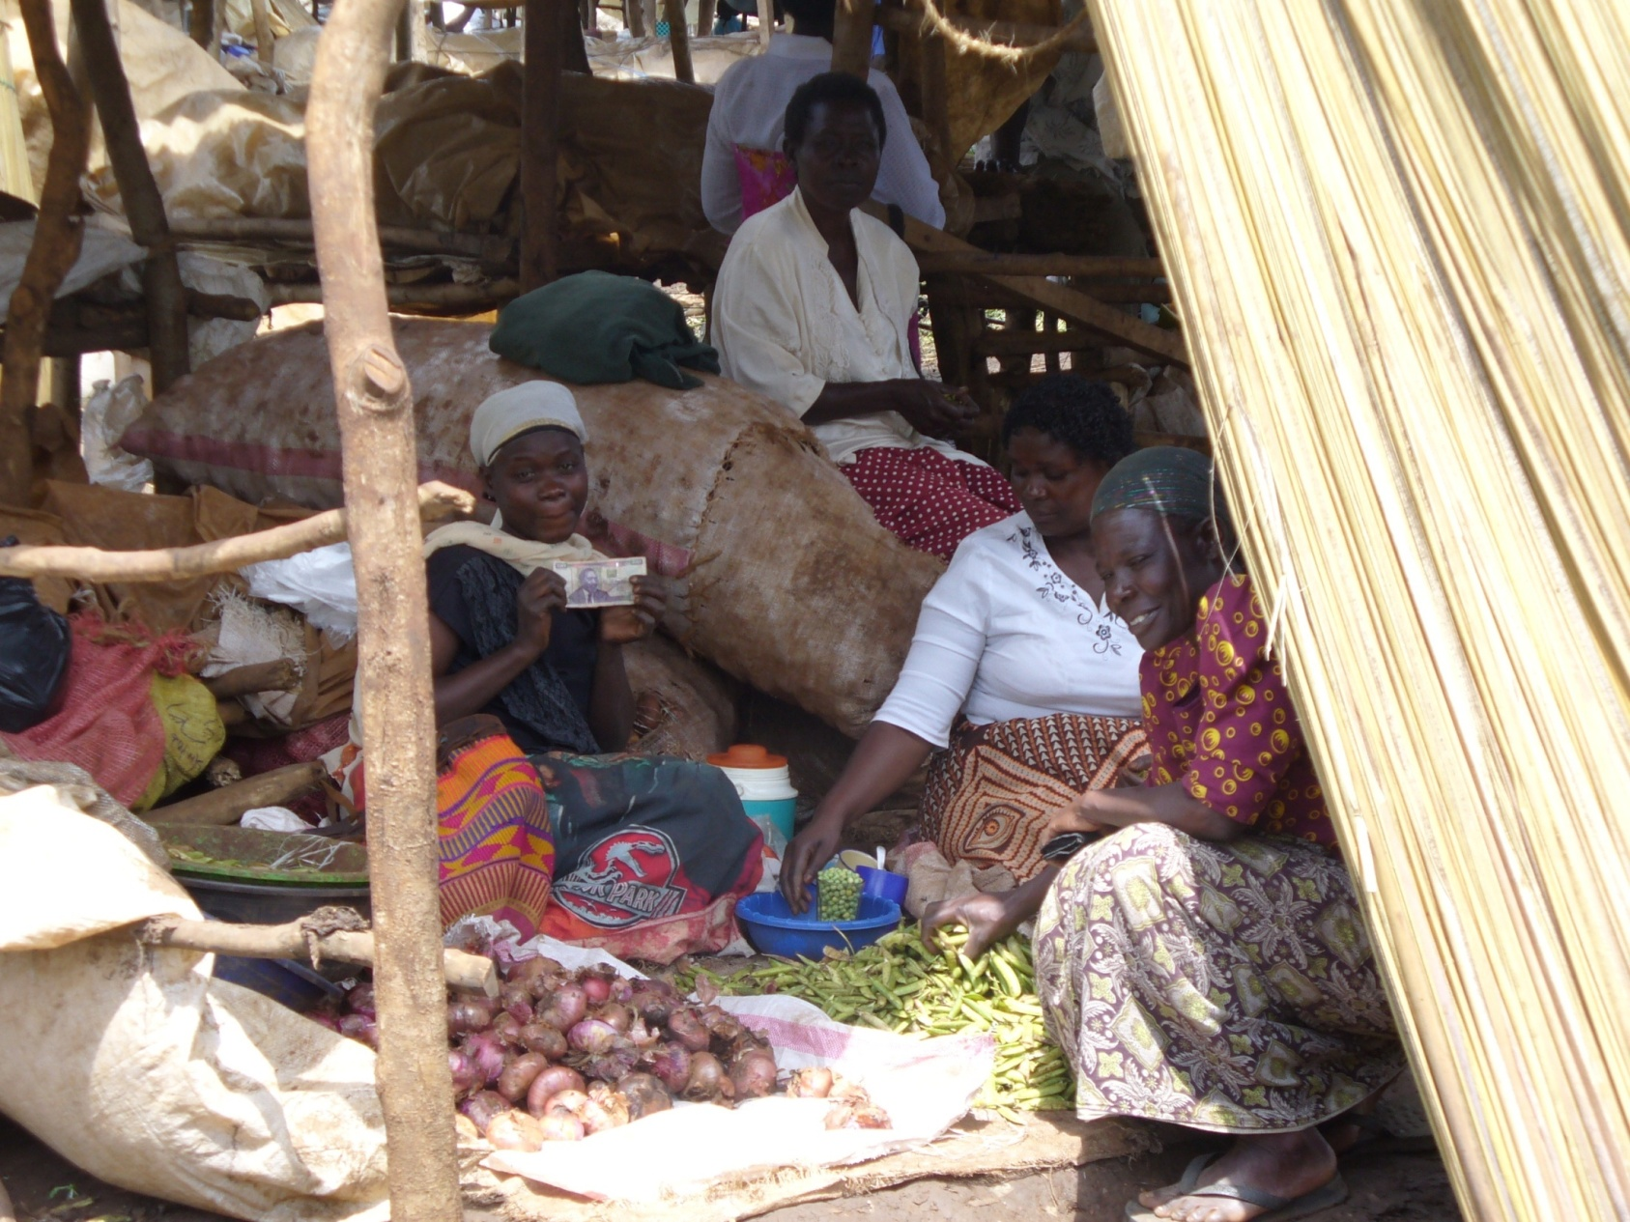
Women and their Money:
Impacts of Enabling Savings
Pascaline Dupas - UCLA, CEGA

Slide 2
Women in Sub-Saharan Africa lack access to formal banking
16% of women have bank accounts (Gallup, 2010)
Rates even lower in rural areas (CEGA-affiliated studies)
Uganda: <3 % (N= 5000 households)
Malawi: <3 % (N= 6000 households
Mali: <4 % (N= 5000 households)
Kenya: <10% (N= 2000 households)
Notes:
Recent and ongoing field experiments by CEGA affiliates have baseline data for female bank account ownership in parts of rural Africa.
Malawi - VSLA Baseline (rural, 5000 hh, 380 villages) < 3% in 2009 Uganda - VSLA Baseline (rural, 5000 hh, 392 villages) < 2.3 % in a Bank, <10% in a SACCO, Cooperative, Farmer Mali - Savings for Change (rural, 6000 hh, 500 villages) < 4% in 2008
Kenya figures are from Anthony for FAIM (although HEMIP papers say 2% of those censused had accts, not broken down by gender)
Also, Gallup reports that 16% of women in SSA have accounts (including urban/rural) http://www.gallup.com/poll/127901/few-sub-saharan-africa-money-bank.aspx

Slide 3
Savings Constraints?
Informal savings mechanisms are risky/costly
Under the mattress
Investment in animals
Susus
ROSCAs
Notes:
Informal savings mechanisms are widespread among women and men in these areas, including Susus, or independent deposit collectors, are popular in West Africa; Rotating Savings and Credit Associations allow groups to pool savings and rotate who cashes in on the pot. Most ROSCA users are women; investment in animals, and simply holding money in the home.
So…do women want formal savings devices?

Slide 4
Demand for formal savings services?
Is there an unmet demand for formal banking services?
If yes, what barrier(s) do saving do bank accounts help overcome?
Short Answer:
Yes, there is a demand for bank accounts among women. Accounts primarily help protect money from others.
Long Answer:
Review of 2 studies conducted in Kenya with CEGA-affiliate Jonathan Robinson from UCSC
Notes:
Informal savings mechanisms are widespread among women and men in these areas, including Susus, or independent deposit collectors, are popular in West Africa; Rotating Savings and Credit Associations allow groups to pool savings and rotate who cashes in on the pot. Most ROSCA users are women; investment in animals, and simply holding money in the home.
So…do women want formal savings devices?

Slide 5
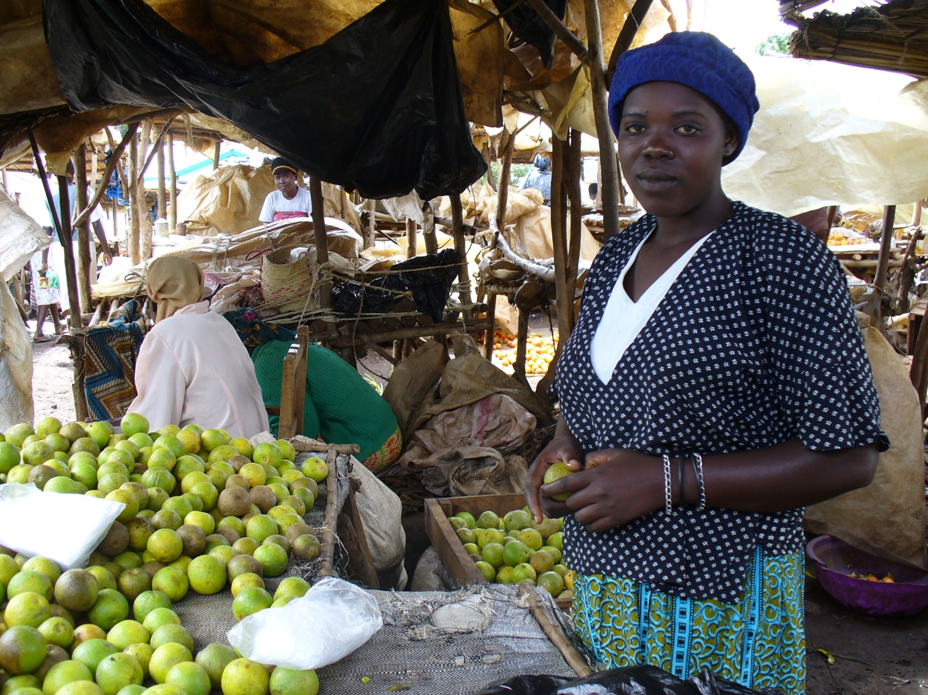
Study #1: Banking on Women Market Women can benefit from formal bank accounts
Notes:
In a field experiment in rural Western Kenya, we offered to a random sample of small business owners, both men and women, formal savings accounts in a village bank. All of the women were market vendors. Some of the men were market vendors, most were bicycle taxi drivers.

Slide 6
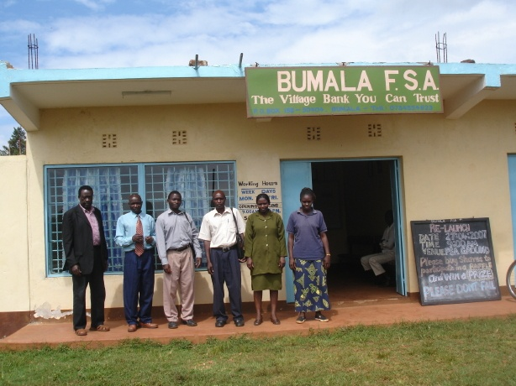
Testing the impact of banking access
Formal savings accounts in a village bank, program paid $6 opening fee.
No interest but withdrawal fees = negative return
Collected data on account recipients + comparison group over 6 months.
Notes:
The accounts were not interest-bearing, and the bank charged withdrawal fees, so in effect, deposits accrued negative interest. Our study sent enumerators to the homes of those randomly chosen to receive an account, and gave them a voucher redeemable at the local village bank. The voucher covered the cost of the account opening fees (~$5) but did not contribute anything in the form of a deposit. So what we offered was a one-time opportunity to open an account without paying fees.
We collected data - through self-filled log books – on business investments, expenditures, health shocks 6 months, for both the treatment group (those offered bank accounts) and the comparison group, who were also small business owners from the same communities, but did not receive free savings accounts.

Slide 7
Women’s Savings: Daily Average
On average, women in the treatment group had ten times more savings in a bank than women in the control group.
This difference nearly doubled when comparing actual account-openers against the control group.
~ US$ 0.01
~ US$ 0.10
~ US$ 0.20
Notes:
Self-reported
Women continued to maintain savings levels through informal mechanisms (their savings in ROSCAs remained stable, investment in animals actually increased), so bank savings did not crowd out informal savings.

Slide 8
Women’s Investment in Business
Women in the treatment group invested 45% more in their business
Women with active accounts invested twice as much than women in the control group
~ US$ 3.20 ~ US$ 4.70 ~ US$ 6.30
Notes:
Women in the treatment group, that is, women sampled for an account, invested on average 240 KSH in their business on a daily basis, that’s about 140KSH, or $2 more per day than the women in the control group. Women who were actually using their accounts invested an average total of 480KSH per day, or about $3.40 more than women in the control group.
Overall, these results suggest that the treatment had a substantial effect on market women’s ability to invest in their business.
We see no change in the category of items traded by women in the treatment group. We also did not observe a change in the type (retail vs. wholesale) of businesses among women in the treatment group. For most women, greater investment thus simply meant larger quantities being purchased wholesale and sold retail.

Slide 9
Women’s income (proxied by total expenditures)
~ US$ 2.00 ~ US$ 2.30 ~ US$ 2.80
Notes:
To test whether the effect on investment levels led to increased profits, we examine expenditure data.
The accounts had a significant positive impact on expenditures on the entire sample, with this effect most strongly concentrated for market women.
private expenditures include meals in restaurants, sodas, alcohol, cigarettes, own clothing, hairstyling, and entertainment expenses

Slide 10
Coping with Health Shocks
Illness shocks (e.g., malaria) are very common
Women typically have to miss work and disinvest in their business when they or a family member is ill
Those who got access to an account were less likely to do so
Women withdrew money from their account to cover medical expenses
Notes:
Women in the control group worked and invested less when they or a family member were ill.
Treatment women lost few hours to illness and maintained or even increased investment levels when they or family members were ill.

Slide 11
Conclusions from Study #1
There appears to be a demand for formal bank accounts among rural female micro-entrepreneurs
These accounts can help women grow their businesses and protect them against shocks
Poverty reduction quite rapid (we saw relatively big effect within 6 months)
Important to validate these findings on larger sample, and in other countries. Currently doing replication studies in: Kenya, Uganda, Malawi, Chile, Philippines
Notes:
There is a demand for formal savings among rural female microentrepreneurs – 40% offered opened one, despite saving already in other ways.
Women saved, invested and grew their business, reaping larger profits.
Their savings guarded them against health shocks by allowing them to draw from savings instead of their business to handle their own or family illness. Their increased wealth may already be making them healthier.

Slide 12
Questions that Study #1 raised
Why do these accounts, which have a negative interest rate, have such appeal and impact, especially if women are already using informal savings mechanisms?
Study # 2 tries to tease out importance of potential barriers to savings

Slide 13
Study #2: Mine or Ours?
Women need tools to help them say ‘no’
to money demands from others
Notes:
In another study in the same part of Kenya, we worked with individuals who were already saving in a ROSCA to figure out why the poor don’t save more. We tested 4 low-cost informal savings technologies designed to help people save towards a particular goal. 74% of the sample were women, because most ROSCA members are women.
The goals we set were preventative or emergency health costs, but they could have been anything (school fees, home improvements, business investments.)

Slide 14
Potential Barriers to Savings
Inter-personal: relatives, friends and neighbors ask for money, and strong sharing norms make it difficult to say ‘no’
In particular, other people within the same household (husband) may have different savings goals
Intra-personal: self-discipline problems, preferring to spend now

Slide 15
Innovative Saving Products Offered
Safe Box: locked box in the home, owner has key
Helps keep money from others
Money can be spent on anything
In particular, money available to deal for emergencies
Lock Box: locked box in the home, key held by program officer
Helps keep money from self and others
Money earmarked for specific savings goal
Cannot be used for emergencies
Health Savings Account (HSA): Individual account held at ROSCA for health emergencies
Keeps money from others
Earmarks it for health emergencies
Notes:
Four different savings technologies to test which barrier is the most prevalent, for whom, and which mechanism can help dissolve that barrier.
High take-up all around
Followed for a year

Slide 16
Results: Investments in Preventive Health Products over 12 months
~ US$ 3.4
~ US$ 5.7
~ US$ 3.9
Notes:
Results of spending on health over a year, in KSH
Safe Box and Health Pot yielded the highest investments in health.
People saved less in the Locked Box and the Health Savings Account because they could only access it in emergencies.

Slide 17
Results: Inability to afford medical treatment in past 3 months
Notes:
Results of spending on health over a year, in KSH
Safe Box and Health Pot yielded the highest investments in health.
People saved less in the Locked Box and the Health Savings Account because they could only access it in emergencies.

Slide 18
Other Results
Married women benefitted more than unmarried women.
Lasting impacts – recent follow-up after two years suggest that 60% of women still have their box, and 65% still contribute to HSA
Notes:
The unmarried in the sample were women, so the second finding holds for women.
Simple storage mechanisms (safe box, HSA) had very large impacts
Shielding money from others plays a strong role in enabling saving
Demands from both the spouse and other households are important
Married women benefitted more than unmarried women.
Safe Box users said it was much easier to deny requests for money – both from outside and inside the household - because it was locked in box.
While self-discipline is a barrier,

Slide 19
Conclusions from Study #2
Simple storage mechanisms (safe box, HSA) had very large impacts
Main channel: they help shield money from others
Demands from both the spouse and other households are important
Locking money away is very attractive for women, as long as they can access it for emergencies
Self-discipline is a barrier for some women, but much smaller barrier than sharing norms
Notes:
The unmarried in the sample were women, so the second finding holds for women.

Slide 20
Overall Conclusions and Future Research
Both studies show that simple saving devices can have high impacts on women’s ability to save and invest in their business, their health
Ongoing studies looking at the impact of enabling savings on
Business creation
Investments in agricultural technologies
Investments in education

Slide 21
Thank you!
For more information: pascaline.dupas@gmail.com

