Slide 1
MONITORING ROAD INFRASTRUCTURE INVESTMENTS in the Rural Philippines
OCTOBER 13, 2016

Slide 2
AGENDA
About Planet
Road Monitoring in the Rural Philippines
Ground Validation
Lessons Learned

Slide 3
To image the whole world every day, making change visible, accessible and actionable.

Slide 4
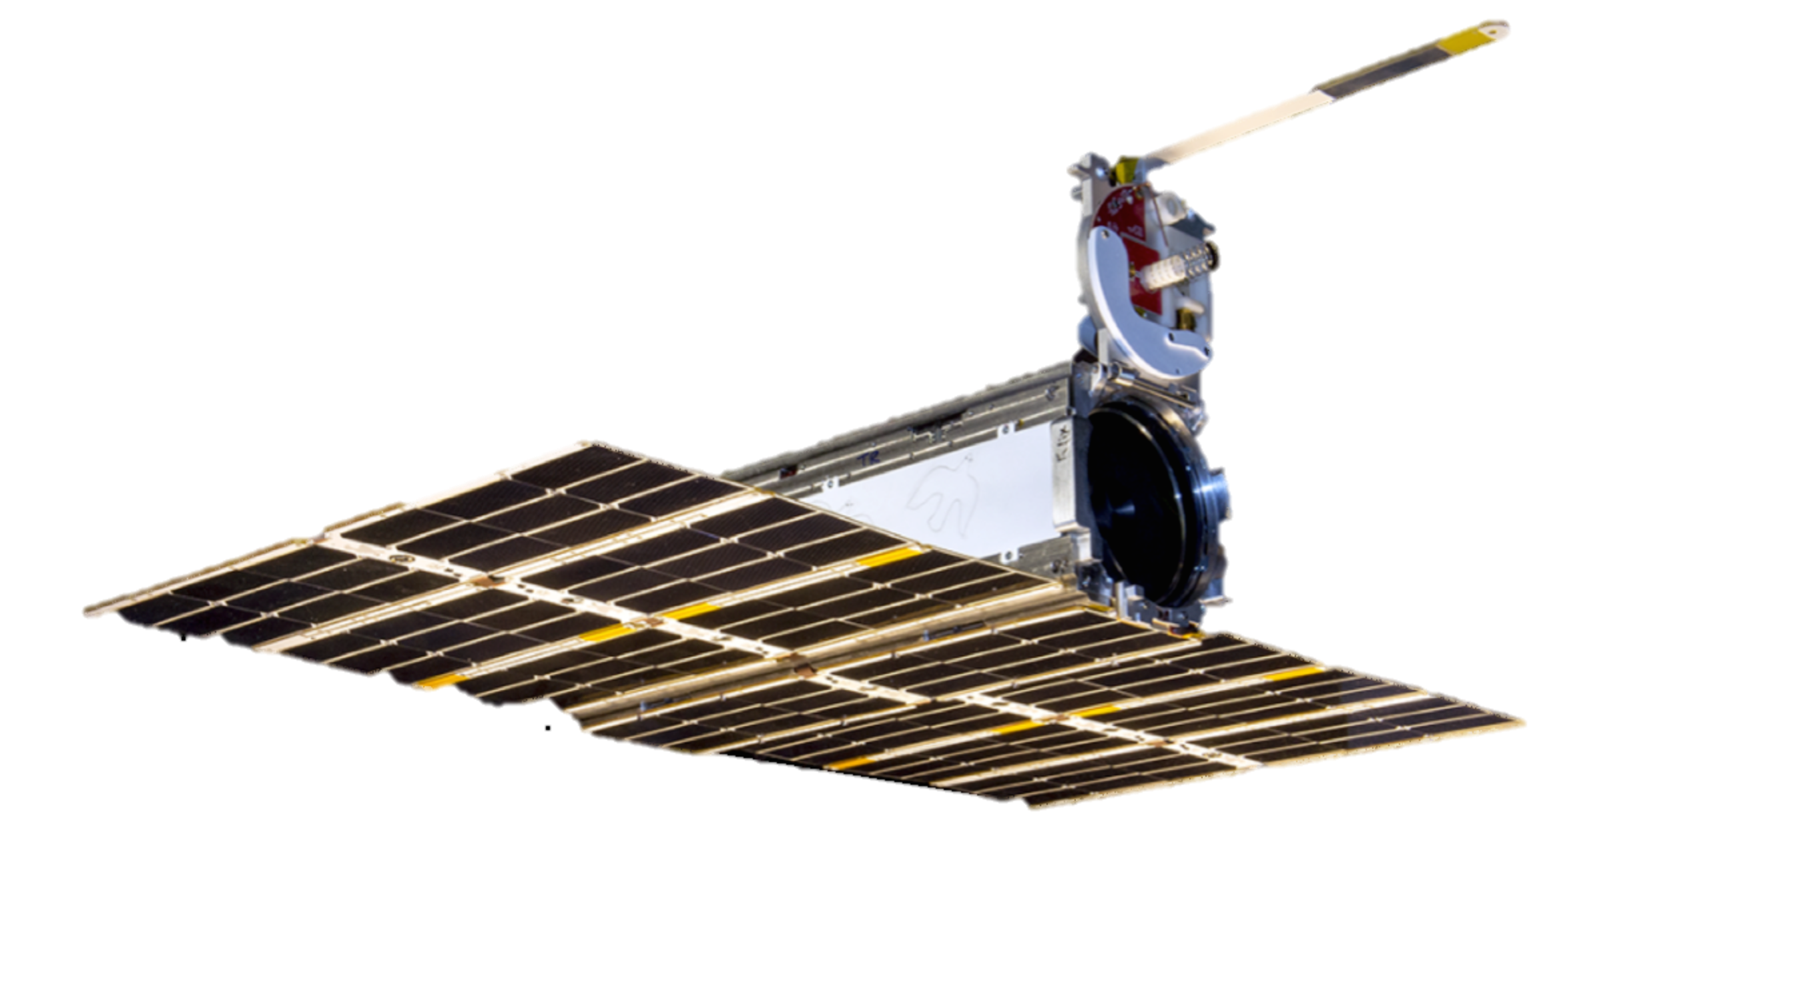
THE DOVE SPACECRAFT
10cm
30cm
10cm
Notes:
Planet designs, builds and launches satellites faster than any company or government in history.
We use consumer-grade electronics to build highly capable satellites at drastically lower costs. With the most advanced satellites launching into orbit every 3-4 months, our capabilities are on the cutting edge and always advancing.

Slide 5
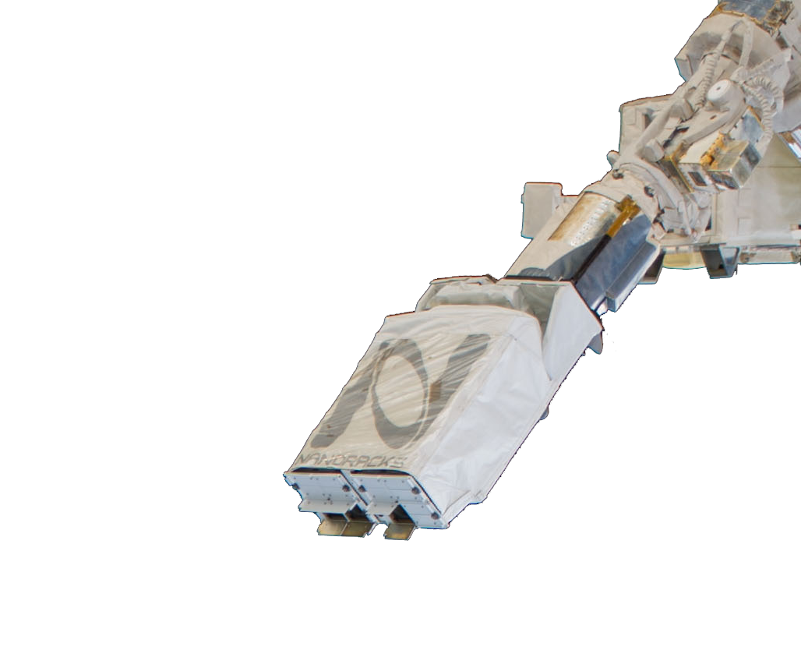
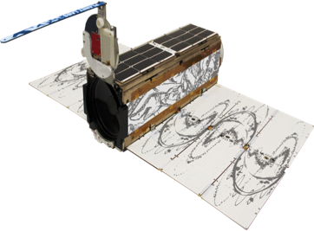
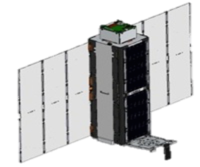
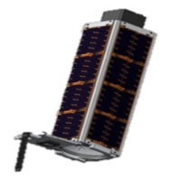
AGILE AEROSPACE
BUILD 13
JUN 2015
BUILD 6
APR 2013
BUILD 1
APR 2012
13 Builds in only 3 years
Notes:
Similar to agile software development – we iterate fast and release often - across spacecraft development, mission control, and product development.
We deploy new spacecraft every few months instead of every few years. The allows us to put new technology into space faster. We have iterated fast and release often (13 design cycles in 3 years) and we’ve embraced best-practices from Silicon Valley.
Whether it’s new sensors such as Thermal, Short Wave, Red Edge or submeter resolution, the advantage we offer is to make these innovations happen faster and cheaper and to be more relevant and accessible to users.
We just released for technology demo our newest build, Build 13, and we’re excited to see that fly later this year. As context, most satellite production companies would not have finished one complete design cycle in 3 years. We’ve finished 13, and put over 70 sats on orbit in that tie frame.

Slide 6
Notes:
This video shows how our satellites are on a monitoring mission versus a tasking operation.
This lends itself toward the capture of serendipitous events across the globe. We effectively create a line scanner for the planet by putting the satellites in on particular orbit and placing them along track where one satellite’s swath width just overlaps with the one previous.

Slide 7
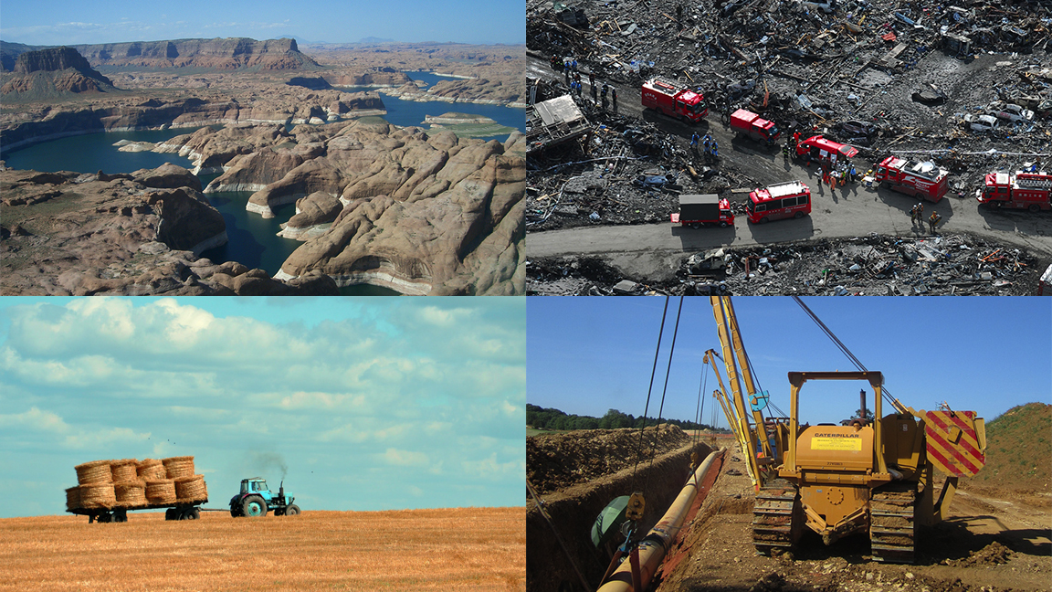
WITH SAME-DAY IMAGERY, YOU CAN…
... know the overall health of forest and water resources
… send critical resources exactly where they need to go
… monitor harvests and agriculture everywhere
… check regional activity for infrastructure and security
Notes:
Humans are constantly affecting our planet, and our actions have far reaching effects. You can’t fix a problem if you don’t know about it. With imagery at a much higher temporal resolution - you can see see trees being cut, fields harvested, roads built, thus providing an unprecedented ability to detect and act on change

Slide 8
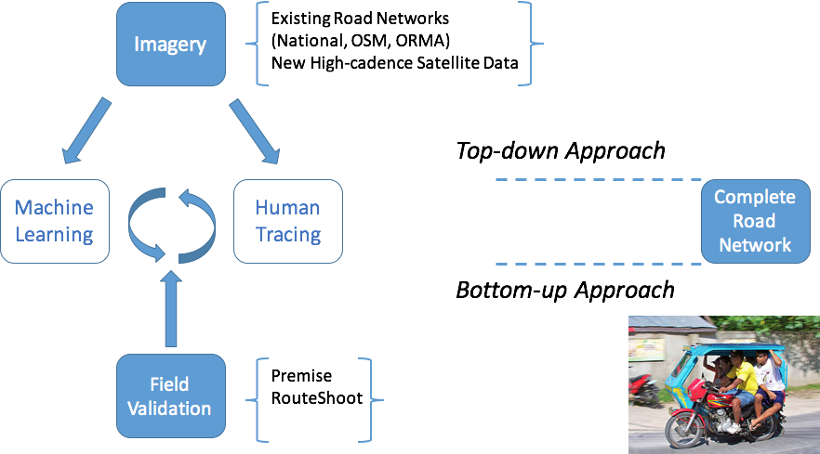
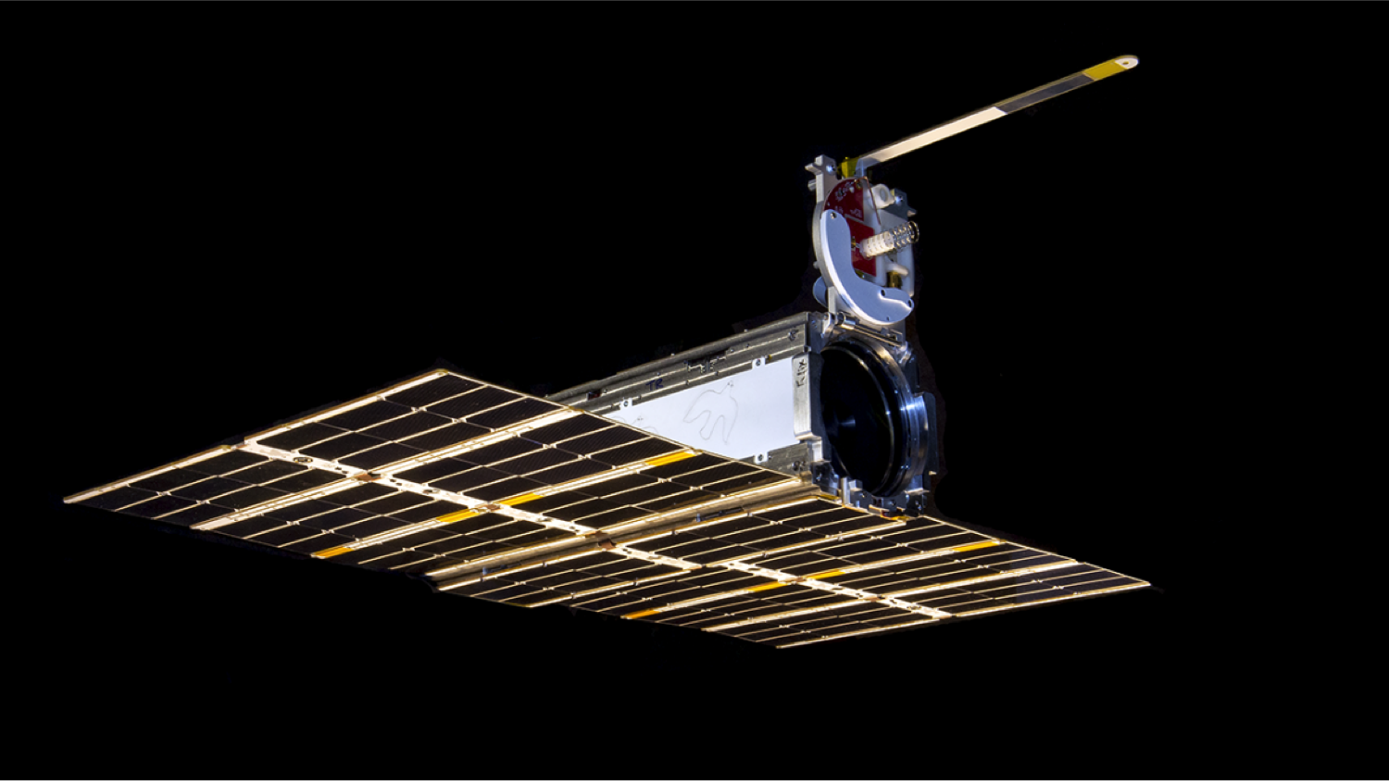
ROAD MONITORING IN THE RURAL PHILIPPINES
Investment in road infrastructure is massive, but tracking progress is challenging
Planet provides more current imagery, from which new roads are traced by crowd-sourcing
New road segments are validated in the field
Data are integrated into the Open Roads Mapping Analytics Platform and accessed by Philippine government
Notes:
Investment in road infrastructure is massive, but tracking its progress and efficacy for rural populations is a challenge
-In the Philippines in particular, no connective service is more urgent than roads – and the Government as well as development organizations have increased investment in road programs to meet a stated commitment of paving the primary national road network by the end of this year
-But a comprehensive map of existing roads is still missing – so the goal of this project was the map the approximate 4,000km of unmapped roads in Palawan
In this project, we worked with multiple partners to demonstrate the application of our Earth monitoring technologies to solving this challenge – combining satellite imagery with ground-data collection through smart phones to demonstrate rapid, comprehensive road mapping for Palawan.
-Planet provided current and high-cadence imagery, from which existing road networks were mapped
-New roads were then traced by crowd-sourced users via our partners at the Pallas Ludens Vision Lab… This was an experimental aspect of the project, which leveraged machine learning for road prediction (including predictions around whether the road was dirt or concrete).
-New road segments identified by the machine learning and human-led tracing activities were then validated in the field by Premise Data Corporation (verified both presence and quality)
-And finally, data was integrated in the Open Roads Mapping Analytics Platform and made accessible to World Bank and Philippine government organizations.

Slide 9
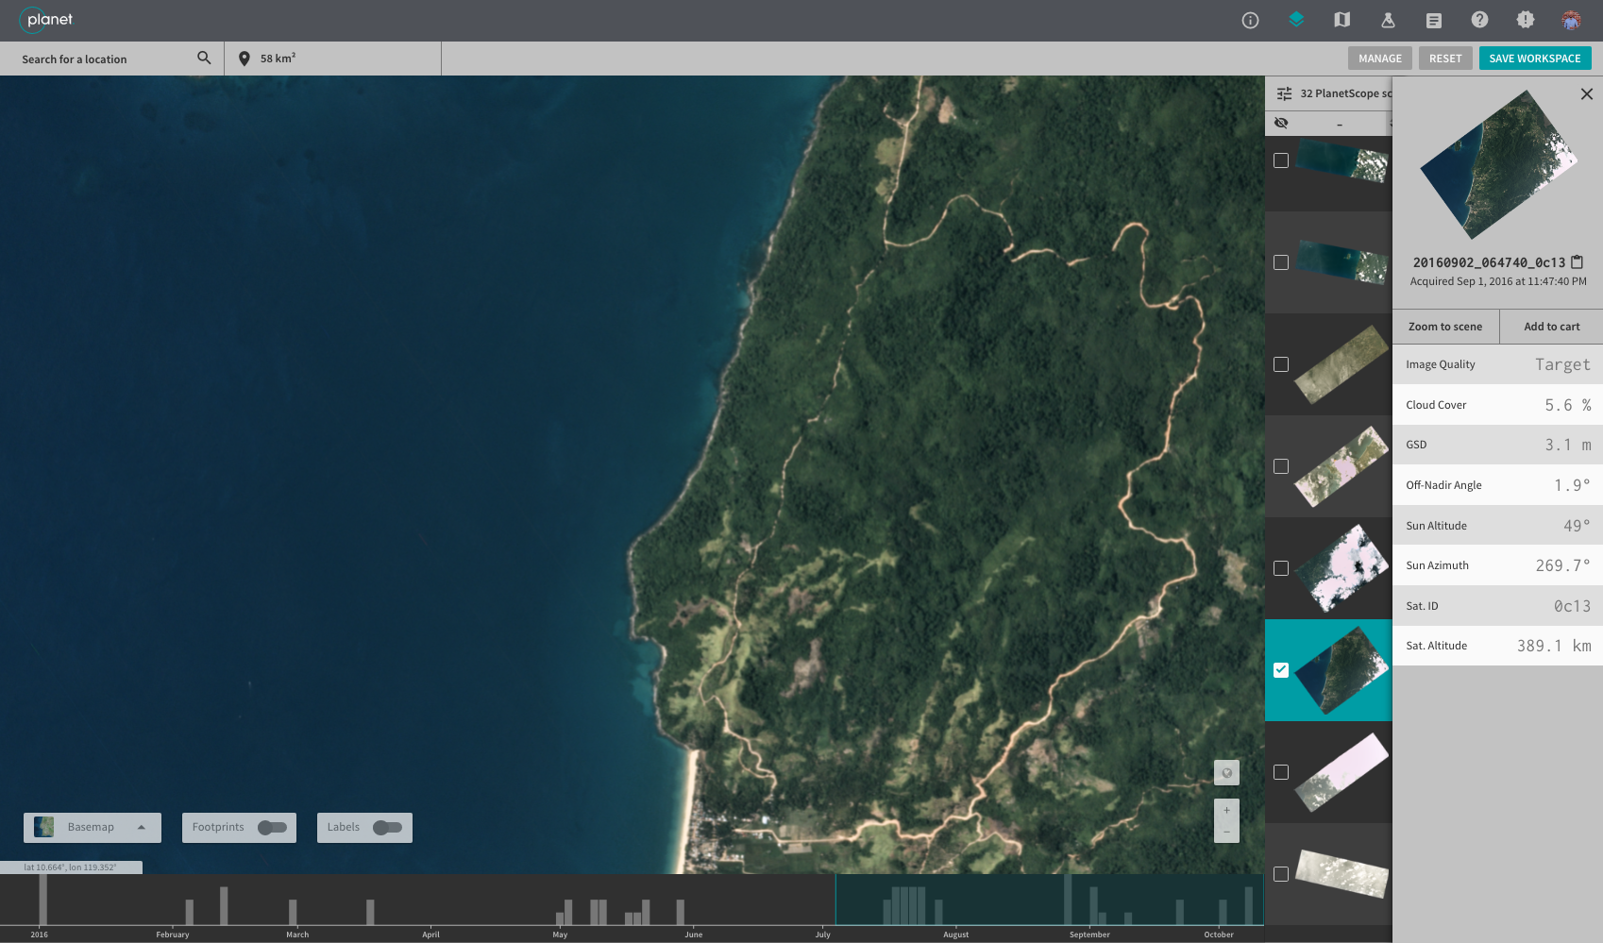
ROAD MONITORING IN THE RURAL PHILIPPINES
Notes:
So here is a quick visual on how the initial imagery looked through the Planet API

Slide 10
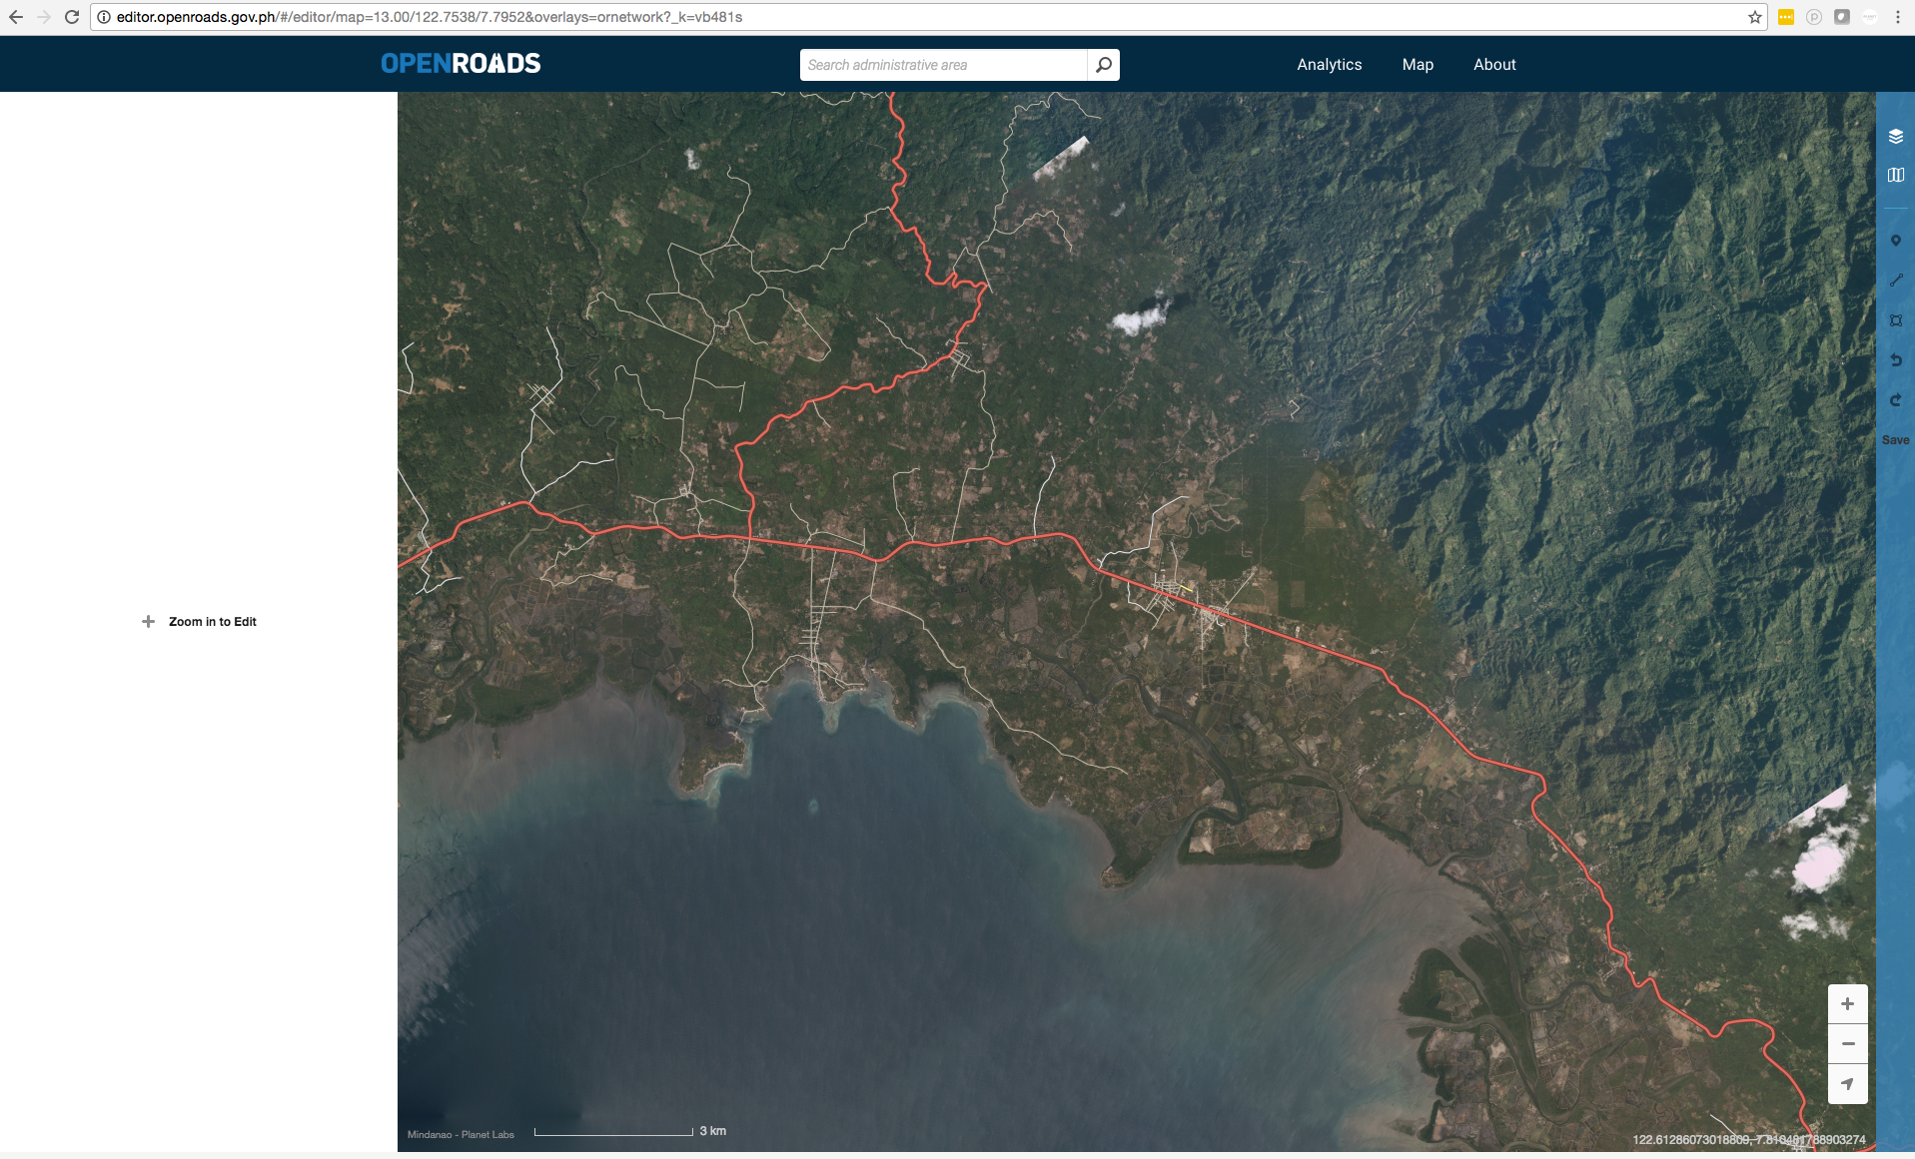
Automated Planet Mosaic w/ hand-tracing in Open Roads Mapping Editor
Notes:
Human-led road tracing from the satellite imagery

Slide 11
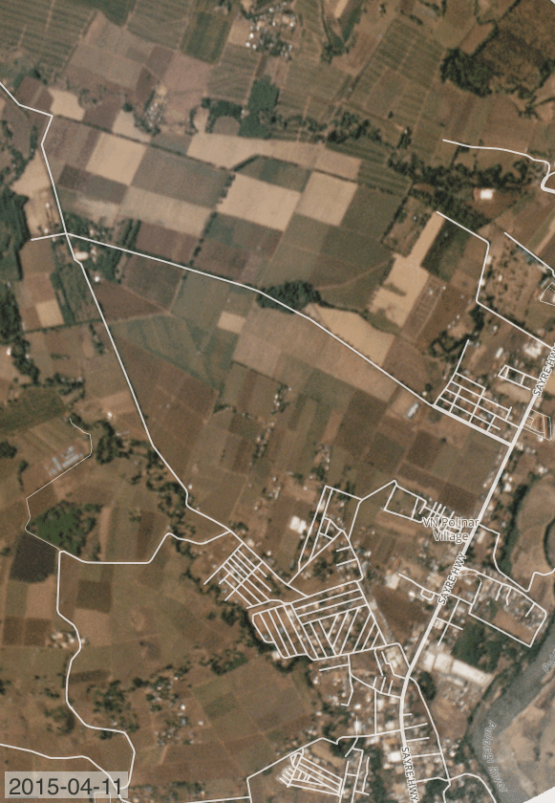
Road under construction in Planet's uniquely timely dataset.
Notes:
The change visible with high-res, high-cadence imagery from Planet

Slide 12
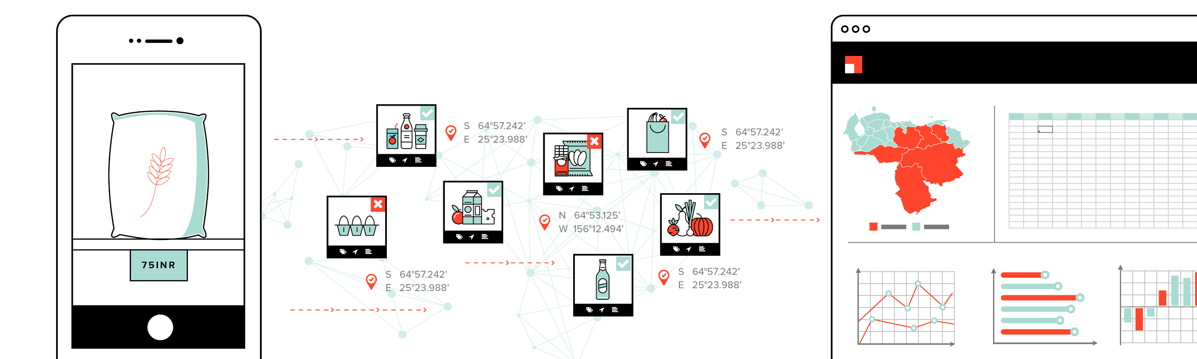
Ground Validation via Premise
Capture Data
Fraud Detection & Quality Control
Quantify, Index, Analyze
Contributors complete survey tasks by capturing data and photos using the Premise Android app.
Data quality is controlled through a mix of machine learning, computer vision, and manual methods such as visual spot checks and cross-verification.
In addition to a full download and audit trail of of all data, Premise provides analytics dashboards showing key indicators and insights.
Notes:
Validation of the human-led and machine learning road tracing via Premise
Users use Android app, stored into analytics dashboards that show key indicators and insights

Slide 13
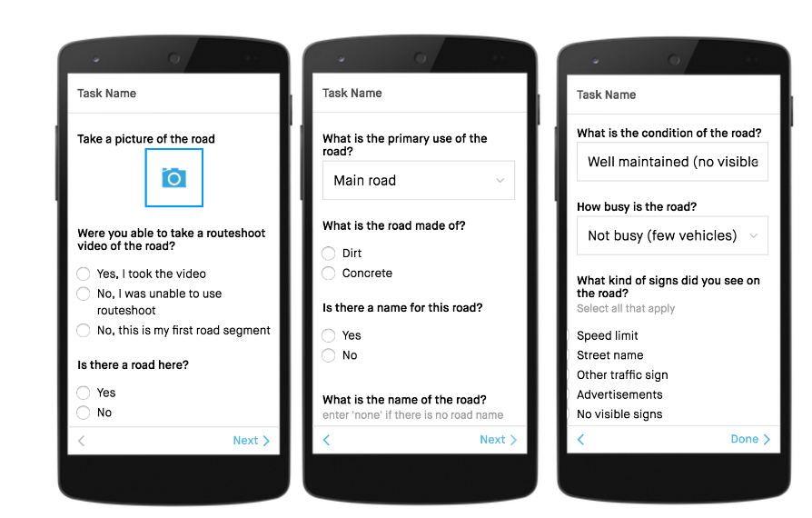
Ground Validation via Premise
Open Roads Survey
Notes:
So this is how the input screen would look for user

Slide 14
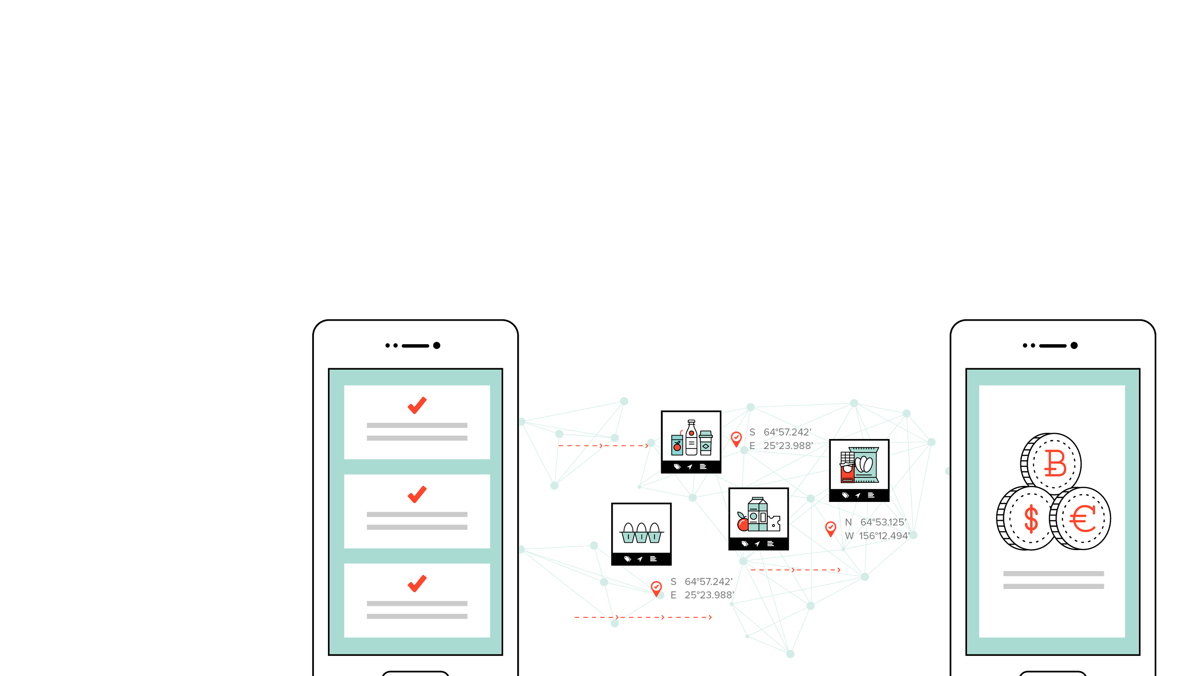
Network Contributor Composition
Premise remotely manages, directs and pays a global network of data contributors through the Premise Android app.
Local Government (e.g., Palawan Special Projects Unit)
DPWH / Woodfields (Mindanao)
RACER
Facebook Recruitment
Notes:
Then made available and accessible to end users and decision makers

Slide 15
LESSONS LEARNED
Satellite cadence and mosaics – capacity is increasing daily
Machine learning prediction – excellent for national roads, generally too conservative for local roads
Tasking – interfaces with users only at start and end of road segment, not along
New roads – need mechanisms for field users to identify and upload new roads
Notes:
Cadence and Mosaics:
-Since the project initiation, Planet has dramatically increased imagery availability, now collecting imagery for a given location on the Earth’s surface approximately every week – soon to be every day
-Increased capacity would therefore support rapid discovery of future road construction projects in satellite data moving forward
Machine Learning Prediction:
-Pallas Ludens predictions were excellent for national roads, predicting more than 90% of such roads
-But for local roads, the machine learning was far too conservative – failed to predict much of the local road network
Tasking:
-Field validation and geoprocessing for predicted roads led to challenges
-Did not allow for tracking along road segments, only interfacing with users at the start and end of segment
-Video-level detail was required to understand road condition
New roads:
-Need to allow users to source totally new roads (that were not on the satellite prediction layer) independently

Slide 16
THANK YOU
VISIT US AT PLANET.COM

