Slide 1
Technology for Infrastructure Monitoring

Slide 2
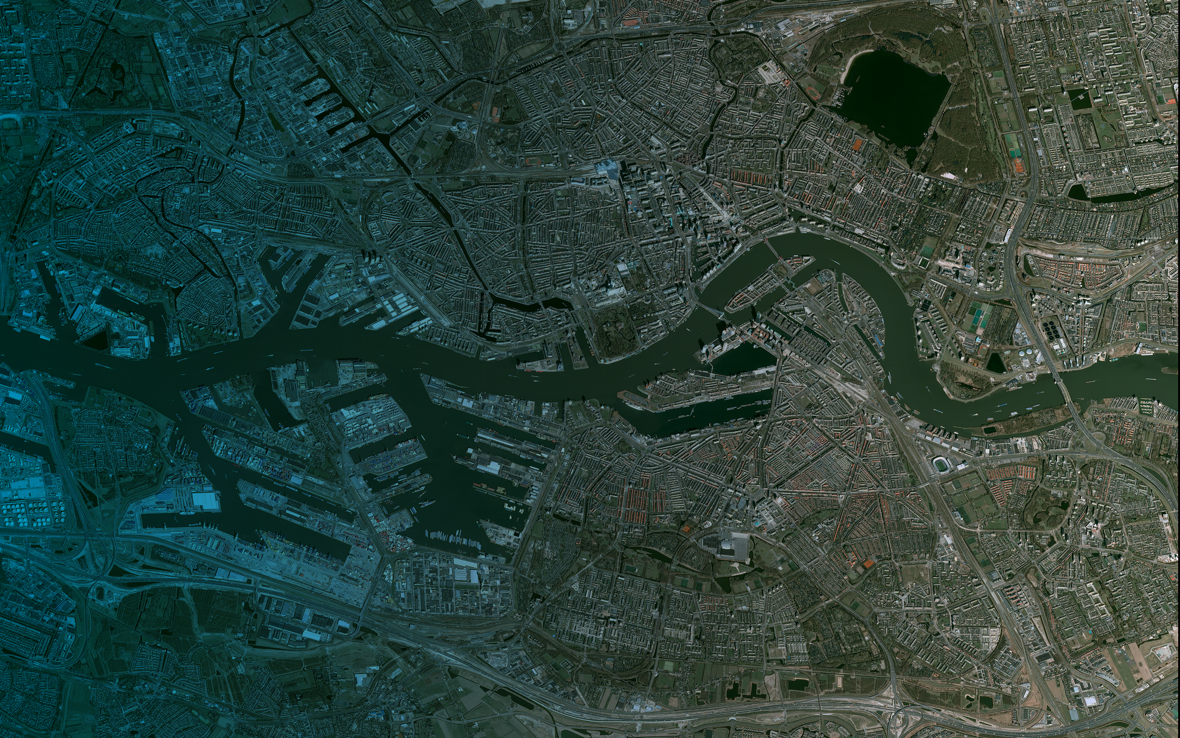
Orbital Insight uses computer vision and data science to turn millions of images into a quantitative understanding of the world.
Port of Rotterdam. Source: Airbus DS 2016

Slide 3
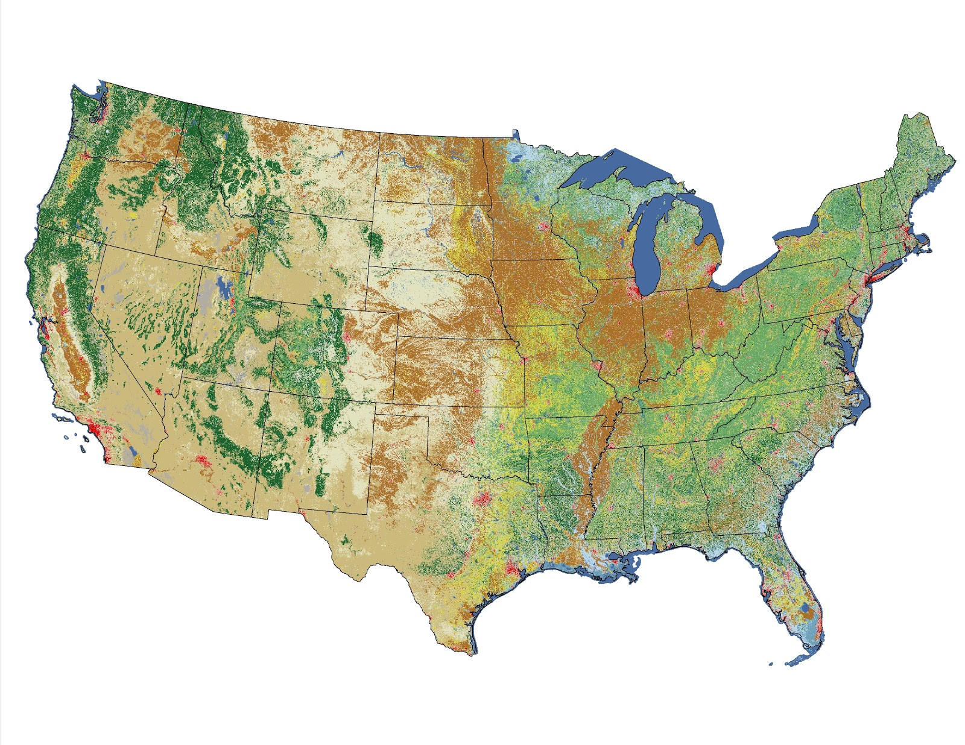
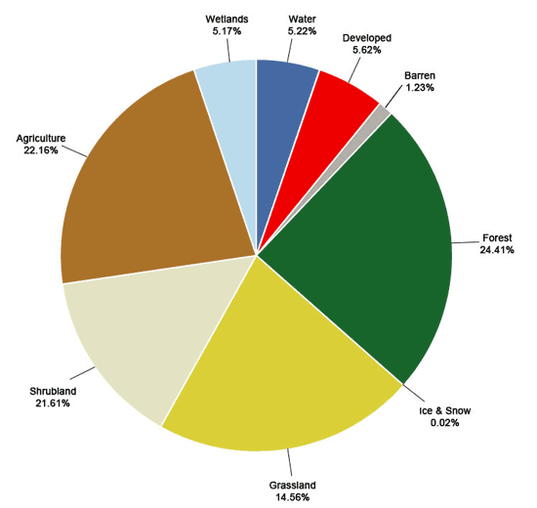
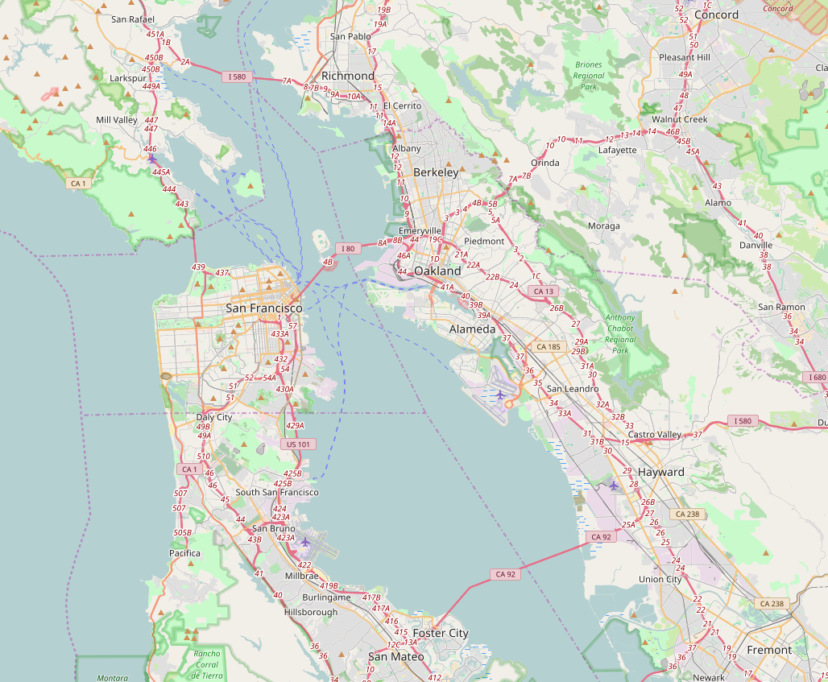
Infrastructure monitoring at scale is hard
NLCD
Sources
Surveys
Large scale investment by orgs. e.g. Govt.
E.g. National Land Cover Dataset (NLCD)
US only - every 5 years
Crowdsourced
Tools
Open Street Maps (OSM)
Relies on crowdsourcing
Challenges
Incomplete coverage
Ground truth-ing, large scale and high frequency is exceedingly hard
OSM

Slide 4
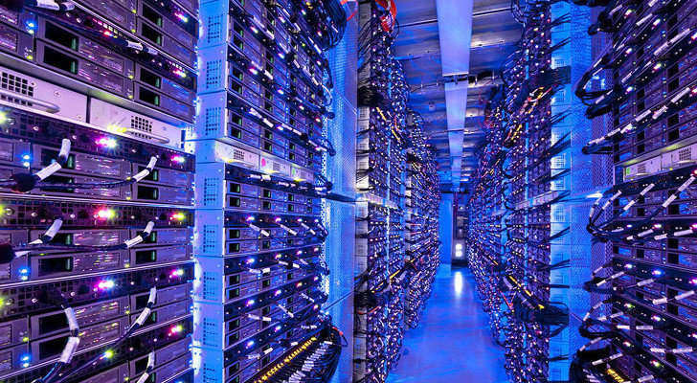
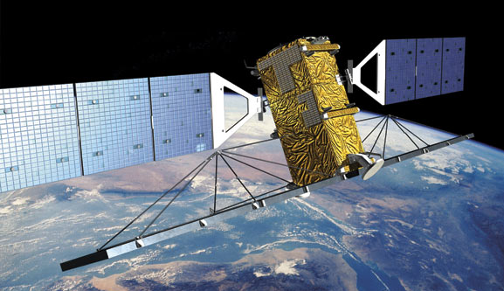
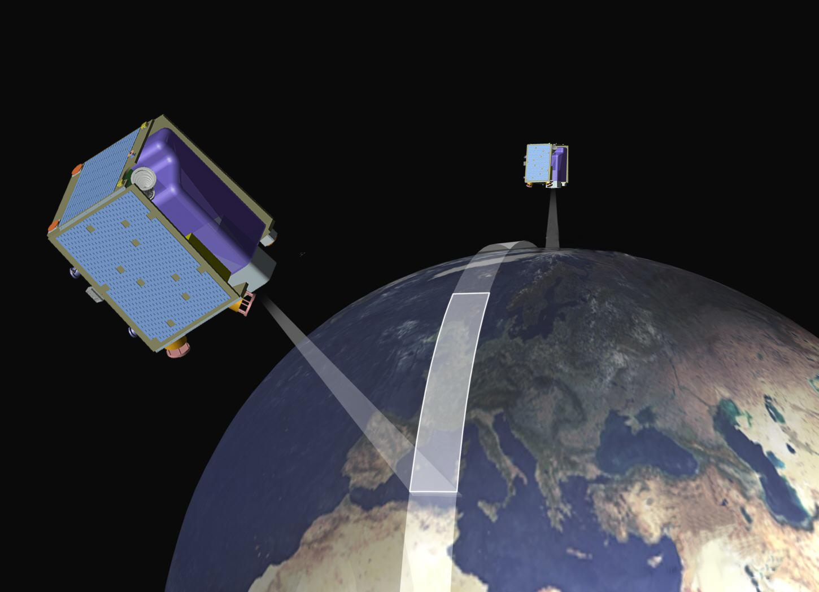
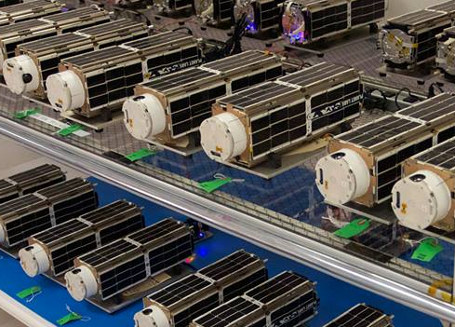
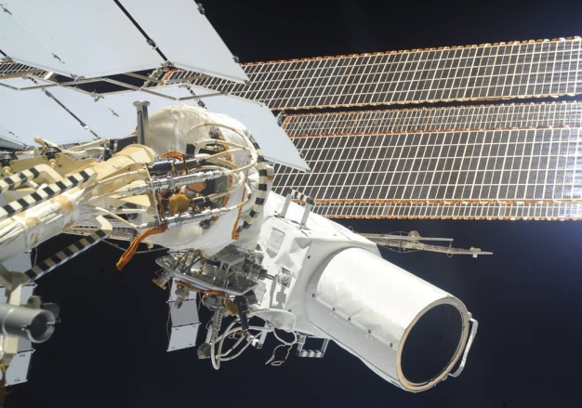
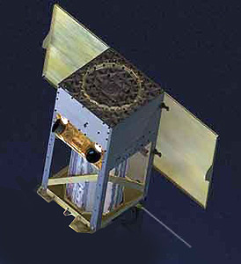
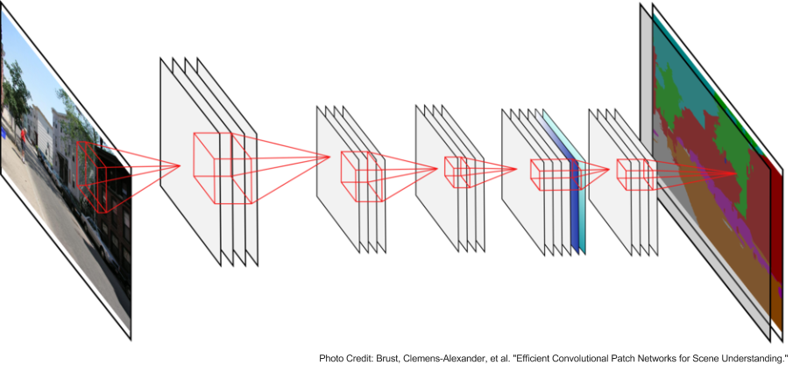
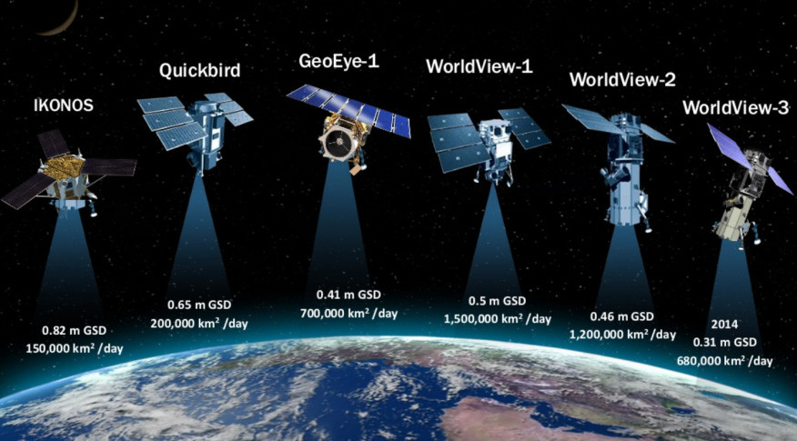
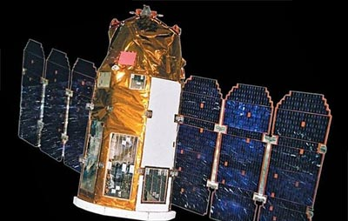
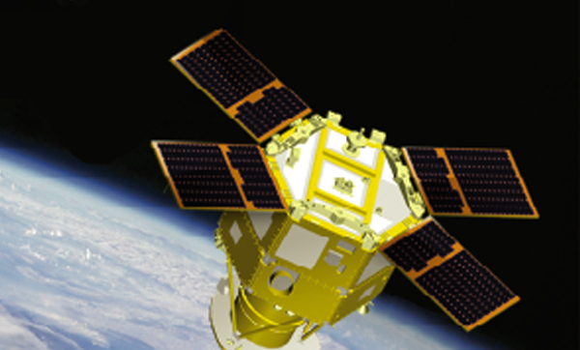
Satellites & Big Data Science Simplify Things
Massive Data Centers
Multiple satellite providers
Computer vision and machine learning algorithms
Cloud computing and engineering scalability
Virtual Satellite Constellation
Convolutional Neural Networks

Slide 5
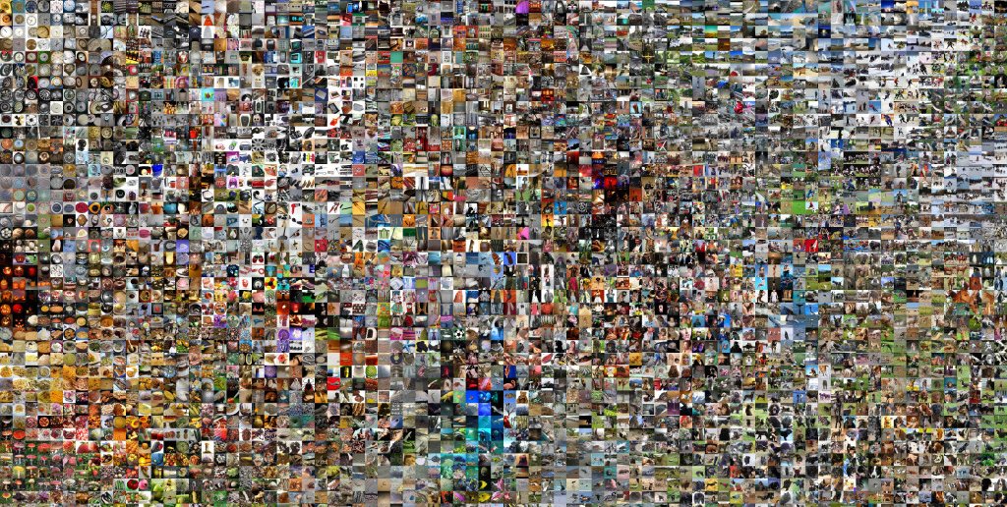
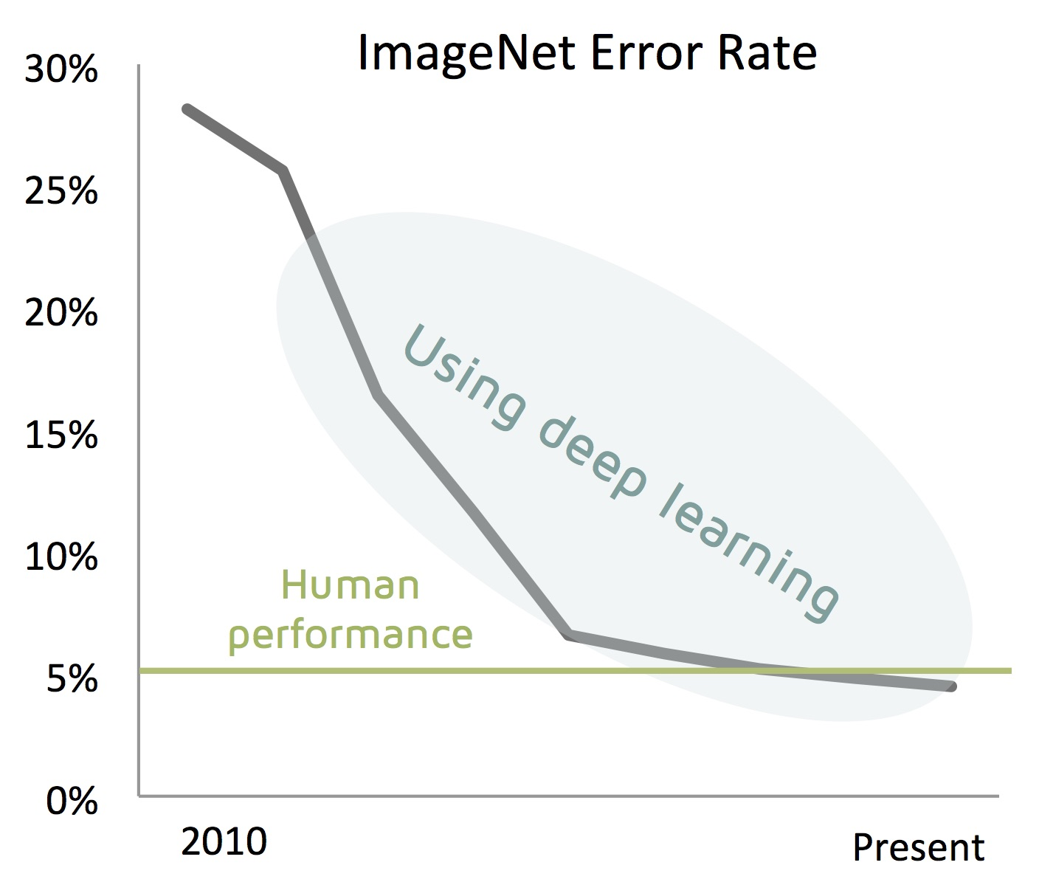
What’s New: The Triumph of Deep Learning

Slide 6
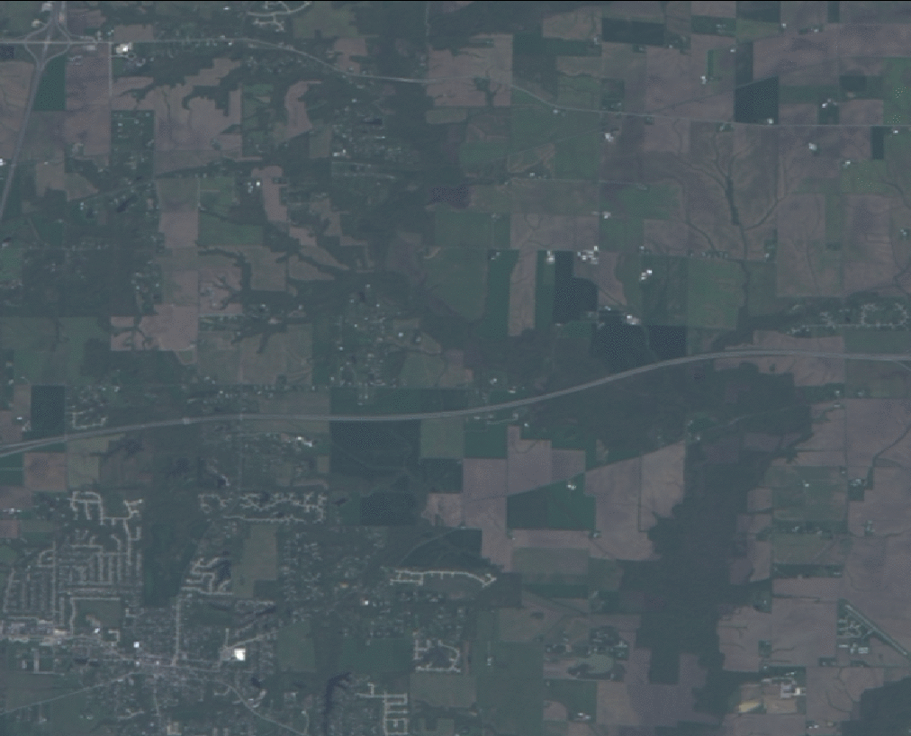
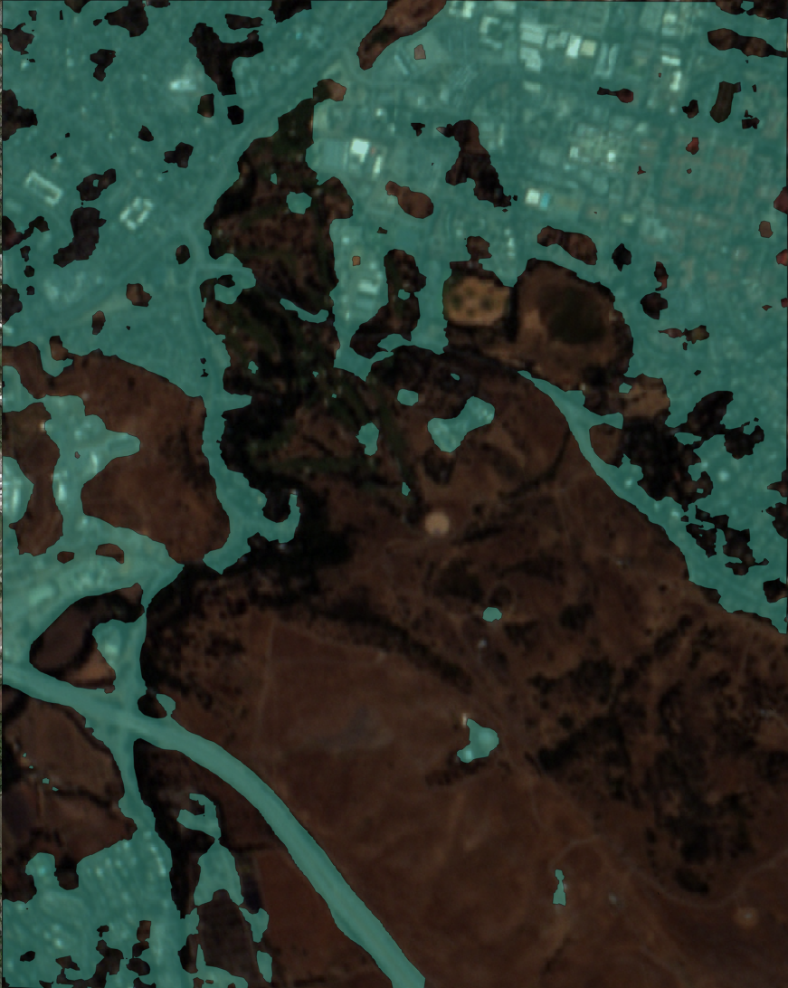
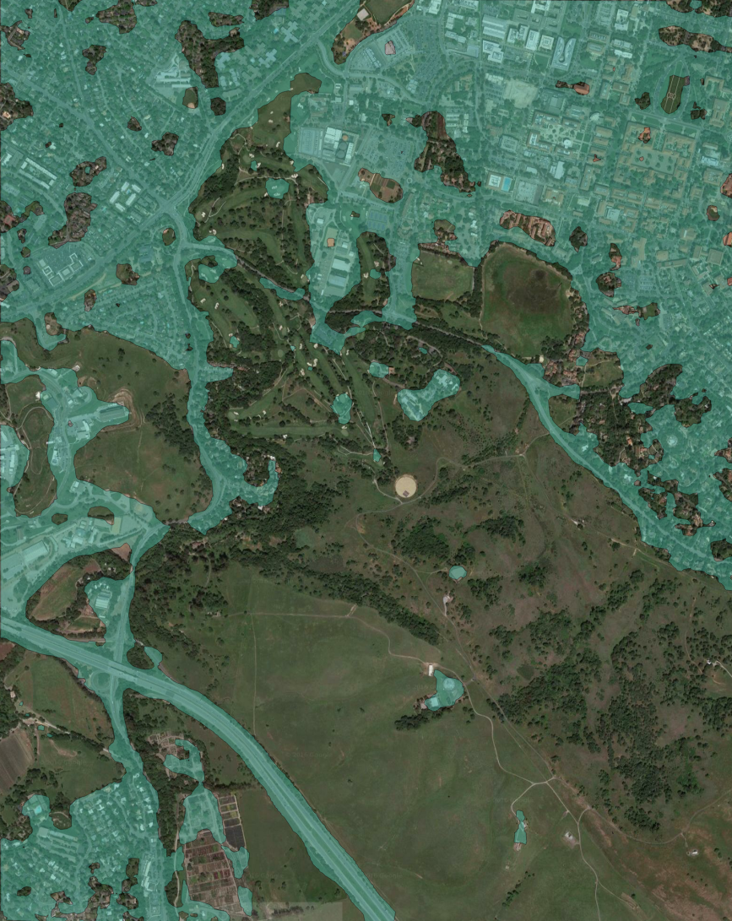
So what can we do with this?
Classification of land use – buildings, roads etc.
Use survey and crowd sourced datasets verified and at small scales as training sets for deep learning – imperfect but do the job
Building classifier on Stanford using PL imagery
Training dataset using NLCD

Slide 7
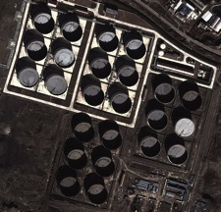
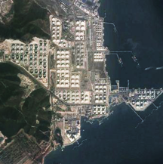
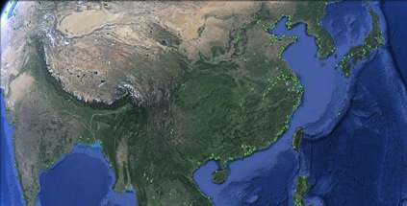
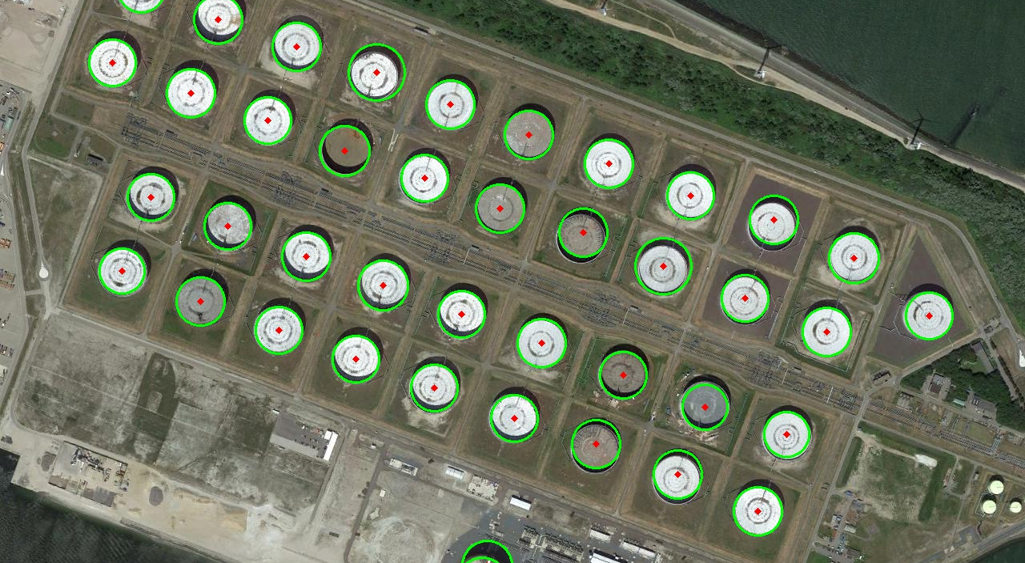
Infer World Oil Storage
Dalian, China’s largest oil storage hub
Monitor crude oil inventory worldwide
Track 20k+ storage tanks in 800+ areas around the world by satellite.
Create continuously-updated estimate of global oil inventory
More comprehensive and much more timely than the International Energy Administration’s survey methods
Insight about regions that do not publish storage data, e.g. China, South America

Slide 8
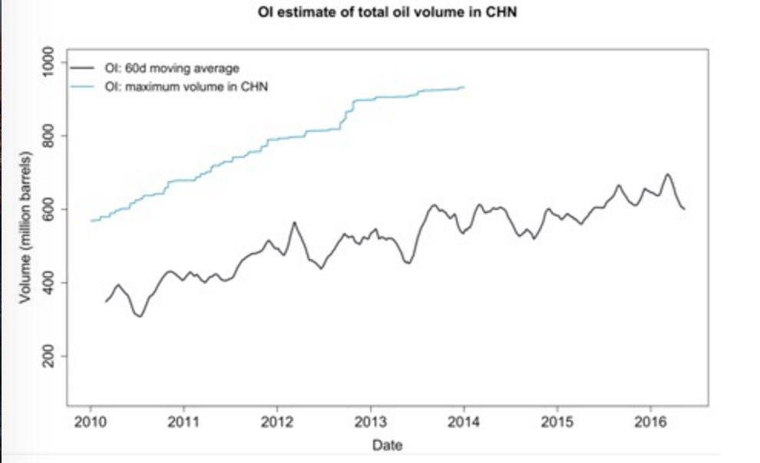
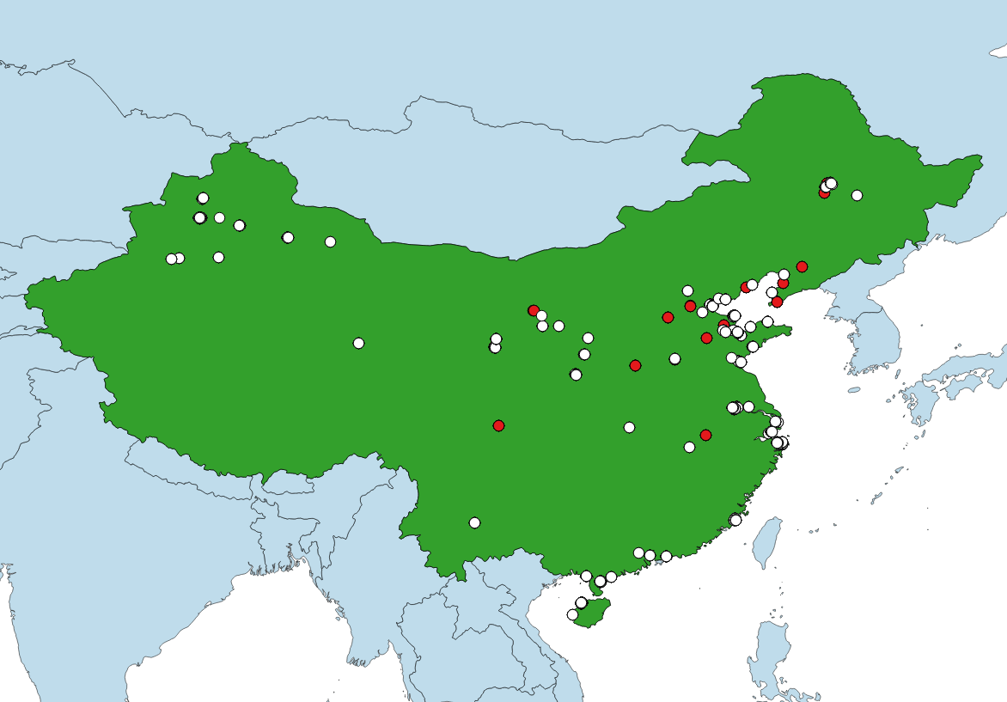
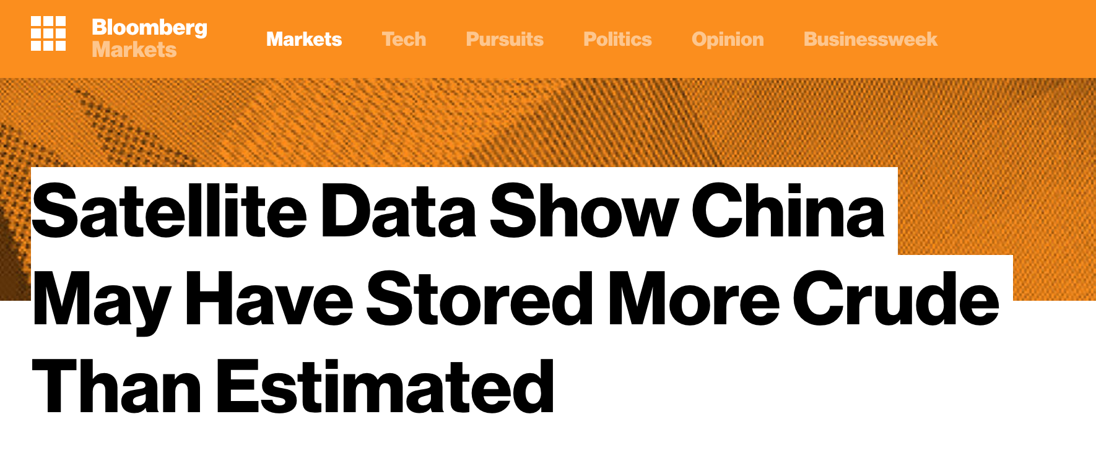
Finding “Unknown” Oil Tanks in China
Over 2,000 tanks discovered by OI scanning algorithm with high recall
Human in the loop workflow
Wide area search using Landsat
Convolutional Neural Network
Trained to find clusters of white dots
Reduces a large country like China to manageable number of images (1k)

Slide 9
Infrastructure monitoring using time series changes
Illinois
Kohl’s pre-open
Kohl’s post-open
12/12/2010
02/23/2012
Detection can be achieved using automated means – ML + Statistics
Validation/Ground truth can be verified using human in the loop

Slide 10
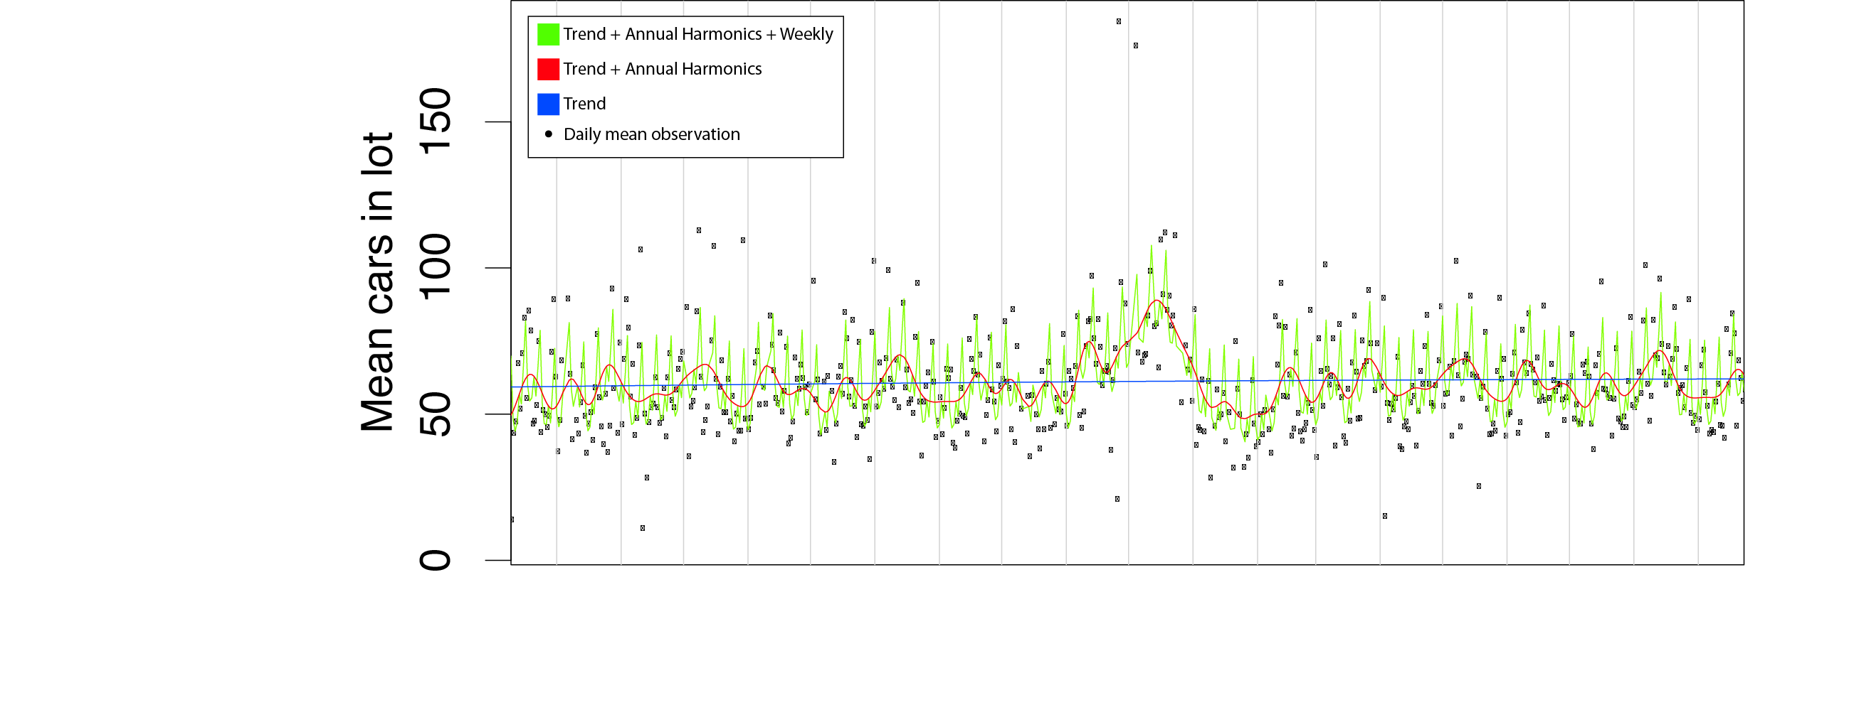
Time Series data is very informative...w/ huge scalable
One million images
4 trillion pixels.
1.2 Billion cars
Extract CPI/Macro indices w/ high accuracy
78% hit rate for macro

Slide 11
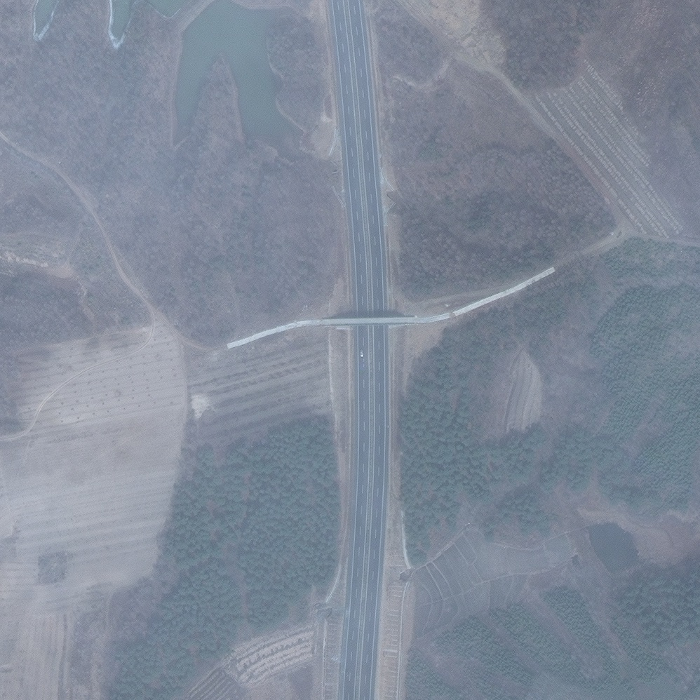
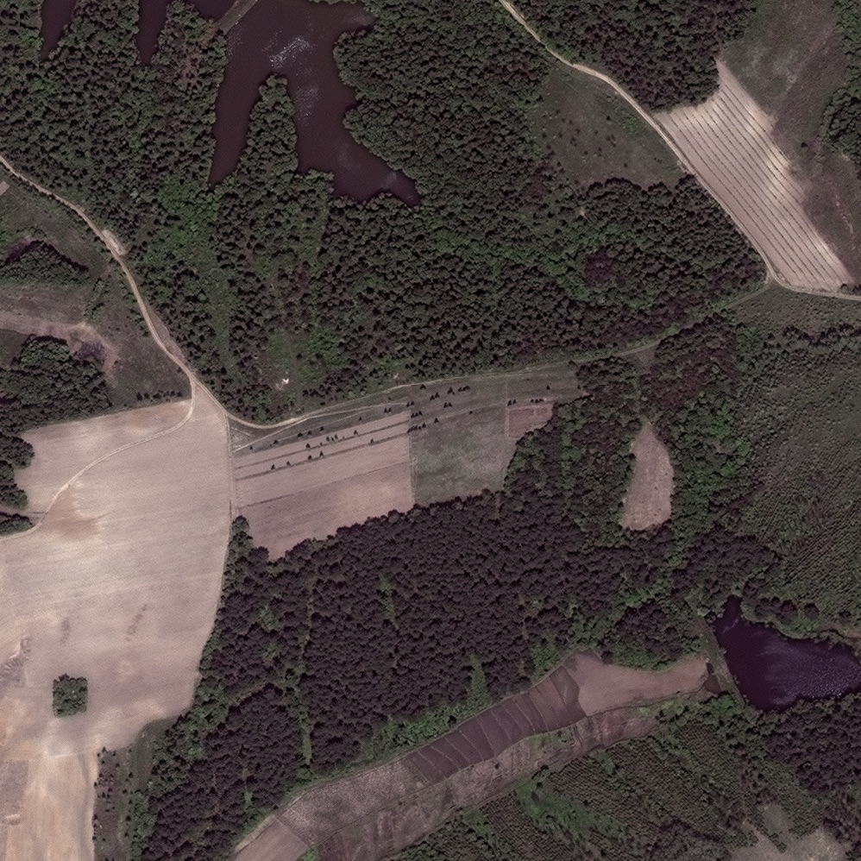
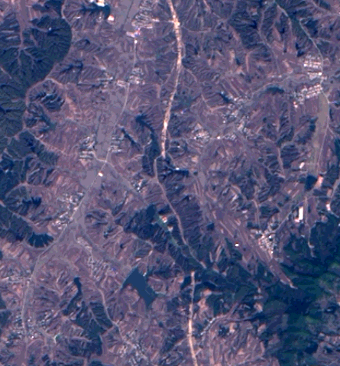
Techniques can be applied to roads…
Image Processing
Road construction

Slide 12
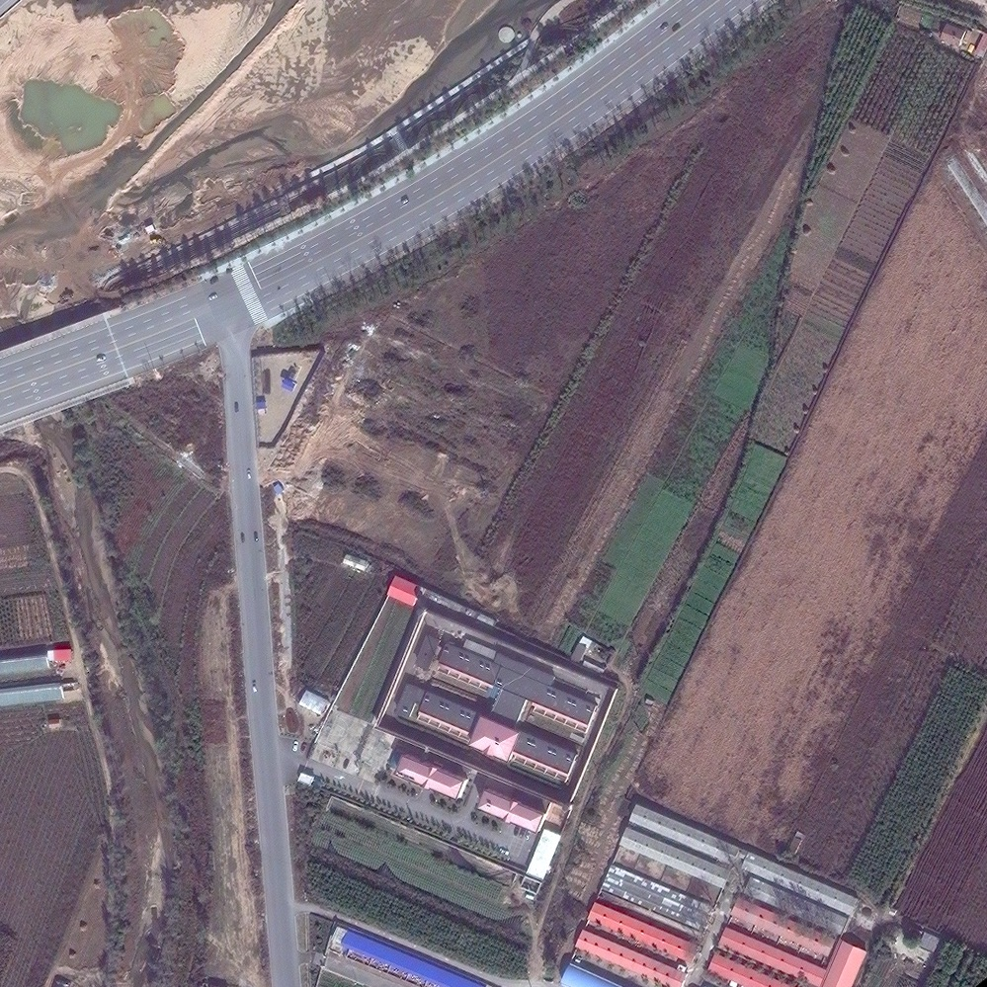
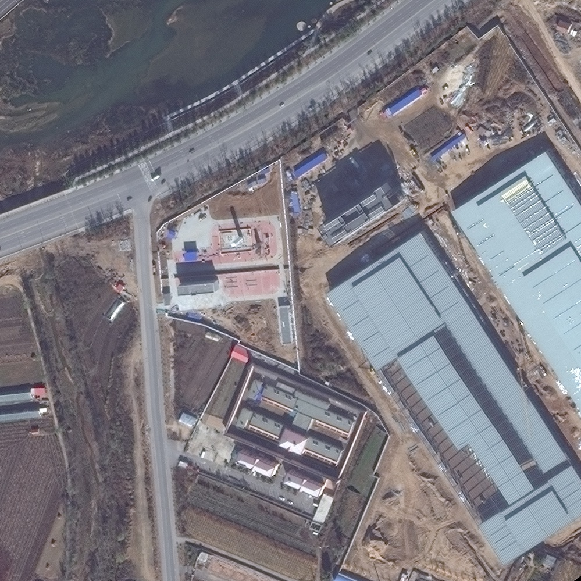
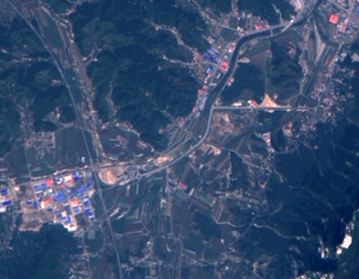
Or buildings…
Image Processing
Building construction

Slide 13
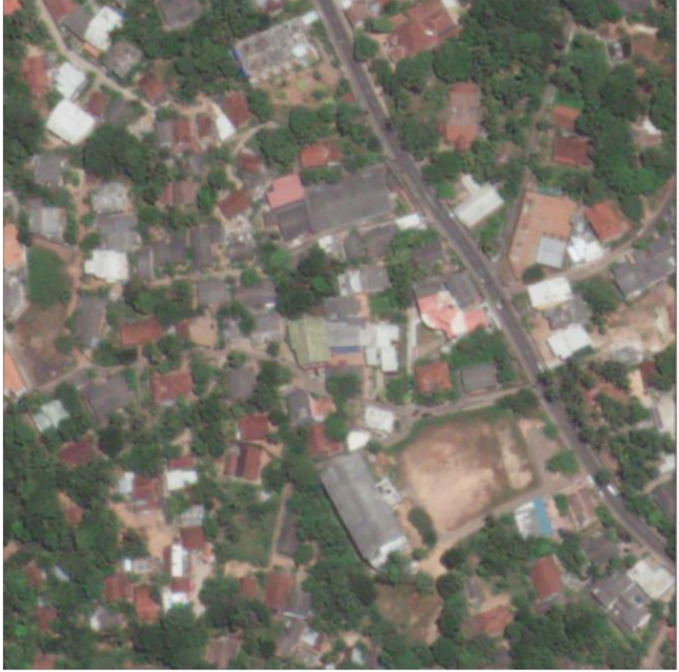
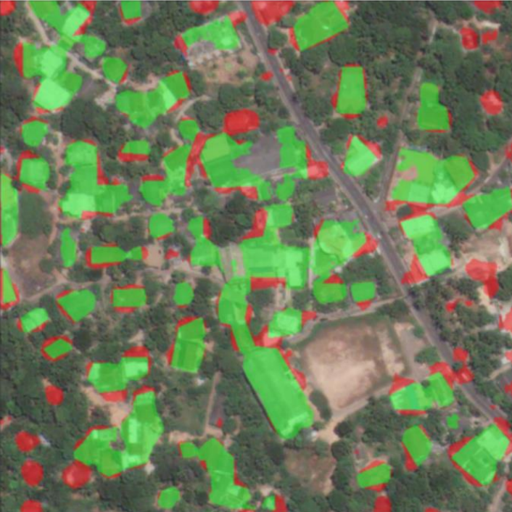
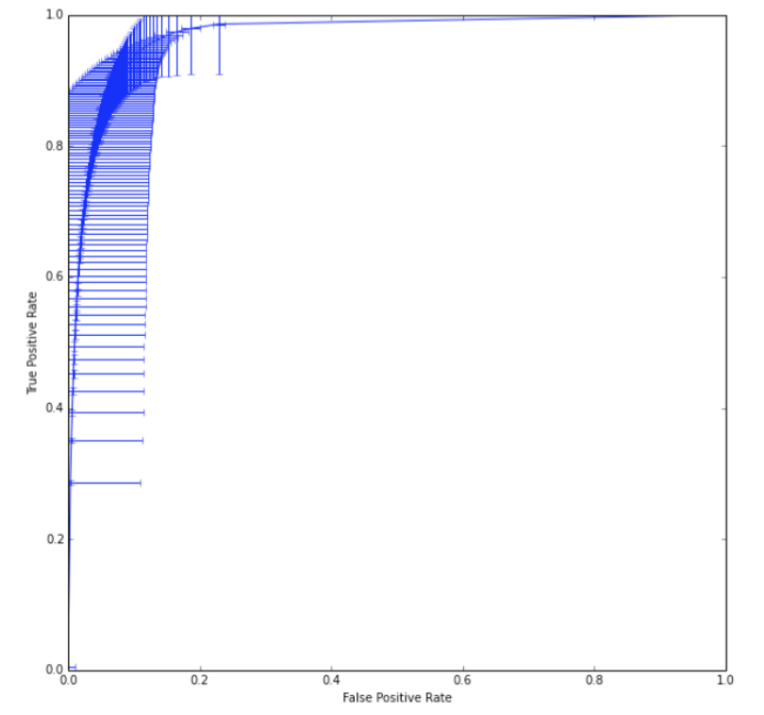
Communities…
Raw Image
Processed Image
ROC Curve
High anti-correlation with poverty

Slide 14
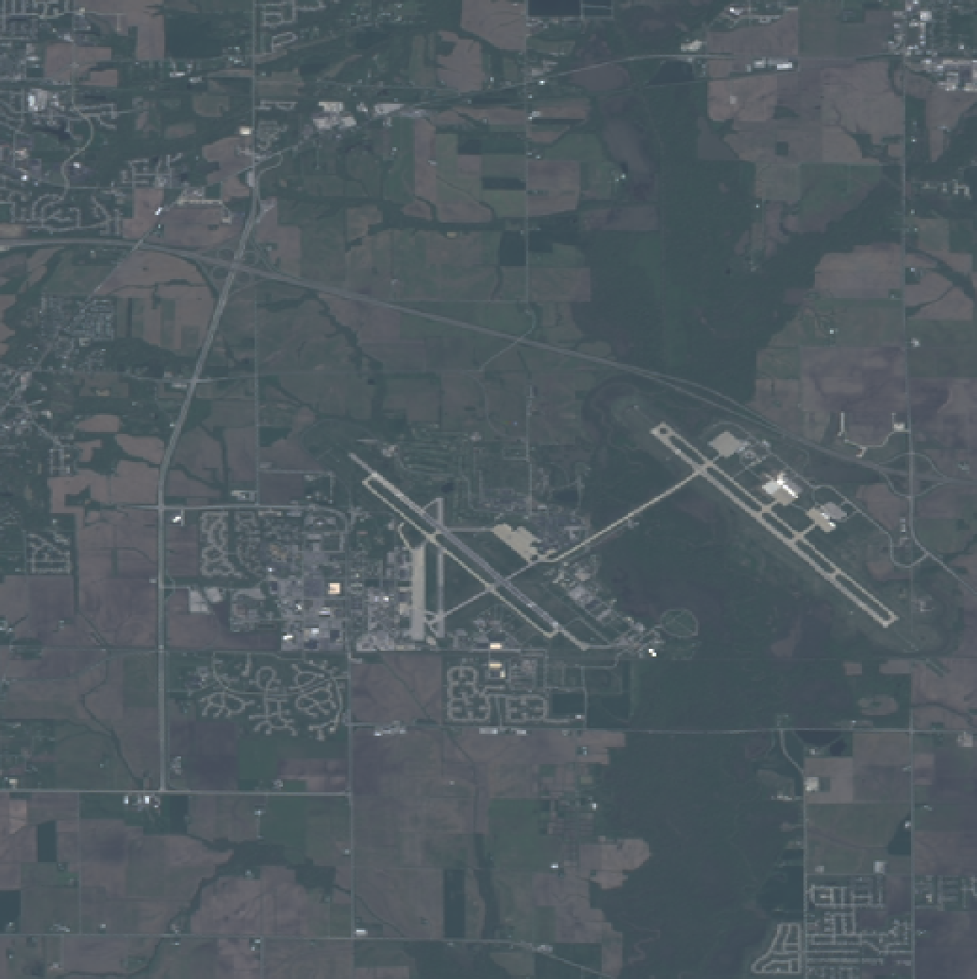
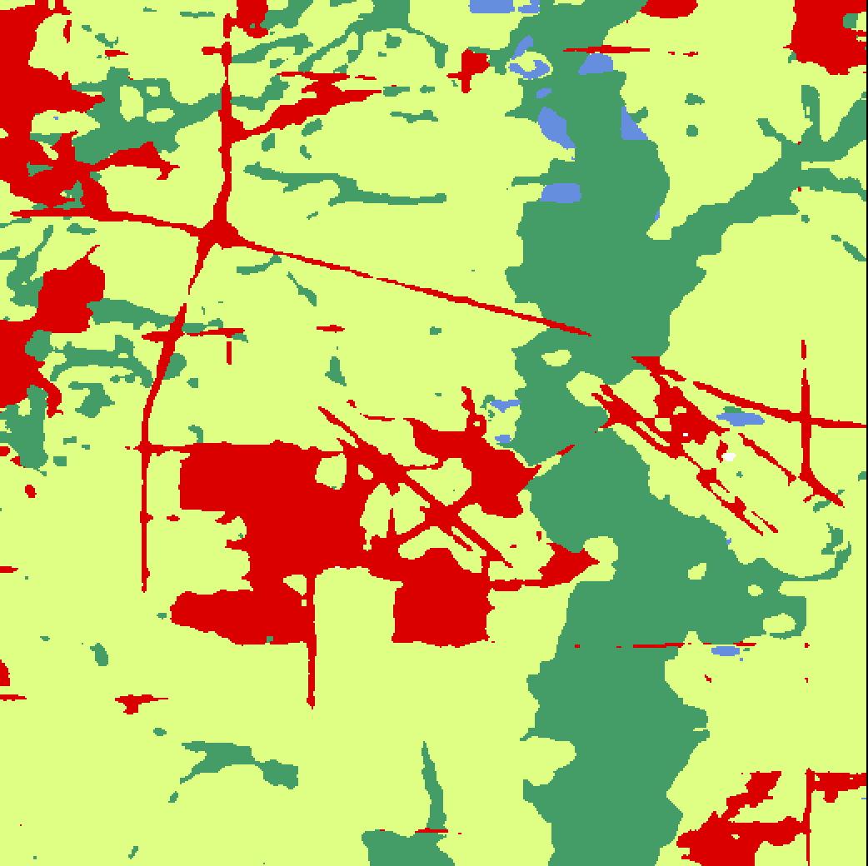
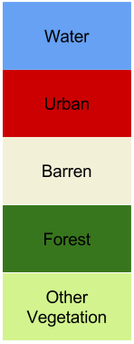
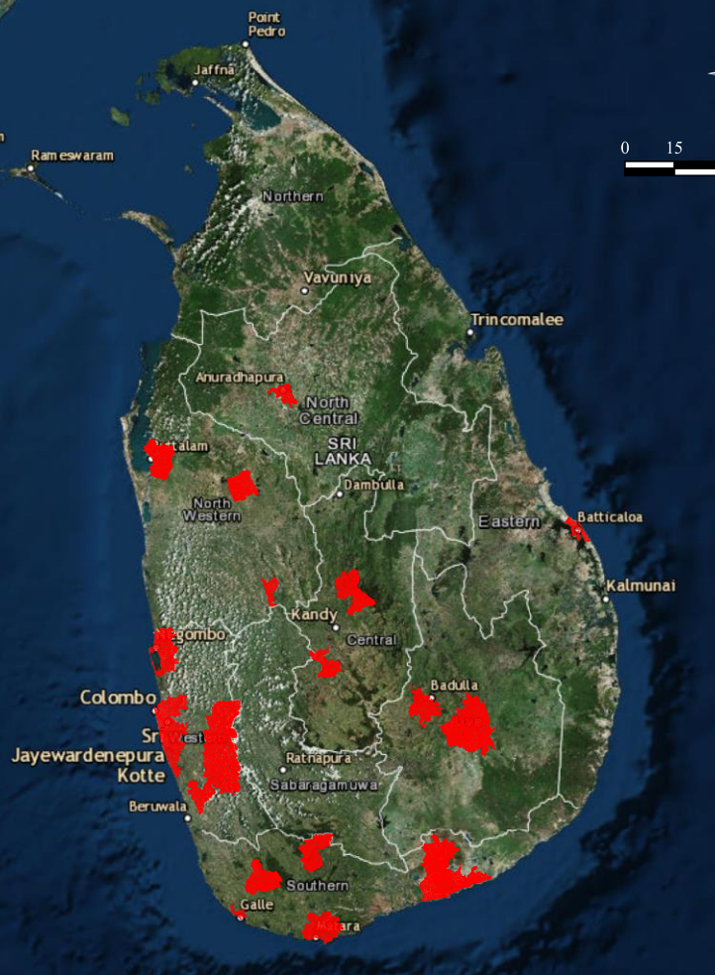
Regions and countries…
RGB Image
CNN Output
Illinois

Slide 15
Thank you! Questions?
Visit us at orbitalinsight.com

