Slide 1
More With Less: How Data Changes Utilities
Michael Kanellos
Industry Champion OSIsoft

Slide 2







Pioneers of Digital Transformation
35⁺
years
1.5B
sensors
19,000
sites
127
countries
1300
case studies
65%
of Industrial
Fortune 500
2x
employees in
last 6 years

Slide 3












The PI System: Insight on Demand
The Right Data to the Right People, at the Right Time, in the Right Format

Slide 4
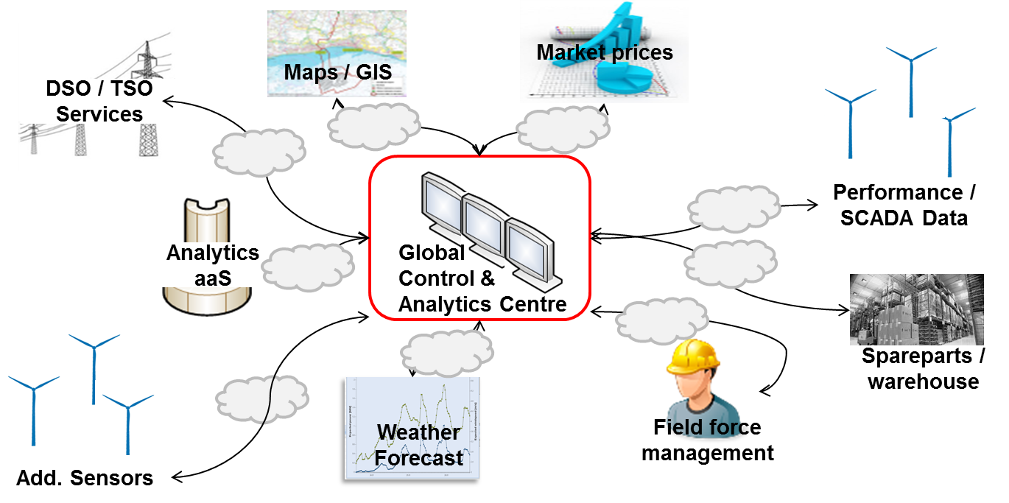
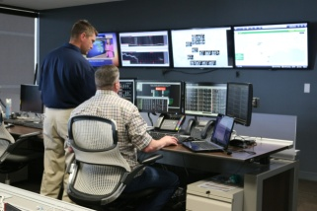
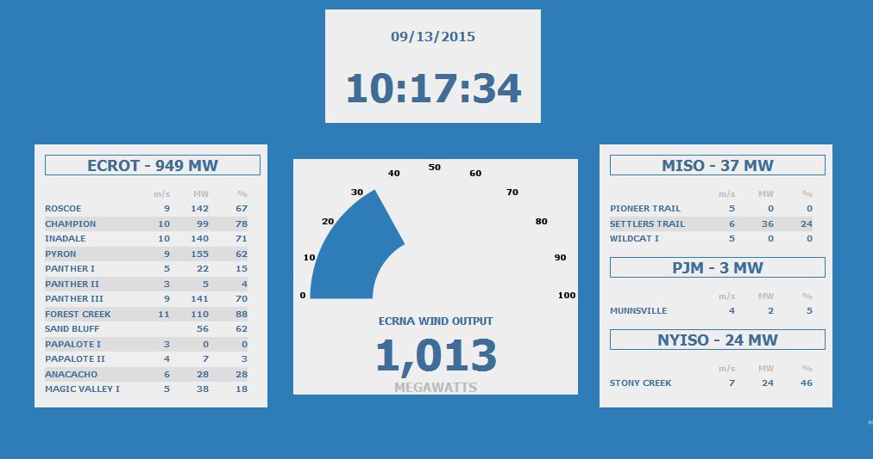

A Day in the Life of Operational Data: E.ON
310,000 sources, 250 data formats, 140+ locations

Slide 5
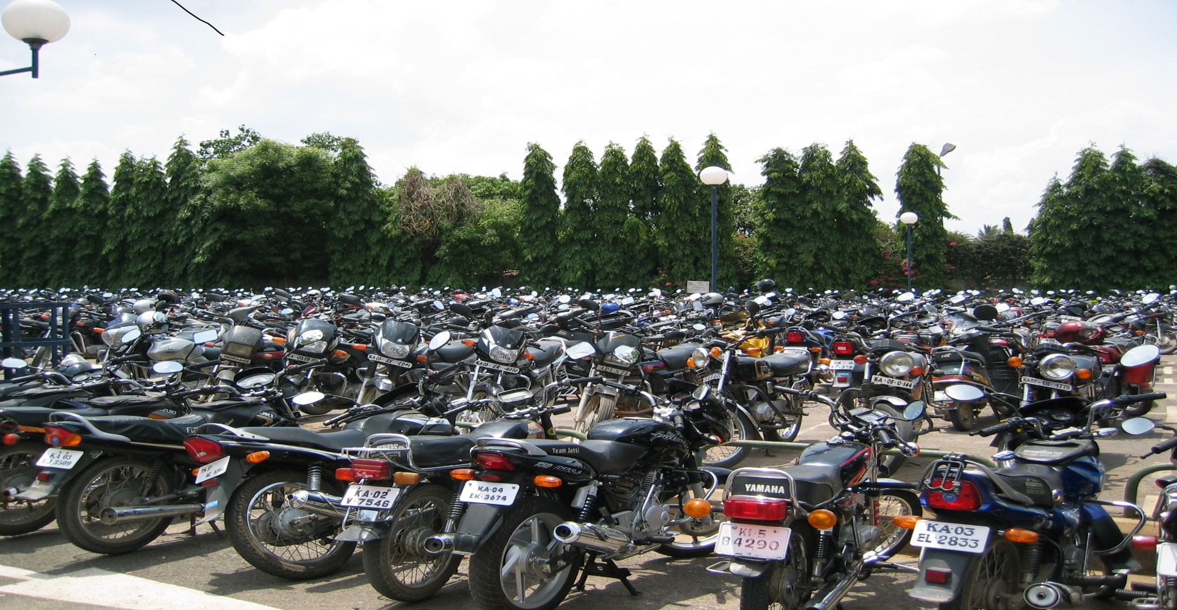
The Future:
Energy demand up 48% by 2040
Food demand to double by 2050
67% of world in cities by 2050
33 countries face extreme water stress by 2040
Data = Infrastructure

Slide 6
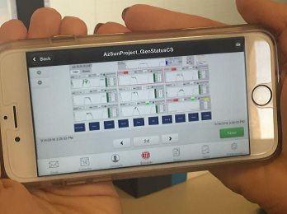
Solar, Storage and Software
APS: 170 MW across state, six technicians.
Smart grids:
1.2GW to 20GW
Power Theft: an $89 Billion Problem
Electricity:
The Three Ss

Slide 7

Industry:
1% for the 1%
54% of delivered energy
Small changes make a big difference
Alcoa: 1,800 process tweaks = millions in savings
Energy funded by maintenance?

Slide 8
Water: The Big Drip
32.6 trillion liters in leaks annually: Three Gorges Dam only
39 trillion liters
Maynilad: leakage down from 67% to 32%
Halifax: saving 38 million liters a day

Slide 9
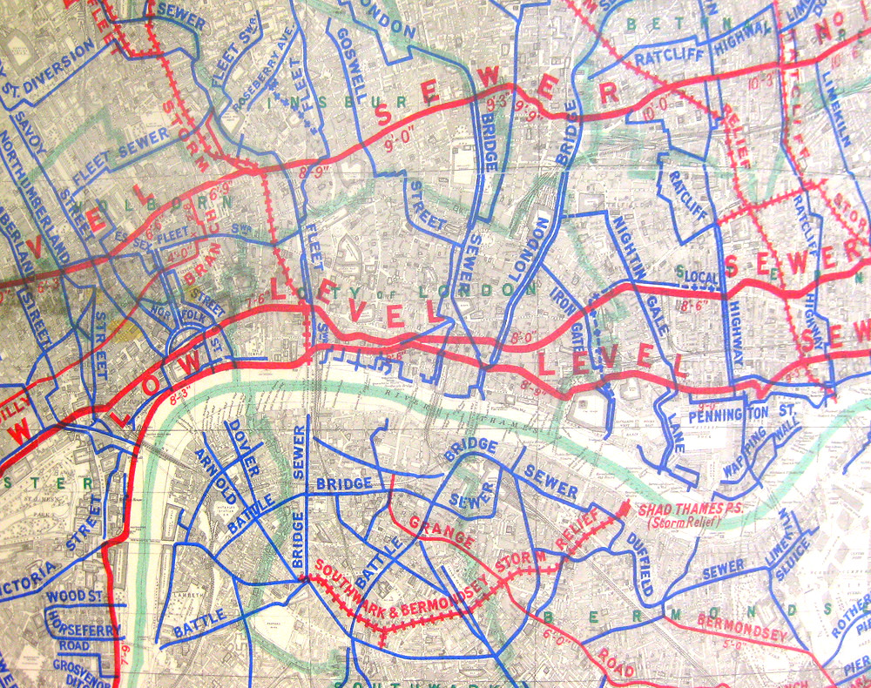
Wastewater:
The Next Overflow
Thames Water: 2x as much wastewater as water
United Utilities:
Analytics to predict sudden discharge

Slide 10
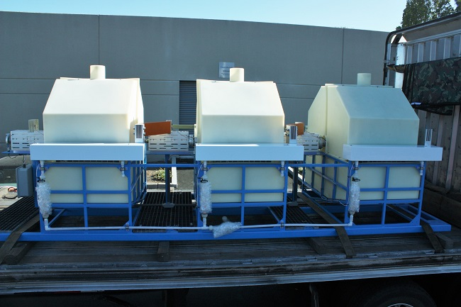
Water Recycling:
The Solar of Water
42% less than desalination.
Modular and distributed
45% of world population living in dry lands

Slide 11
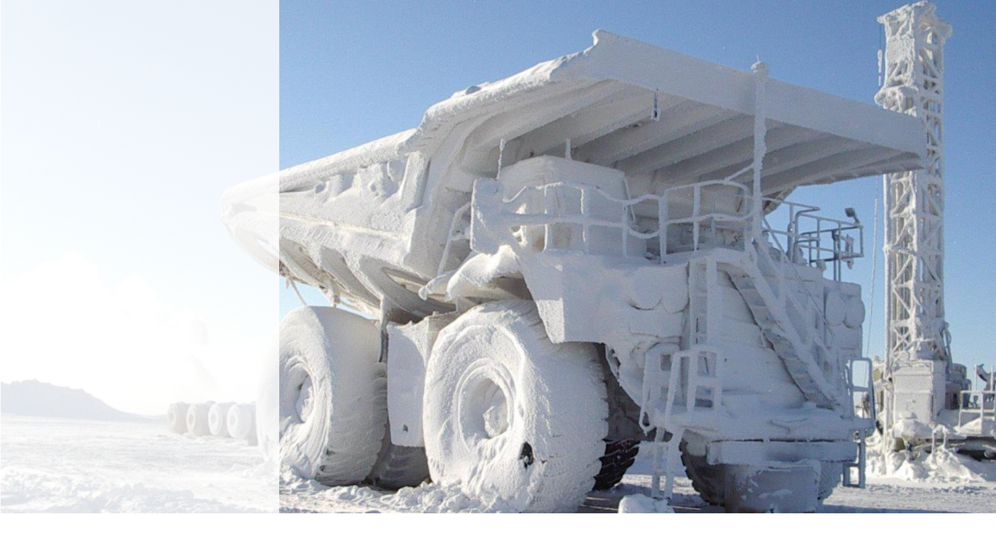
So What’s the Problem?
The OT/IT Divide
One company: two cultures
Data a hidden asset
The Utility Model
Monopolies not evil: just outdated

Slide 12
Thank You mkanellos@osisoft.com

