Slide 1
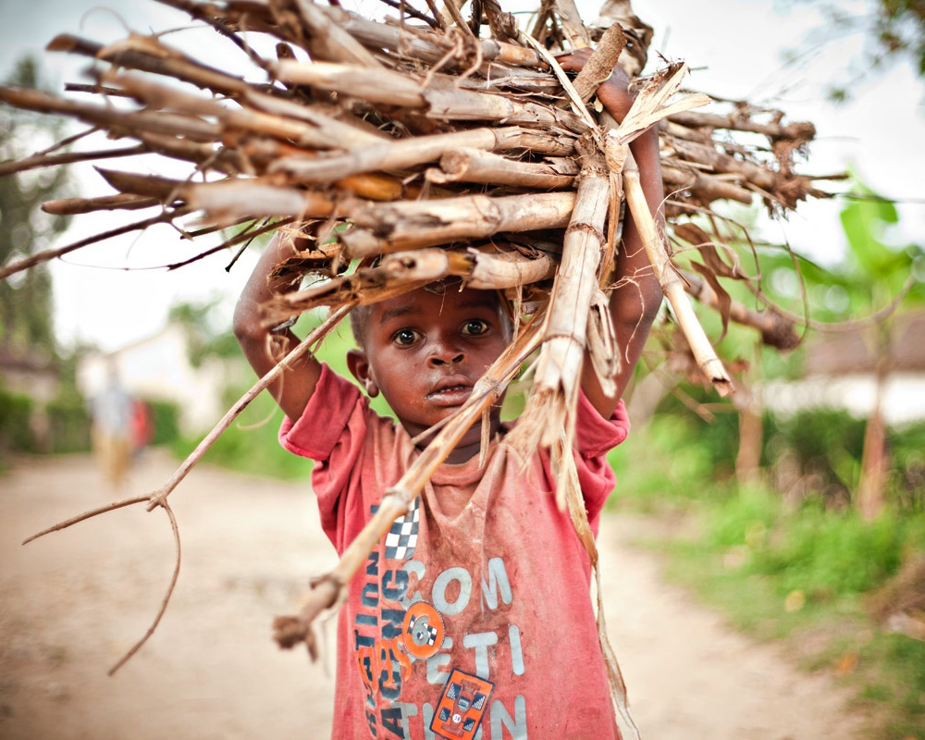
Evan A. Thomas, PhD, PE, MPH
Associate Professor
evan.thomas@pdx.edu

Slide 2
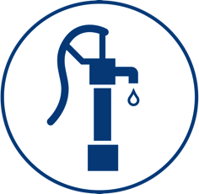
Notes:
In global development, we have what I’d call an “open loop,” both in terms of the way these projects are funded, and in the way they are evaluated and monitored.
Funders, from church groups, Rotary Clubs, all the way up to USAID and the World Bank, provide funding for projects that are supposed to improve the health and livelihood of people in developing communities.
These include things like community and household water treatment systems, improved cooking stoves, latrines, and solar lighting.
Once these projects are installed, typically they are evaluated by the implementers themselves.
Or you may have external experts visit the projects a few times. Under the best of circumstances, sometimes funding is available to run a randomized controlled trial to rigorously evaluate if the projects are improving health or other outcomes.
But, usually sooner rather than later, the funding runs out for that particular project, and everyone moves on.
This has resulted in sad statistics like as much as 60% of water pumps in some African countries are broken a few years after they’re installed.
As Kurt Vonnegut observed, “A flaw in the human character is that everybody wants to build and nobody wants to do maintenance.”
So in Rwanda, and elsewhere, we’re trying to “close the loop”. We have two transformational ways of doing this.

Slide 3
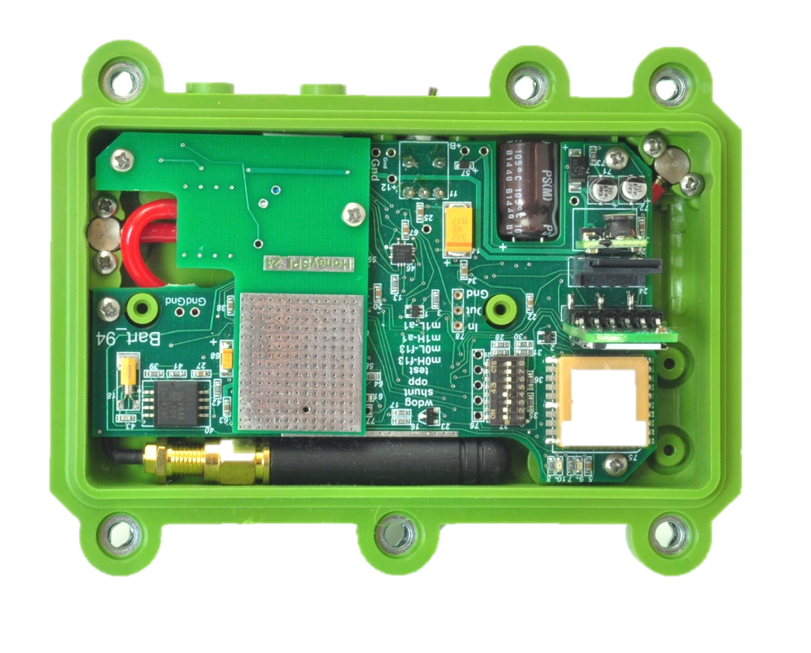
HEALTH
CREDITS
Notes:
The first is a business model – using carbon credits that are generated from the projects themselves and sold to international buyers, to close the loop on funding.
The second is a tech solution – using cellular network based remotely reporting sensors to tell us how projects are performing around the world.

Slide 4
Combining Sensors, Surveys, Observations within a Health Impact Randomized Controlled Trial in Rwanda

Slide 5
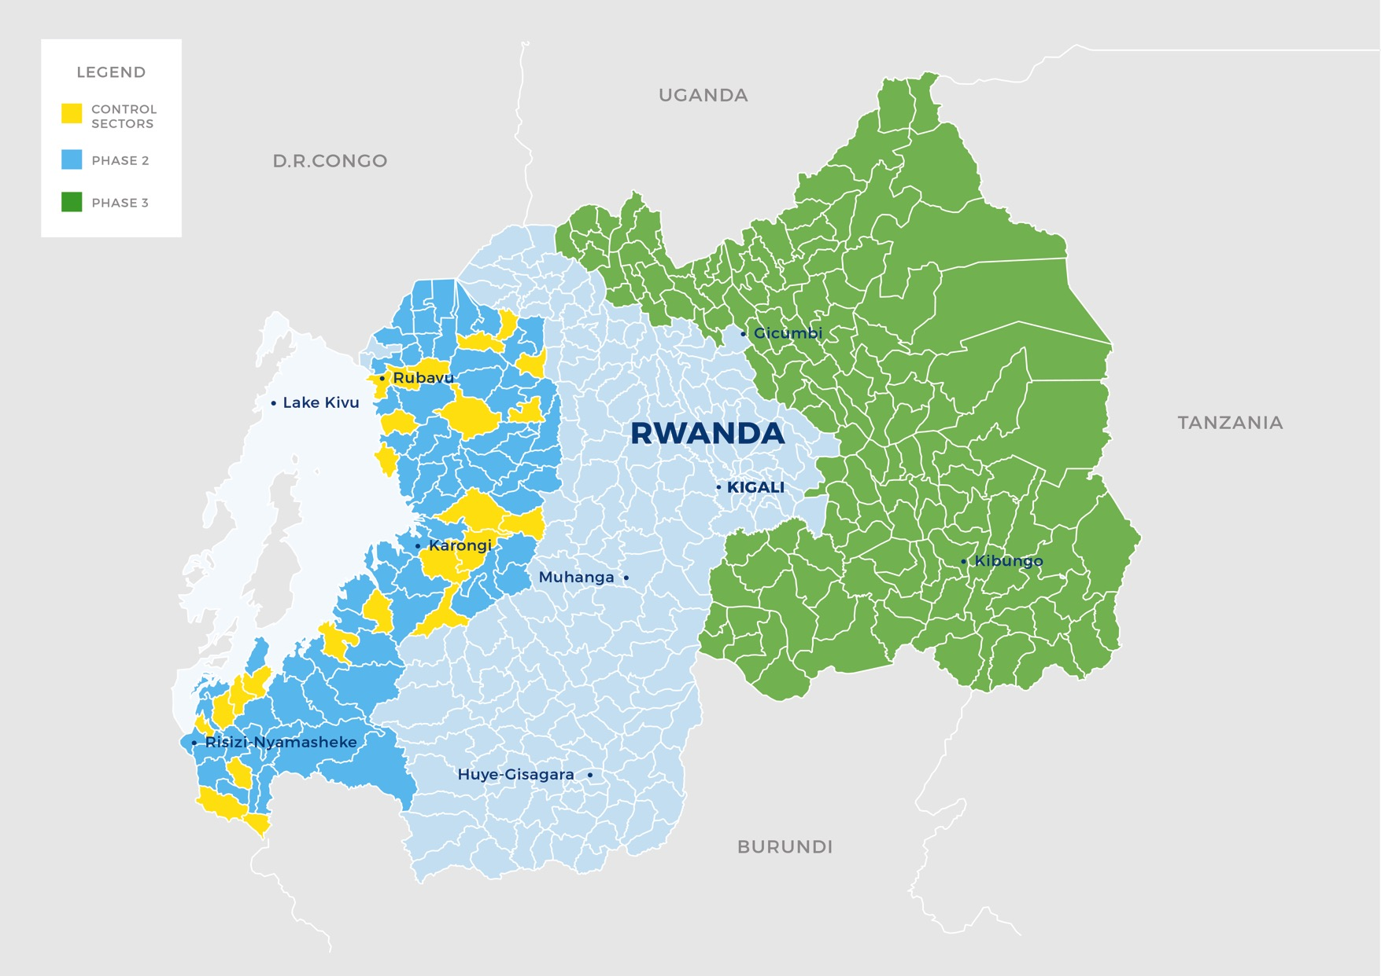

Slide 6
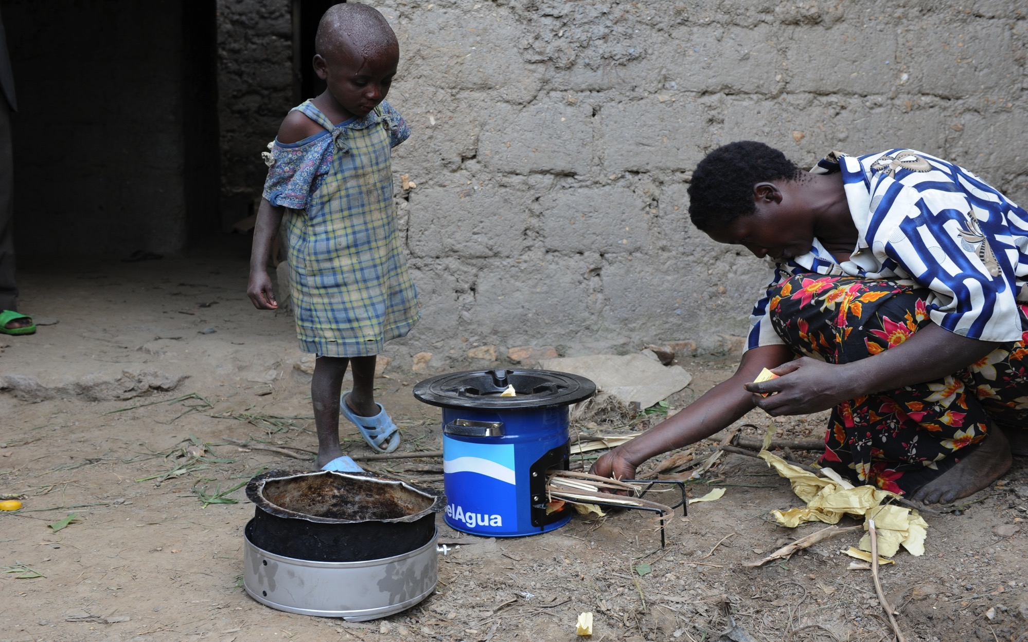

Slide 7
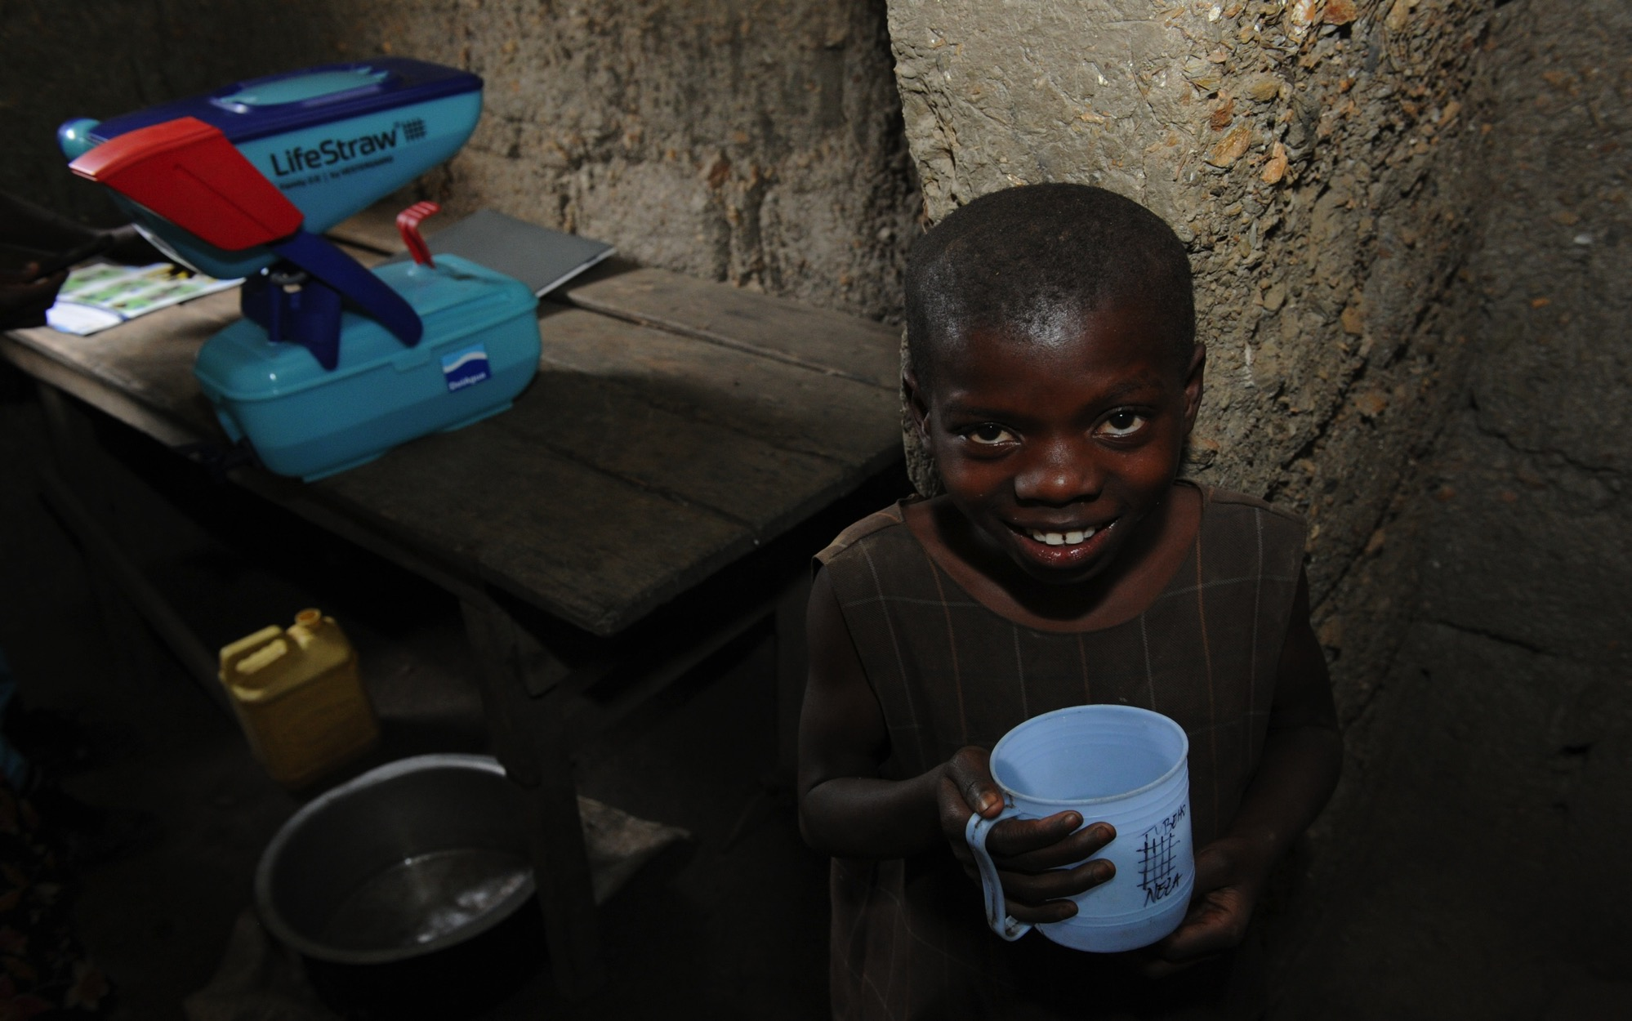

Slide 8
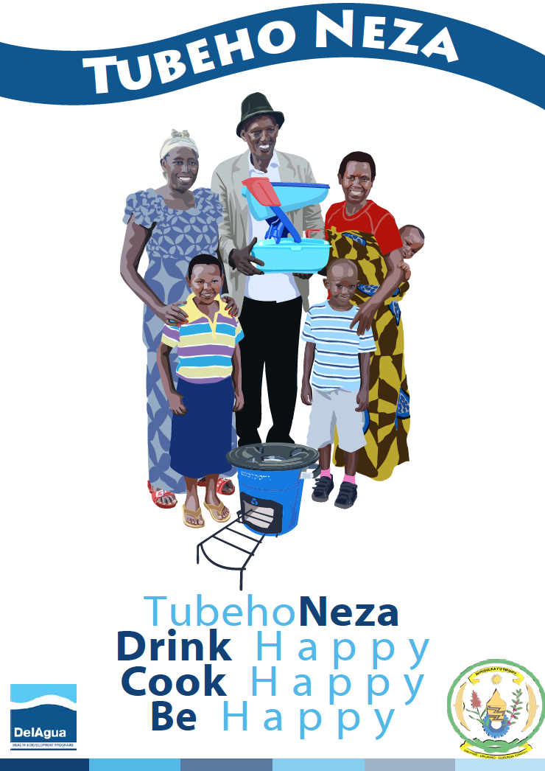
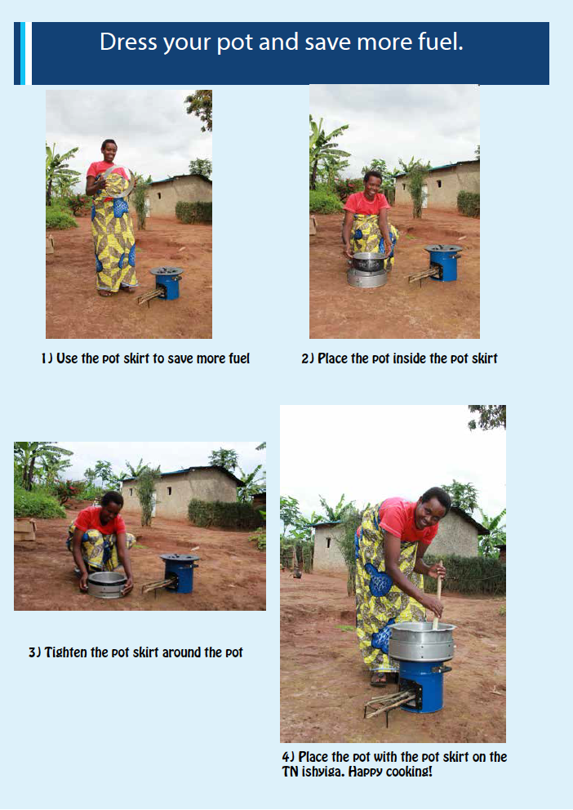
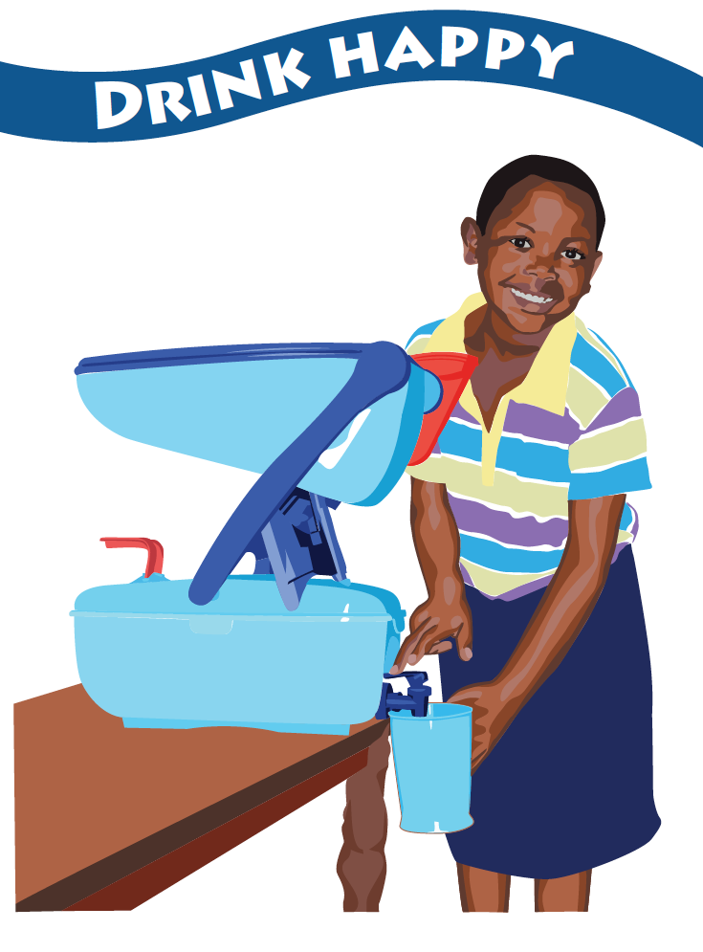

Slide 9
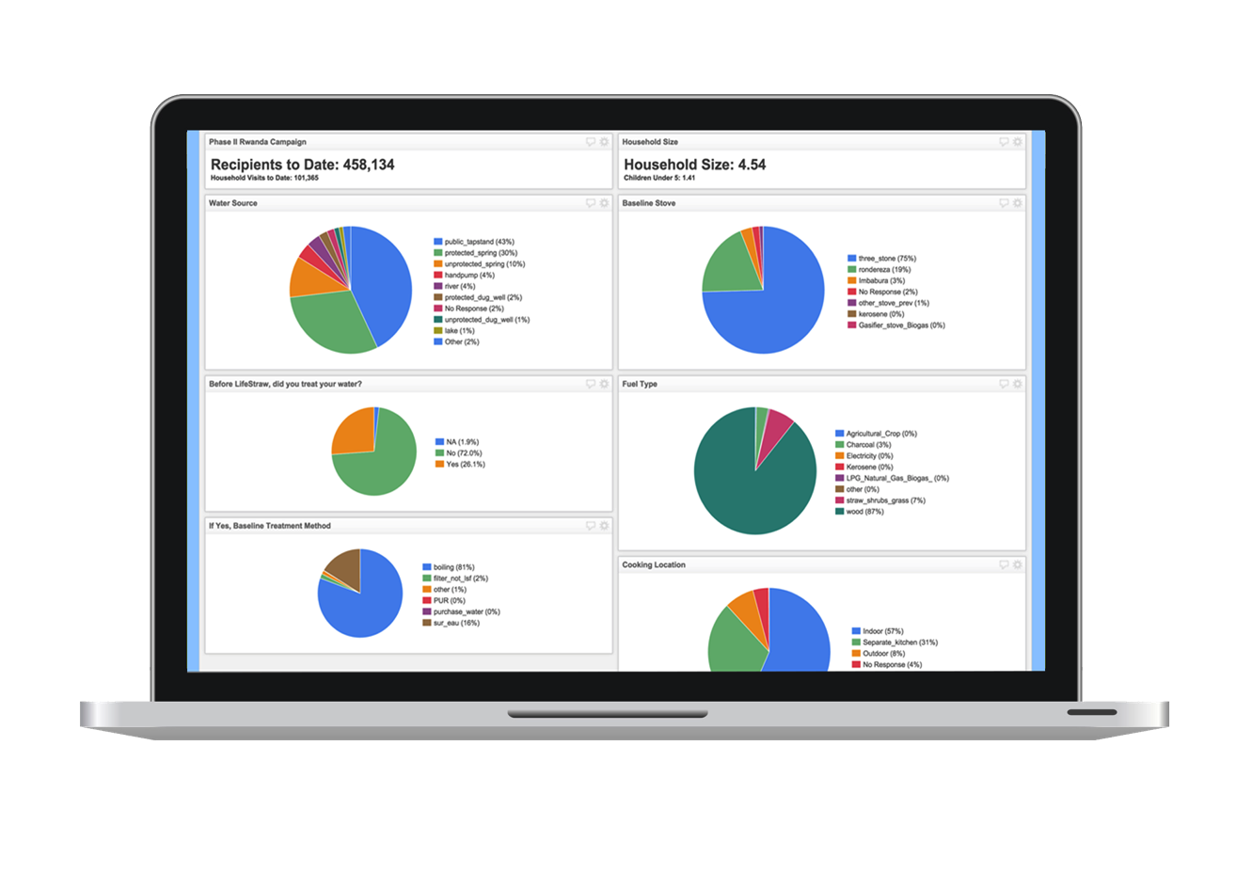
Recipients
Household Size
Water Source
Baseline Stove
Treatment?
Fuel Type
Treatment Method
Cooking Location

Slide 10
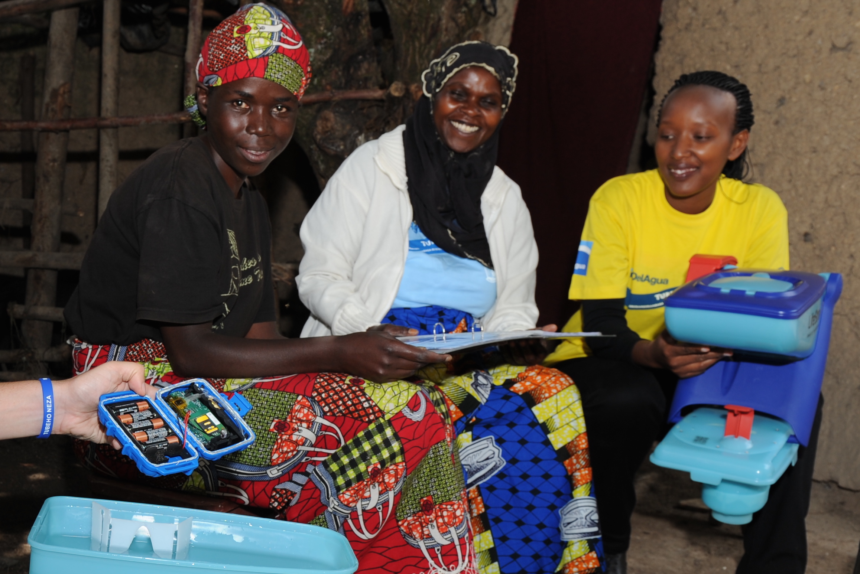

Slide 13
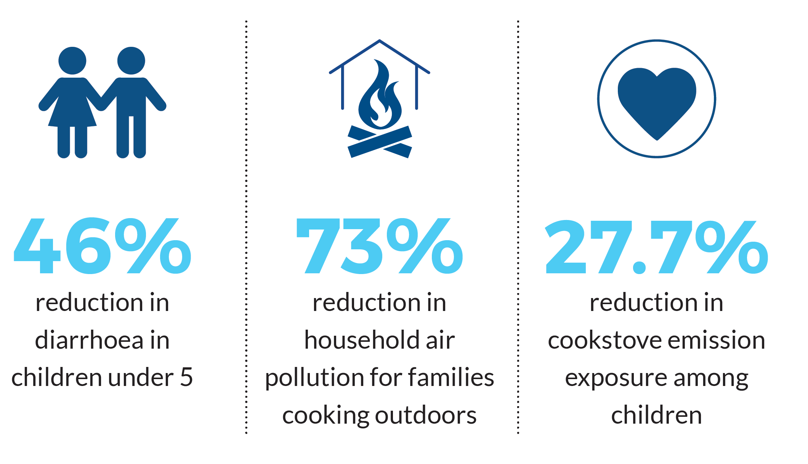

Slide 14
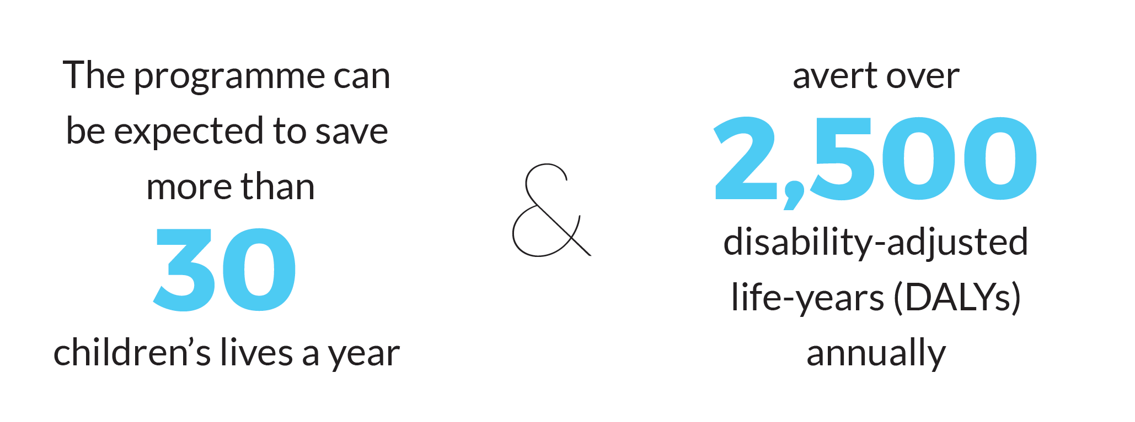

Slide 15
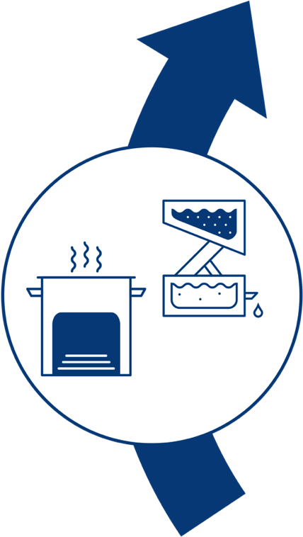
Sensors monitor and reinforce healthy behavior change and adaptive programming
Health impact modeled from RCT and adoption data
HEALTH
CREDITS
Payments are made to households and program implementer to sustain impact
Carbon credits and health impact credits calculated and sold
Notes:
The United Nations carbon credit market is a 100 billion dollar a year industry.
More than 90% of credits come from just 5 countries, and less than 2% from all of Africa.
My team was the first in the world to commandeer this system and apply it to to household drinking water.
Here’s how it works:
Many people in Rwanda boil their drinking water. Many more drink untreated, dirty water.
When we install our water filters and cookstoves, we reduce both the actual use and the un-met demand for firewood.
This equates to carbon credits issued to us by the United Nations.
We sell these carbon credits to buyers around the world.
And we then use that much of that revenue to invest in these projects.
This creates a closed loop where we are incentivized to have a impact because that’s how we get paid.

Slide 16
Combining Sensors and Cloud Dashboards with Technician Repair Services in a Longitudinal Study of Water Pumps in Rwanda

Slide 17
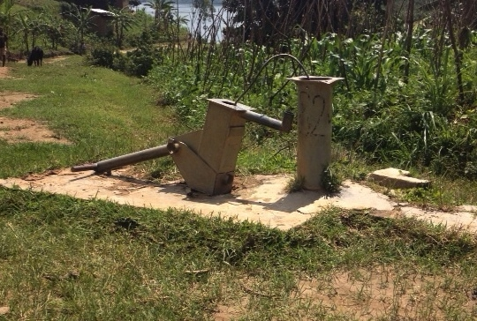
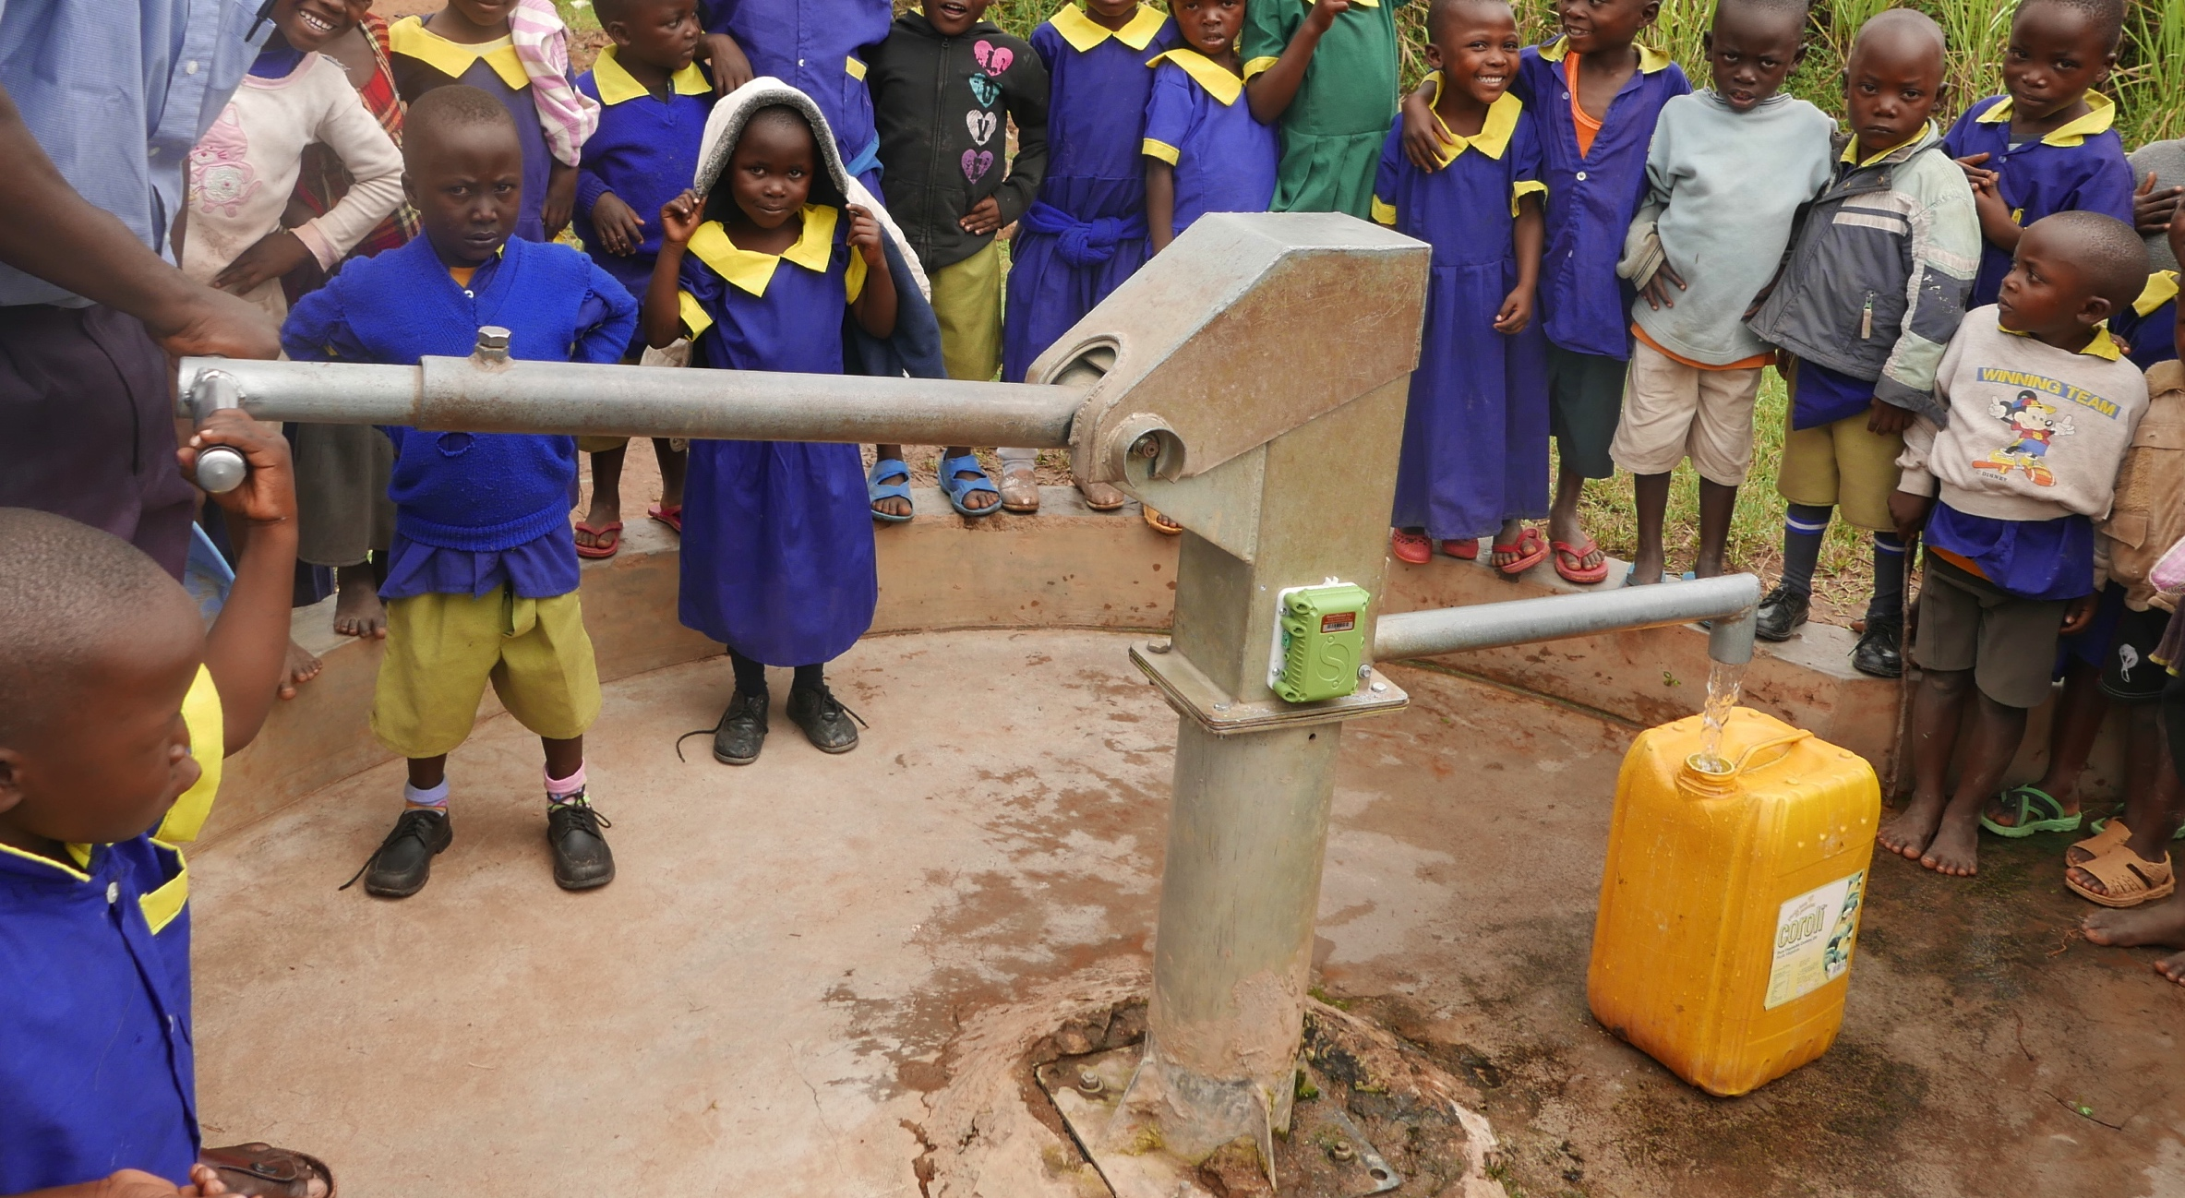

Slide 18
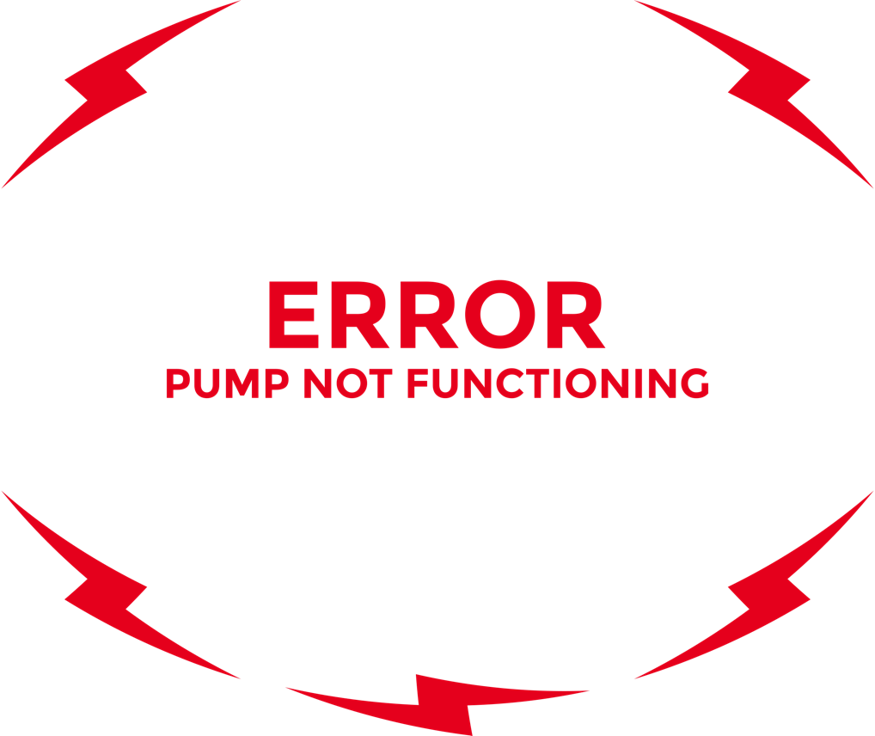
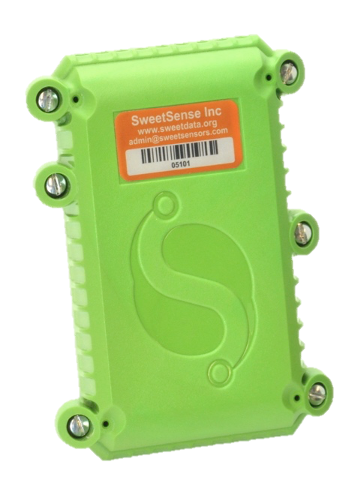
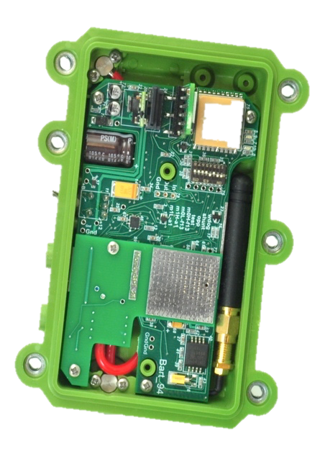
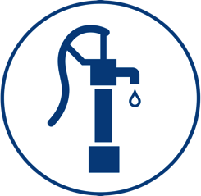
Notes:
But we also use tech to “close the loop”.
We use sensors, designed at Portland State University and connected to the cell phone networks to remotely report to the world how things are going with the stoves and water filters.
We also have these sensors on other projects - we’ve put about 300 of these in a dozen countries around the world.
We have them in latrines in India, to help anthropologists and epidemiologists study sanitation behaviors.
We have them in water test kits to map out rural water quality.
We have them on hand water pumps in villages to let technicians know if a pump needs repair.
All of our data gets transmitted over the cell phone networks, directly to the internet.
We can analyze our data online, and report it back to community members, program managers, and funders.

Slide 20
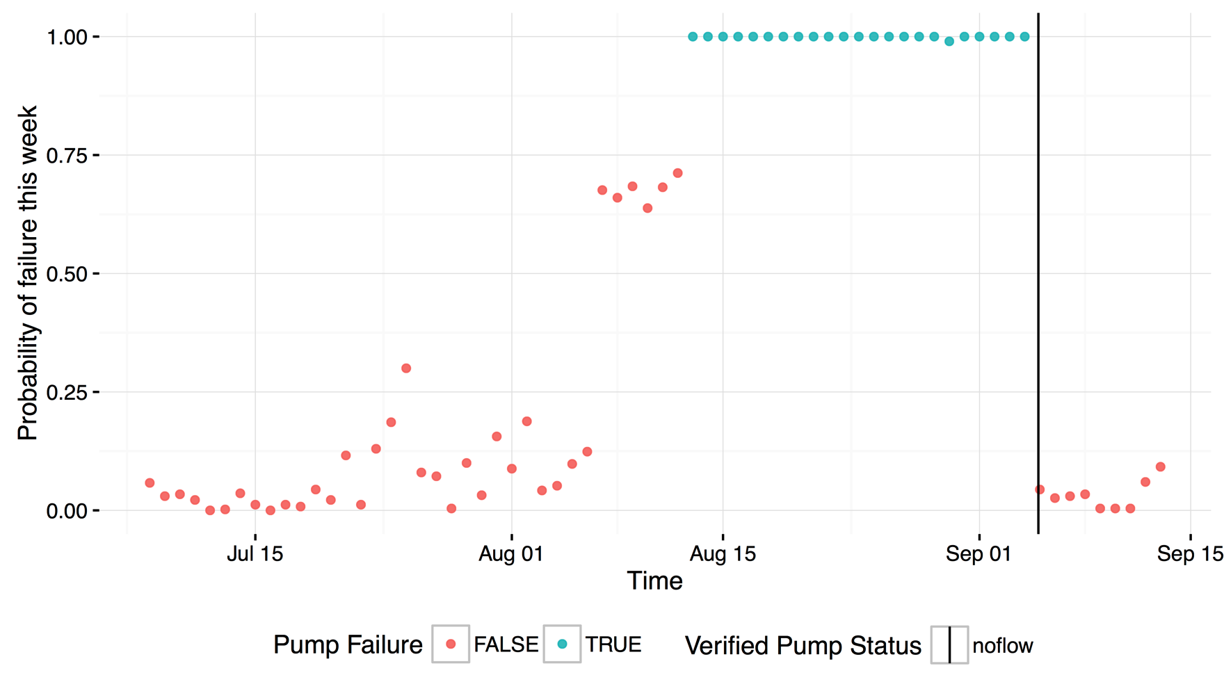
A Vision for Learner-Assisted Predictive Pump Maintenance
threshold for maintenance dispatch

Slide 21
Sanitation Intervention Utilization and Service Delivery

Slide 22
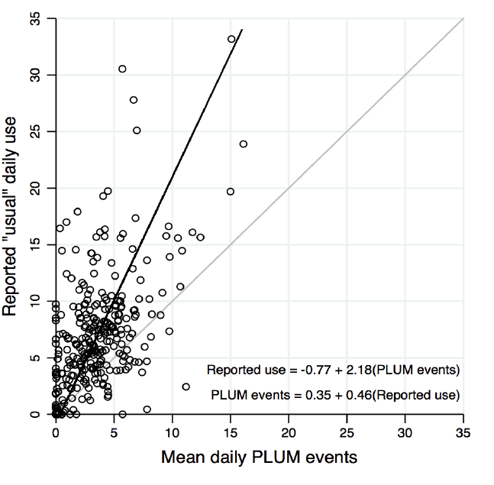
Latrine Use Monitoring – India
2-week installation periods.
Comparison of concurrent survey responses.
Mean reported use was 2x sensor-detected use.
Poor agreement between survey and sensor data.
Sinha, Nagel, Thomas et al, 2016, AJTMH

Slide 23
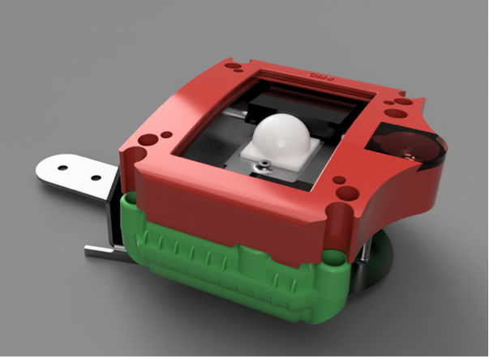
Sanergy Inc – Operations QAQC
Latrine operators scan RFID badges to request cleaning services.
Cleaning staff scan badges to report servicing.
Sensor detects high uses between service events and requests service.
Service cases linked to SalesForce.

Slide 24
What Next: Institutionalizing Water, Sanitation and Energy Services From Promises to Performance

Slide 25
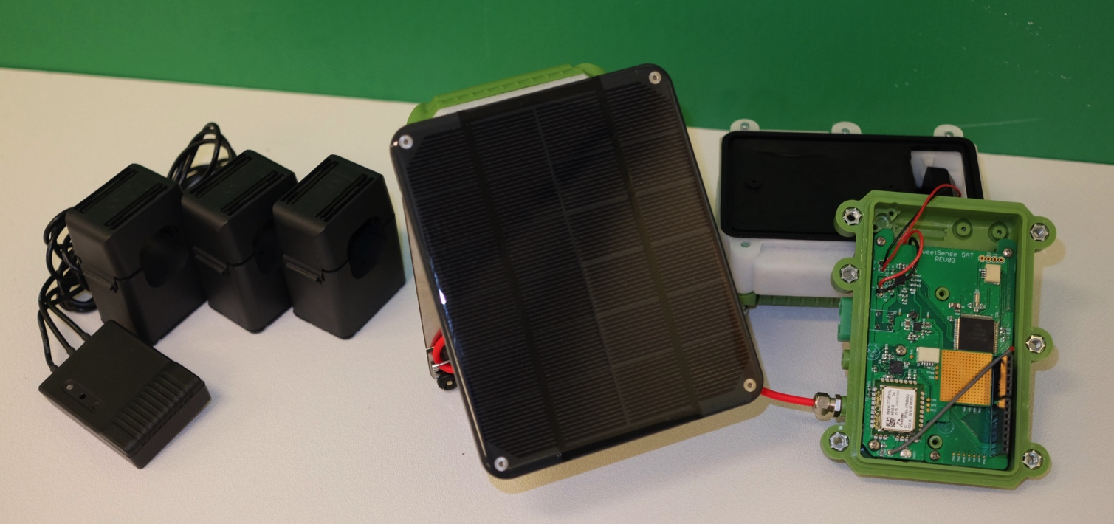
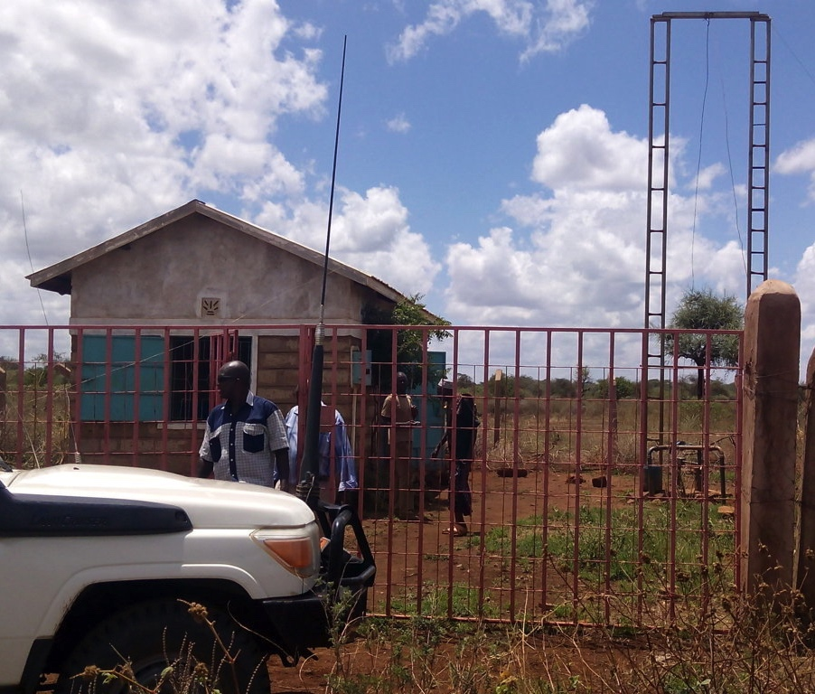
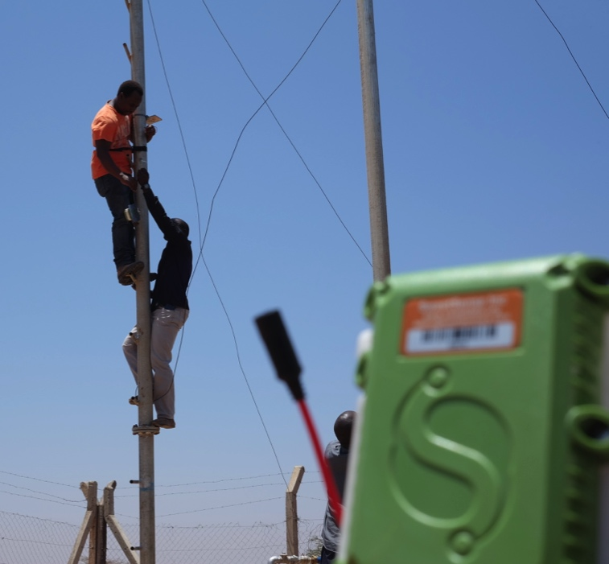
Kenya RAPID
Project Budget: $35 million
Duration: August 2015 – August 2020
Coordinated by: Millennium Water Alliance
- County Ministries of Water, Agriculture, Livestock, Fisheries, Health and Education of Isiolo, Garissa, Marsabit, Turkana and Wajir
- National Ministries of Water, Agriculture, Livestock, Fisheries, Health and Education
CARE
Catholic Relief Services
Food for the Hungry
World Vision
Acacia
Aqua for All
IBM Research
SweetSense Inc
The Coca-Cola Africa Foundation
Vitol Foundation
- Swiss Development Corporation (SDC)
- United States Agency for International Development (USAID)

Slide 26
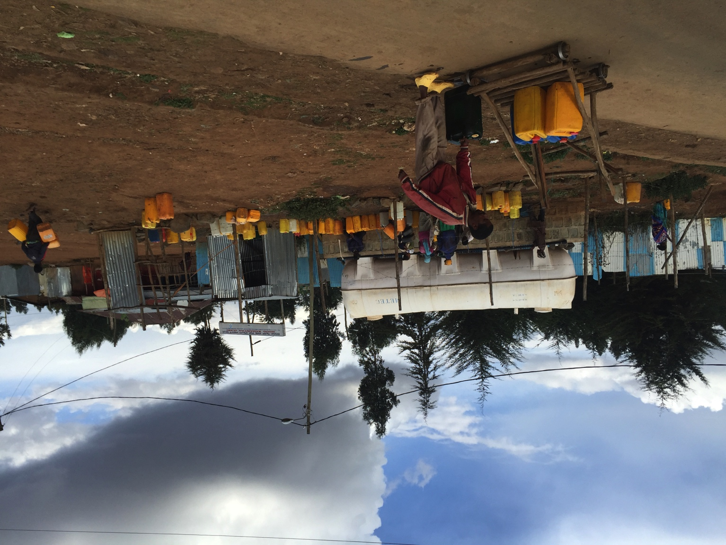
Lowlands WASH - Ethiopia
23.8 Million – USAD
AECOM Prime
CARE USA
IRC
SweetSense Inc
Focus on drought resilience
First time USAID has required sensors in a RFP

Slide 27
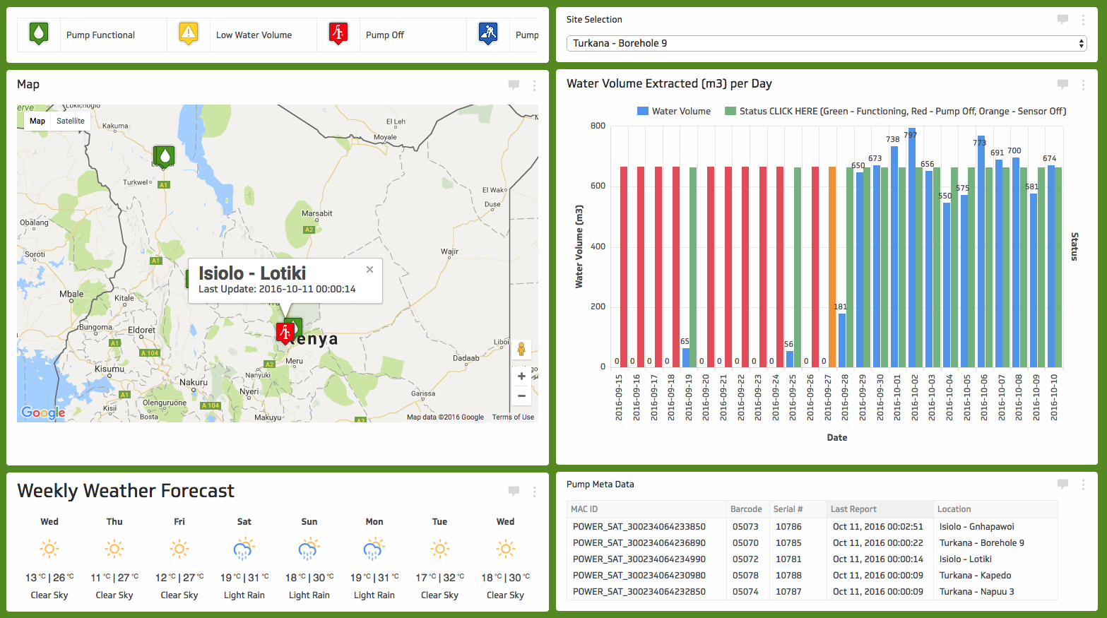
Decision Response Aids

Slide 28
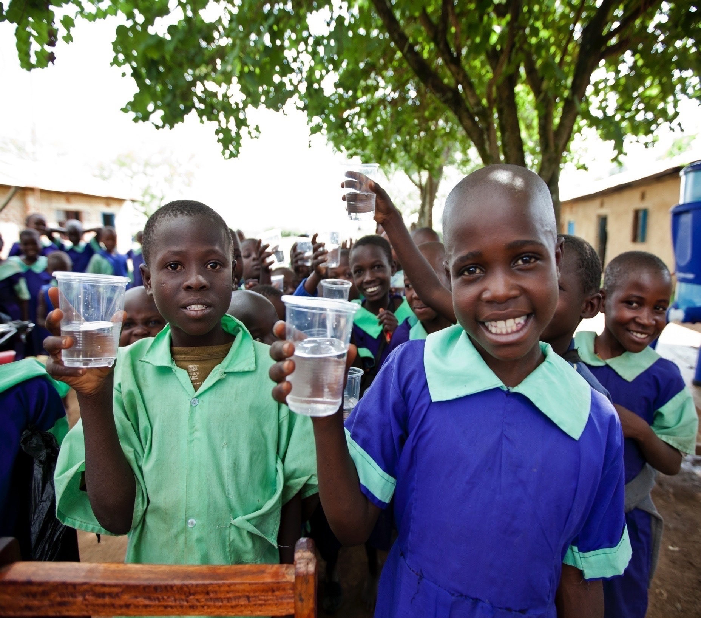
Notes:
Along these lines, the City of Portland spends about 160 million dollars a year, serving about 900,000 people with water.
That comes out to about $180 per person per year, and that’s with the benefit of infrastructure that’s mostly already built, providing water from pristine watersheds!
Meanwhile, you may have heard of the idea that a donation of something like 25 bucks will bring water to someone for their entire life in a developing countries.
But 25 dollar donations haven’t solved this problem yet. It’s a big, expensive problem and we need to “close the loop” in these humanitarian projects.
We need new and better business models, to engage businesses in these challenges, in a way that can help pay for on going services.
We need new and better methods to actively monitor how these projects are going, so we can compare and improve them.
Carbon credits and electronics sensors in Rwanda are a first step – but we need more action.
We need to close the loop in humanitarian projects, and ensure that the day this picture was taken was the first, and not also the last day that these kids had clean water.
Thank you.

